Slide 1
Special Use Permits

Slide 2
Special Use Permit
Use permitted by zoning but subject to requirements or conditions to ensure:
Harmony with zoning
No adverse impacts to neighborhood
Sometimes referred to as:
Special exceptions
Conditional uses
General City Law § 27-b
Town Law § 274-b
Village Law §7-725-b

Slide 3
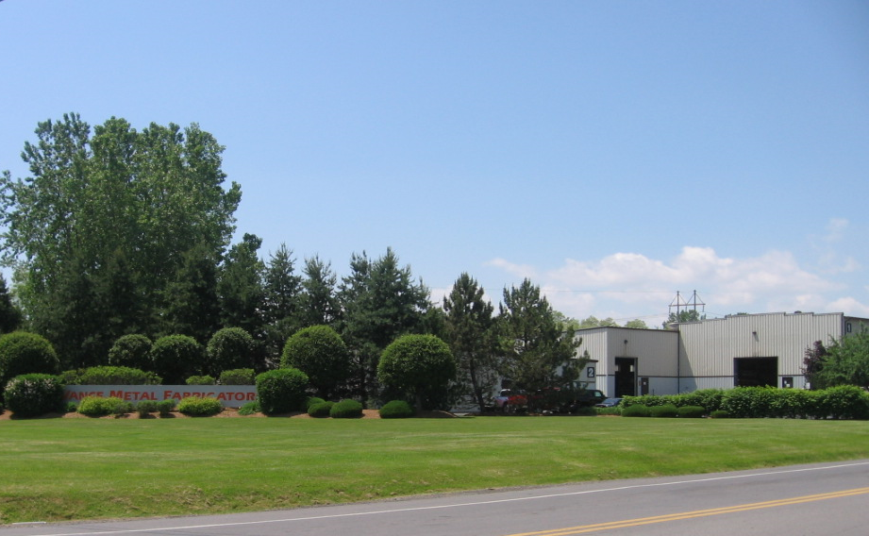
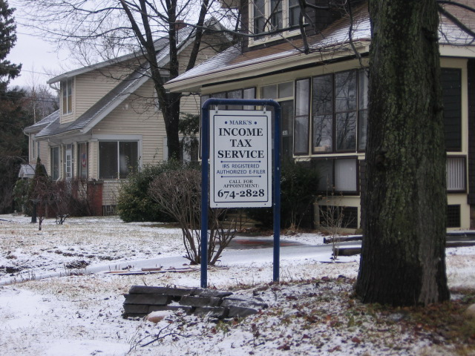
Purpose
Allows for greater variety of land uses while recognizing that some uses may present challenges to compatibility within a zoning district
Provides an added layer of review for uses that require special attention by the nature of their use
Allows for mitigation of potential adverse impacts

Slide 4
Special Uses

Slide 5
Uses allowed by special use permit
Require SUP only when use impact might need mitigation
Clearly list and define uses in zoning -- avoid “and other similar uses”
For example, for outdoor dining or events in neighborhood-commercial

Slide 6
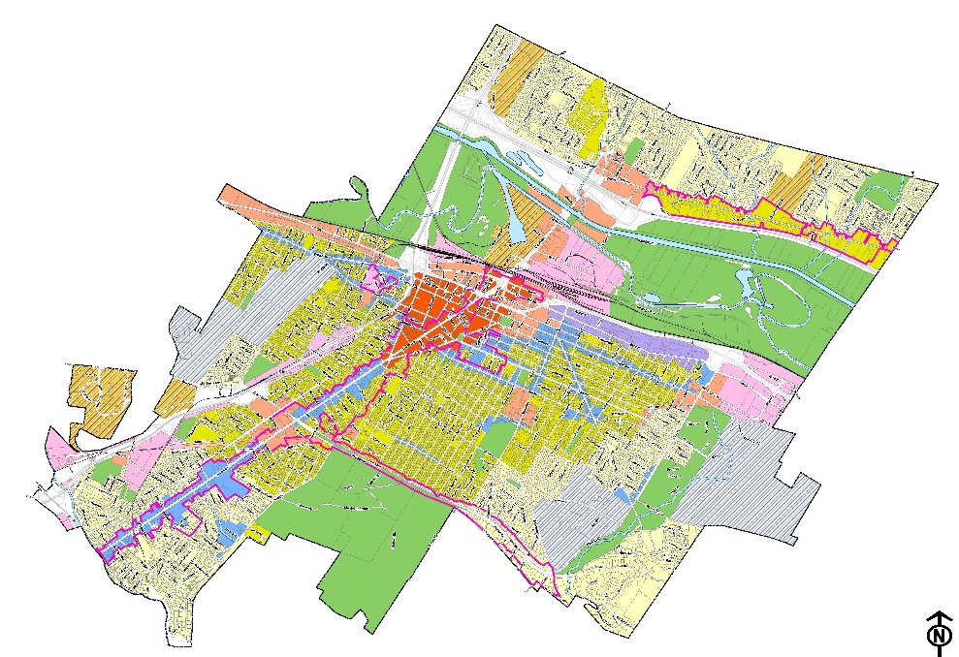
Special uses allowed by location
By zoning district
By overlay zone
In sensitive/unique areas, some or all uses may require additional review for compatibility

Slide 7
Example of special use in district
Gas station allowed by SUP in neighborhood commercial district

Slide 8
Example of special use in any district
Some uses commonly require SUP for aesthetic impacts

Slide 9
Example of special use in overlay
Ridgeline Protection Overlay
All new development above set elevation could require an SUP to consider aesthetic impact on viewshed
Waterfront Protection Overlay
Protects natural shorelines and riparian buffers, water quality, viewsheds and public access
A SUP could be required for more intense uses to ensure environmental impacts are mitigated
Housing development on ridgeline impacts viewshed while house below ridgeline is barely visible

Slide 10
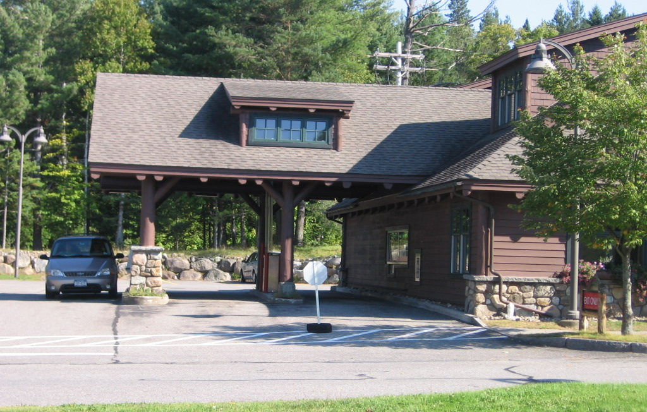
Different from site plan review
If use is generally deemed appropriate, Site Plan Review (SPR) for a project may be all that is necessary
Reviews all aspects of site design and development plans for permitted use – including mitigation of impacts created by proposed site development
Site development impacts for drive-throughs on auto-oriented commercial zone may be mitigated through SPR as the use is generally compatible

Slide 11
Special use criteria vs use regulations
Example additional standards that can be evaluated in Site Plan Review
Drive-through windows:
(4) Traffic circulation.
(a) A traffic study addressing both on-site and off-site traffic and circulation impacts is required.
(b) Pedestrians should be able to enter the establishment from the parking lot or sidewalk without crossing the waiting or exit lanes, when practicable.
(c) Waiting lanes shall accommodate the following number of cars to be in a queue or stacked based on the use:
[1] Fast-food restaurants and coffee shops: sufficient to accommodate a minimum queue of eight vehicles.
[2] All other drive-through windows: sufficient to accommodate a minimum queue of four vehicles.

Slide 12
Special use criteria vs use regulations
Example criteria that is more interpretive/situational – Special Use Permit appropriate:
Drive-through Windows:
A. Due to potential impacts on traffic volume, vehicular and pedestrian circulation and the environment, the following additional standards are required for the permitting of drive-through windows.
(1) Site location criteria. The site of the drive-through window shall meet all of the following criteria:
(a) The use shall not substantially increase traffic on streets in R-SF and R-MF Zoning Districts….

Slide 13
SUPs are not use variances
Use Variance
Special Use Permit
Required for a use not permitted by zoning
Statutory test must be met
Zoning Board of Appeals (ZBA)
Required for use permitted by zoning but subject to additional review criteria / requirements
Local standards
Planning Board, ZBA or other review board
North Shore Steak House Inc, v. Board of Appeals of the Village of Thomaston

Slide 14
Administration

Slide 15
Review Board
Governing board may retain authority to review SUP applications
OR
Delegate authority to another board
Planning Board
Zoning Board of Appeals as “original jurisdiction”
Other boards

Slide 16
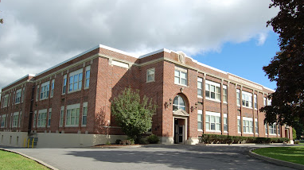
“Permanent” permit
SUPs run with the land unless otherwise stated in local zoning and as long as use remains the same and meets any conditions of the permit
Dexter v. Town Board of Town of Gates
Weinrib v. Weisler
If use changes or conditions cease to be met, permit may be revoked by enforcement officer

Slide 17
Temporary permit
Allows review board to re-appraise application (new facts and circumstances)
Most appropriate for seasonal uses
Requires authorization from governing board
(Scott v. ZBA of the Town of Salina; S.V. Space Development Corp. v. Town of Babylon ZBA)
Renewable permit
If renewal application is subject to same review as a new application, SUP can’t be denied (provided all requirements and conditions are met)

Slide 18
Special use permit review criteria
Decisions to deny or condition approval must be based on criteria or standards provided in local zoning or they may be invalidated
Shepard v. ZBA of the City of Johnstown
At a minimum, a general set of criteria for different potential impacts (conformance with the comprehensive plan, neighborhood compatibility, design compatibility, traffic, infrastructure, noise etc.) should be included in local zoning
Additional use-specific standards may also be included.

Slide 19
Criteria for review
General
Specific
Will usually be upheld:
“…in the consideration of public health, safety & general welfare”
“..shall be in harmony with the general purposes & intent of the zoning ordinance & the comprehensive plan”
Best practice:
“Design of new primary and accessory structures shall be consistent in scale, materials, and character with the existing vernacular architecture of the surrounding neighborhood or district”

Slide 20
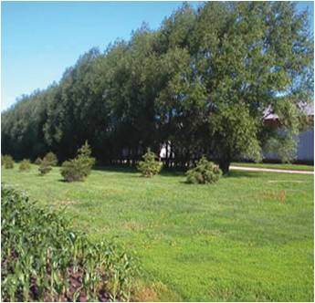
Waiver of requirements
Review board may waive SUP submission/permit requirements with authorization in the local code
Review board determines if requirement:
Is not needed in the interest of public health, safety or general welfare
- Is not appropriate for that particular property
Must be authorized by governing board

Slide 21
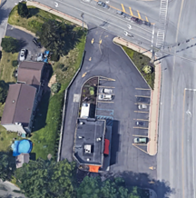
Coordination with Site Plan Review
SUP applications commonly require SPR
SPR review should be conducted simultaneously
If different review boards, coordination may be important for mitigating impacts through site development considerations
If Planning Board reviewing both; both approved at once
Streamlines review process for all
Example: Drive-through window requiring an SUP; traffic circulation impacts potentially mitigated through site development configuration

Slide 22
When an area variance is also required
SUP may not be approved without compliance with Zoning
If an area variance is needed – a “direct appeal” can be made to the ZBA during SUP process
Area variance must be approved prior to SUP approval

Slide 23
SEQRA compliance
Must complete SEQR before making final local decision
Require Environmental Assessment Form (EAF) with application submission
Establish lead agency if coordinated review
Make determination of significance (positive or negative declaration)
“Complete application”
Negative declaration issued
Positive declaration issued and Draft Environmental Impact Statement (DEIS) accepted for public review
NYCRR Part 617.3

Slide 24
Public hearing
Hold within 62 days of “complete application”
If DEIS hearing, hold in conjunction with SUP hearing
Open Meetings Law
Publish legal notice in newspaper of general circulation at least 5 days prior
- Extend to at least 14 days when DEIS hearing
Mail notice 10 days prior:
- Applicant
- County planning (GML 239-m) if applicable
- Adjacent municipality (GML 239-nn) if applicable
- Other property owners if local zoning requires

Slide 25
Referrals
County Referral GML § 239-m
Adjacent Municipalities
GML § 239-nn
Application must be referred to county planning board if it applies to real property within 500 feet of:
Municipal boundary
Boundary of state or county
Park or recreation area
R-O-W of state or county road
R-O-W of county-owned stream or drainage channel
Boundary of state or county land on which public building is located
Boundary of farm operation in state agricultural district (except for area variances)
SUP applications require notice when 500 feet from a municipal boundary
Notice by mail or email to clerk of adjacent municipality at least 10 days prior to public hearing

Slide 26
Basis for Decision Making

Slide 27
Granting permits
Must be approved if local requirements/criteria are met
- Pleasant Valley Home Construction v. Van Wagner
Mitigate environmental impacts before approval
Complete SEQR process prior to making decision
Zoning regulates land; not applicant, landowner, or occupant
SUP approval is granted to, and stays with, the property

Slide 28
Conditions
Review board has express statutory authority to impose conditions
Must directly relate to impact of development on land itself
Should not relate to internal operations of business or activity
Regulate hours of operation only if:
Authorized by governing board;
and
Substantial evidence of impacts that relate to physical use of the land (Old Country Burgers v. Town of Oyster Bay)

Slide 29
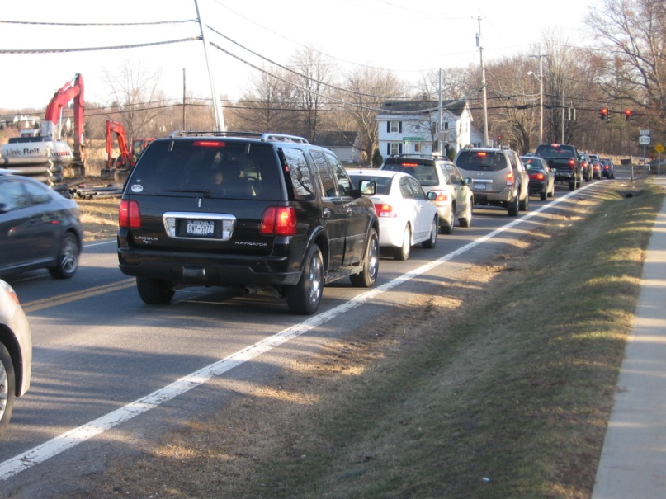
Denying the permit
Base denial on reasonable grounds:
- Site not appropriate for use
- Adjacent property depreciation
- Traffic impact beyond permitted use (YMCA v. Burns)
Support with evidence
For example: traffic study

Slide 30
Wrong reasons for denial: community opposition
Cannot base denial solely on: “…generalized objections concerns of neighboring community members”
- Chernick v. McGowan
- Pleasant Valley Home v. Van Wagner
A dentist office located in a former residential building

Slide 31
Wrong reasons for denial
General objections to use as undesirable
(i.e., tavern permit denied citing reasons of late hours, noise, traffic, etc.)
Holbrook Assoc. Development Co. v. McGowan
Unrelated or previous violation
- Application is attached to use, not applicant (i.e., applicant has violation on different property)

Slide 32
Decision
Must render decision within 62 days after close of public hearing
Decision document shall include “findings”
File with municipal clerk within 5 business days

Slide 33
Findings
When reviewing administrative body’s decision, courts will limit review to "ascertaining whether the determination has a rational basis and is supported by substantial evidence." (Hanson v. Valenty)
Demonstrate reason for approval or denial (applicant did or didn’t meet required standards)
Disclose all evidence relied on in reaching decision
Include analysis of evidence
Relate facts to legal standards
File with decision document
See NYS DOS Legal Memorandum LG02: Role of Findings in Local Government Decisions

Slide 34
Appeals
30-day statute of limitations for appeal
Clock starts on date decision “filed” with municipal clerk
Decisions are not appealed to governing board
Aggrieved parties may file appeals under Article 78 Civil Practice Law and Rules
NYS Supreme Court
Appellate Division
Court of Appeals

Slide 35
Enforcement
Zoning or code enforcement officer authorized to enforce zoning/SUP conditions
Could be stated in
Zoning law
CEO/ZEO duties
Require conditions be met before issuing building permit or certificate of occupancy

Slide 36
Revoking special use permit
Non-compliance
Substantial evidence
Failed to comply with imposed conditions
- Persico v. Incorporated Village of Mineola
Permit holder entitled to hearing before revocation

Slide 37
Resources on New York State Laws
www.dos.ny.gov/publications
Legal Memorandum LG02: Role of Findings in LG Decisions: NYS DOS
Legal Memorandum LU15: Regulating Hours of Operation
NYS DOS Comments – “Court of Appeals’ Decision Addresses Special Use permits, Variances and Waivers”

Slide 38
New York Department of State
Division of Local Government Services
518-473-3355
localgov@dos.ny.gov
https://dos.ny.gov/training-assistance

