Slide 1
Tiny House, Big Questions: Regulating Tiny Homes in Your Jurisdiction
Katie Hodgdon, Counsel
Association of Towns
CDRPC/NYPF Planning and Zoning Workshop
October 20, 2023

Slide 2
Topics to Discuss
Introduction of tiny homes in New York and the tiny home movement
The many definitions of tiny homes
What building codes are applicable to tiny homes?
Regulating tiny homes at the local level
Tiny homes, taxation and affordable housing
Any other questions!

Slide 3
Tiny Homes and the Tiny Home Movement
Not a new concept; however – popularity has skyrocketed over the last decade
Estimated that 10,000 tiny homes exist across the US
Does not take into account unpermitted or unknown tiny homes
“Tiny home movement” – trend where individuals seek minimalist lifestyle through smaller homes / downsizing / increasing sustainability / going off the grid / leaving a smaller economic footprint
True accelerator – 2008 recession, when nearly three million homes were foreclosed upon between 2008-2010

Slide 4
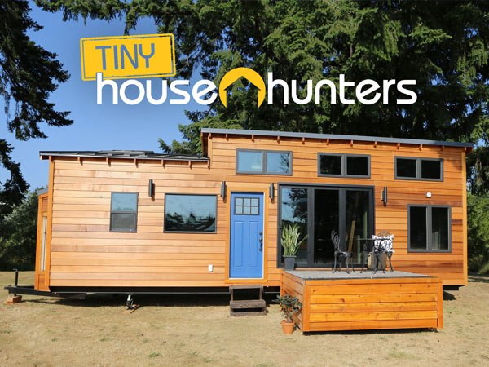
Tiny Homes and the Tiny Home Movement
Average size of typical American house- 2,600 square feet
Tiny homes- generally 400 square feet or less
Pop culture: Tiny house, big living… Tiny House Hunters

Slide 5
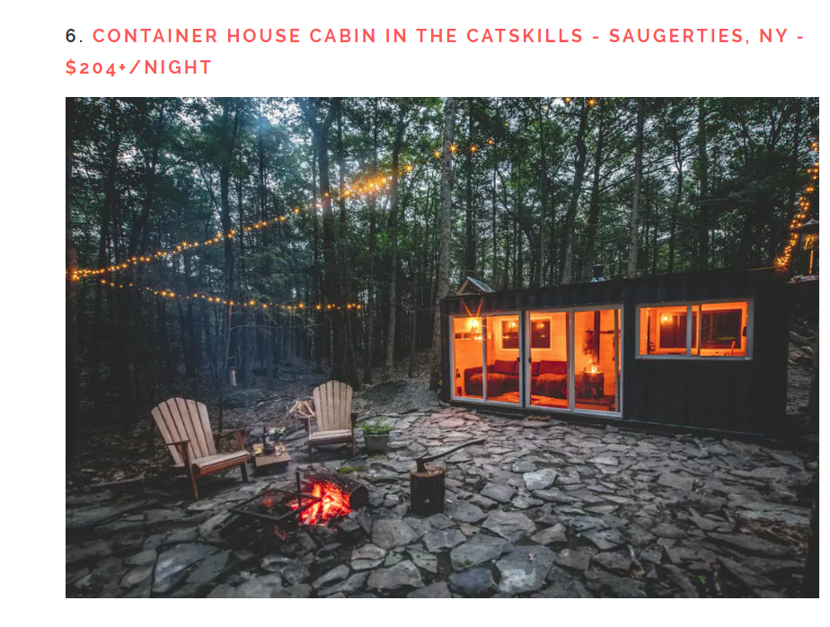
Tiny Homes in New York
Often found on short-term rental platforms:

Slide 6
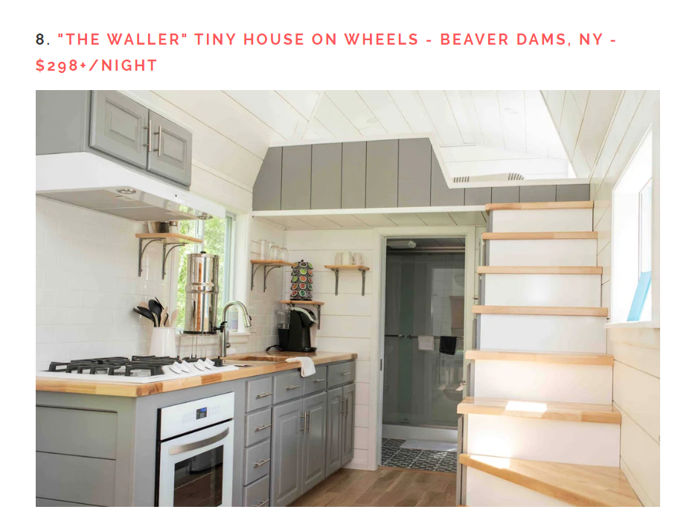
Tiny Homes in New York
Often found on short-term rental platforms:

Slide 7
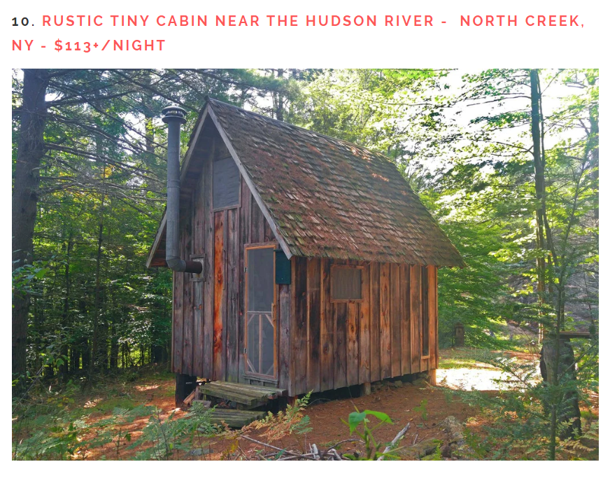
Tiny Homes in New York
Often found on short-term rental platforms:

Slide 8
Tiny Homes- What Are They?
(Alternate heading – definitions are important!)
What IS a tiny home? They can take many forms and because of that, regulating them can be difficult to navigate
Tiny homes are defined at the state level and can and should also be defined at the local level

Slide 9
Tiny Homes- What Are They?
NYS Uniform Fire Prevention and Building Code (Uniform Code) and local zoning apply to tiny homes
Regardless of whether the tiny home owner wants to “go off of the grid”
Building permits required even if locality does not define tiny homes
Local definitions help ensure that tiny homes are regulated at the local level

Slide 10
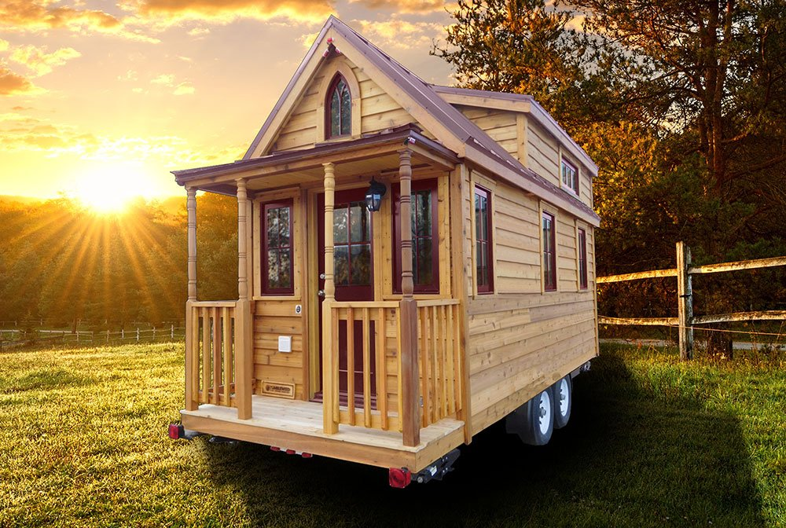
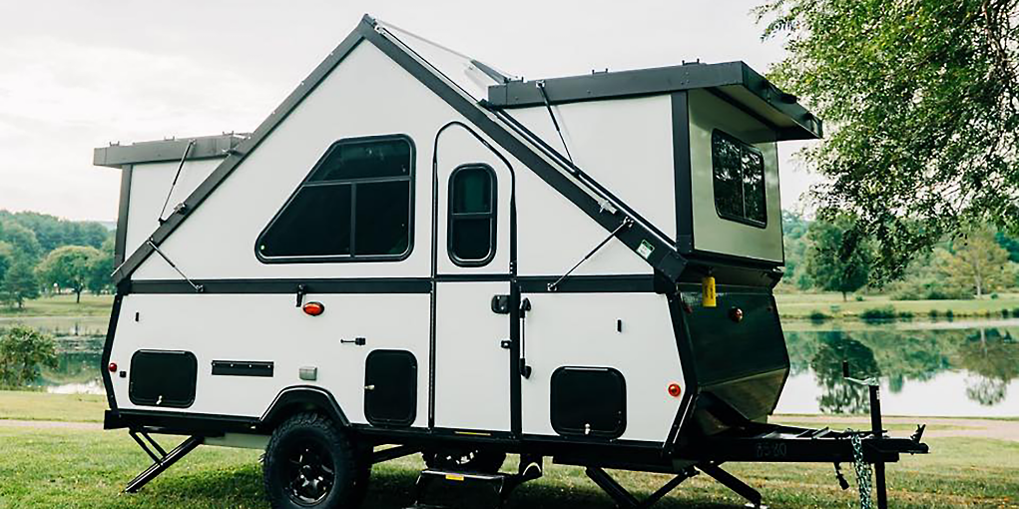
Tiny Homes- What Are They?
Are these tiny homes?

Slide 11
Tiny Homes- What Are They?
Are these tiny homes?
Answer: It depends on your locality’s definition within the code!

Slide 12
Tiny Homes- What Are They?
NYS definition – can be found in Appendix Q of the 2020 Residential Code of New York State
Formally adopted in 2020 from Appendix Q of the 2018 International Residence Code
First code to address tiny homes specifically
“A dwelling unit that is 400 square feet or less in floor area excluding lofts”
Appendix Q applies to site-built tiny homes

Slide 13
Tiny Homes- What Are They?
Local definitions:
“A dwelling unit that is built as a structure and not on a trailer or chassis that is intended to be used as a stationary, continuously occupied dwelling unit that is less than or equal to 400 square feet in total floor area, but not less than 150 square feet of total floor area” – Village of Alfred

Slide 14
Tiny Homes- What Are They?
Village acknowledges that other forms of tiny homes may exist but only allows those as a detached structure on a foundation
Code goes on to require compliance with setback and minimum lot size requirements
*Using zoning authority to limit tiny homes to fixed structures on foundation, essentially prohibiting tiny homes as moveable structures in their permitting structure

Slide 15
Tiny Homes- What Are They?
Local definitions:
In contrast, the town of “name withheld” defines tiny homes as:
“Recreational camping vehicle: Any enclosed motor vehicle or trailer used or designed to be used for recreational travel and temporary living and / or sleeping purposes including . . . Tiny homes . . .”
Town requires a zoning permit for “recreational camping vehicles” that are sited for occupancy for more than 30 days

Slide 16
Tiny Homes- What Are They?
What if a tiny home in this jurisdiction is affixed to a permanent foundation and does not have wheels or a trailer – does it fall within the definition of a recreational camping vehicle and therefore need a zoning permit?
No! The definition encompasses tiny homes but then describes them as enclosed motor vehicles or trailers
Definitions are important – in this scenario, a tiny home that is affixed to a permanent foundation would not need the zoning permit or special permit (although it would need a building permit)

Slide 17
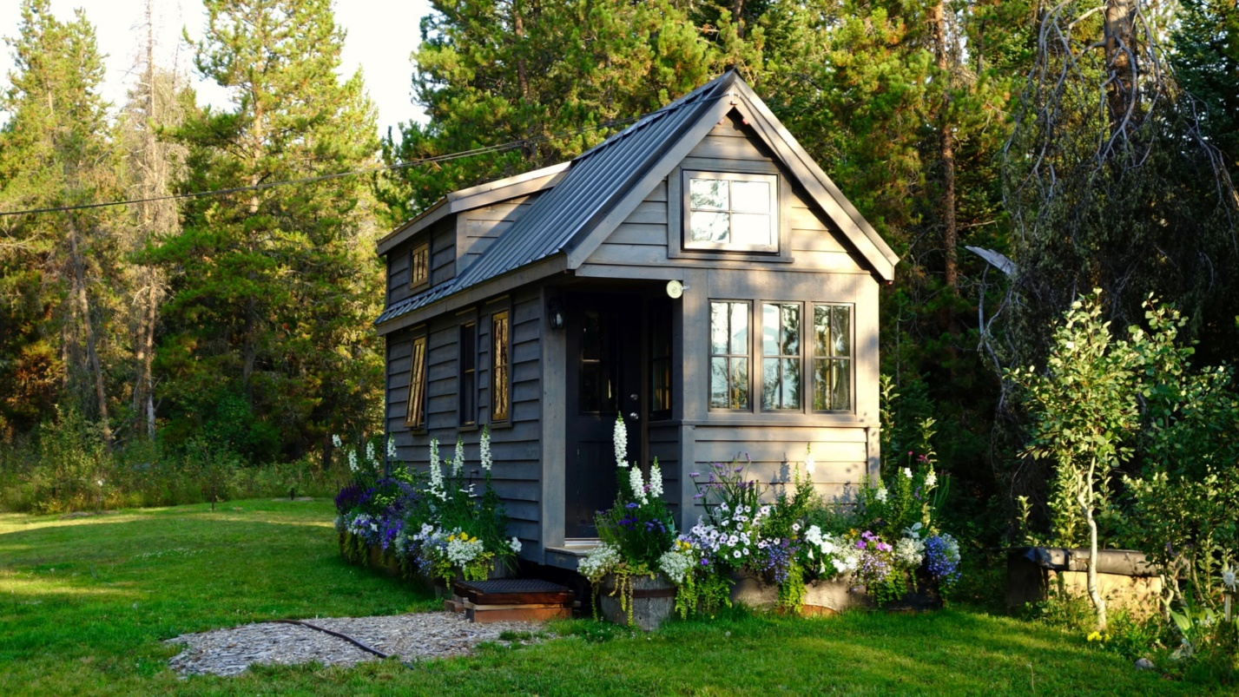
Tiny Homes- What Are They?
This type of tiny home would not be captured by definition and thus not subject to permitting structure:

Slide 18
Tiny Homes- What Are They?
Definitions matter! Increase in tiny home popularity = locality should include or modify its definition of tiny homes to include all forms
This way they are captured by the zoning code and required to obtain the land use or other regulatory permits before siting
If it does not fall cleanly within town’s definition, owner will likely not have to comply with code requirements

Slide 19
Tiny Homes- What Are They?
Tiny homes can also meet more than one definition in a code
Town of Queensbury case- “custom recreational vehicle” on top of a boat trailer was sited on residence without permit
Owner argued that it was not required to obtain a building permit because the structure met the definition of a “travel trailer” within the town’s code

Slide 20
Tiny Homes- What Are They?
Town asserted that it was still a “structure” requiring a building permit
Court agreed- even though it met the code’s definition of “travel trailer,” could still be a structure subject to the code and in this instance, met the definition of a “mobile home,” thereby requiring a permit

Slide 21
Tiny Homes- What Are They?
Moral of the story- definitions matter and locality can define tiny homes to suit the unique needs of the jurisdiction
Another local example: “dwellings that could be built on a foundation OR a mobile structure, that would be subject to all mobile home requirements, with a minimum of 500 square feet required
If this definition is adopted, zoning out tiny homes that are subject to Appendix Q (400 square feet or less)

Slide 22
Tiny Homes- What Are They?
What other forms can tiny homes take?
Manufactured (mobile) home: traditional mobile home that is at least 320 square feet and built on permanent chassis and designed to be used as a dwelling without or without a permanent foundation (Executive Law section 601 [7])
Minimum size specs and have a permanent chassis
A tiny home code be a mobile home if the mobile home is less than 400 square feet
Appendix Q does not apply (not site-built)
Locality ensures homes are installed properly per federal standards

Slide 23
Tiny Homes- What Are They?
What other forms can tiny homes take?
Modular (factory manufactured) homes:
No dimensional restrictions and not built on a chassis
Structures designed primarily for residential occupancy where components are manufactured in a facility and installed permanently at the building site
Considered buildings in the same way site-built homes are under the Uniform Code
Building permit required
An Appendix Q tiny home could be a modular home if the modular home is less than 400 square feet and site built

Slide 24
Addressing Tiny Homes at the Local Level
Structure | Is it a tiny home? | Building permit standards to apply
Site-built, less than 400 sq ft | Yes | Uniform code & Appendix Q standards
Site-built, greater than 400 sq ft | No for Appendix Q purposes | Uniform code
Modular home, less than 400 sq ft | Depends – definition in local code | Uniform code
Modular home, greater than 400 sq ft | Depends | Uniform code
Mobile home, 320-400 sq ft | Depends – definition in local code | Compliance with HUD code
Mobile home, greater than 400 sq ft | Depends | Compliance with HUD code
Recreational vehicle or structure less than 400 sq feet on a chassis with wheels | Depends – definition in local code | Depends upon code – it could be both a trailer and a building (Queensbury case)

Slide 25
Could still be a tiny house pursuant to local definition BUT Appendix Q would not apply
But see Queensbury case

Slide 26
Tiny Homes- Appendix Q Requirements
Appendix Q applies to all site-built tiny homes on foundations that are 400 square feet or less
Provides building safety standards that address minimum requirements for ceiling height, loft areas, loft access, and emergency escape and rescue openings
Allows for ingress and egress to the loft area by stairs or ladders and sets the standards for same
*In addition to building in accordance with Appendix Q, tiny home owners are required to comply with zoning and permitting requirements set forth in the code

Slide 27
Tiny Homes- Appendix Q Requirements
Minimum ceiling height:
Habitable spaces and hallways: 6 feet 8 inches
Bathrooms, toilet rooms and kitchens: 6 feet 4 inches
Lofts: can be less than 6 feet 8 inches
Lofts:
Must have at least 35 square feet and be at least 5 feet in any horizontal dimension
Loft guards located along open side of lofts
Loft accessed via stairways, ladders, alternating tread devices or ships ladders
Emergency escapes:
Comply with 2020 Residential Code, with carve outs for egress roof access windows in sleeping room lofts

Slide 28
Tiny Homes- Code and Permit Questions
Can the locality require a building permit for a tiny home?
Yes, building permits are required for tiny homes, as they are required for all dwellings in NYS
Exception –one story detached structures less than 144 square feet for tool and storage sheds, playhouses, or other similar uses
If tiny home is less than 144 square feet, building permit is still required! A tiny home can take the form of a converted storage shed (if the local code allows) but a permit is still required because it is being used as a dwelling

Slide 29
Tiny Homes- Code and Permit Questions
Can a tiny home be constructed on a chassis with wheels?
Yes, there is nothing at the state level that prohibits this
Locality should ensure that this type of tiny home is encompassed within code definitions if it wants these structures included within regulatory framework
Queensbury case- can still be considered a structure subject to a permit even if “custom RV” – look to structure itself and intent of owner
If tiny home is mobile and relocated after siting at an approved site, subject to Appendix J of the 2020 Residential Code – Relocated or Moved Buildings

Slide 30
Tiny Homes- Code and Permit Questions
Do the occupancy restrictions in the Property Maintenance Code of NYS apply to tiny homes?
No – Section 404.9 provides that the occupancy restrictions set forth in section 404 do NOT apply to tiny houses constructed in accordance with the Residential Code of NYS and Appendix Q
So long as Appendix Q / Residential Code is followed, occupancy requirements to not apply
*More than 400 sq feet- not a tiny home pursuant to Appendix Q and exception would not apply

Slide 31
Tiny Homes- Code and Permit Questions
What about heating facilities, potable water, electric service, and kitchen and toilet facilities in tiny homes?
Governed by 2020 Residential Code – allows for exceptions subject to approval of code enforcement or zoning officer
Locality can impose requirements – should be rational (eg, needs of 350 sq foot home may not align with 2000 sq foot home)
All plumbing fixtures have to comply with Residential Code

Slide 32
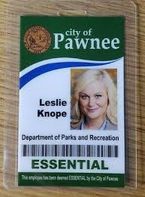
Why Regulate Tiny Homes?
“Well, you know, you have to have zoning codes or else the whole thing could be chaos”
-Leslie Knope, Parks & Recreation

Slide 33
Why Regulate Tiny Homes?
No regulation = no say and chaos abounds
Zoning is not a four letter word (literally and figuratively)
Can also regulate through other methods
Tiny home movement is increasing in popularity as affordable housing stock continues to dwindle and some shifts towards minimalism
Positives?
Affordable housing
Can tax as real property
“Infill development” – weave tiny homes into vacant, underutilized spaces

Slide 34
Why Regulate Tiny Homes?
Building permits are required if the home is a dwelling – regardless of local code
However, local code that explicitly defines tiny homes and imposes permitting requirements will ensure that tiny homes are sited pursuant to locality’s plan
Can address nuisances for neighbors (light, noise, trash)
Parking issues
Safety concerns
Ensure that highway and water infrastructure is sufficient

Slide 35
Options for Local Regulation
Local governments have many tools at their disposal to regulate tiny homes!
Comprehensive plan
General zoning authority
Building permits
Special use permits
Site plan requirements
Broader, outside the box (aka non-land use) authority

Slide 36
Options for Local Regulation- Comprehensive Plan
Comprehensive Plan:
Town Law section 272-a
Village Law section 7-722
General City Law section 28-a
The comprehensive plan is important! Provides the framework and backbone for zoning code
Should be “well-considered”
Necessary to adopt zoning legislation
Does not need to be in one “comprehensive” document or even written at all (?), so long as a court can ascertain that the plan exists and locality acting in furtherance of plan and public interest (Matter of Skenesborough Stone, Inc. v Village of Whitehall, 254 AD2d 664 [1998]

Slide 37
Options for Local Regulation- Comprehensive Plan
Why address tiny homes in comprehensive plan? Locals are empowered to adopt regulations that align with the comprehensive plan
Comprehensive plan should address, among other things, “existing housing resources and future housing needs, including affordable housing”
If tiny homes are covered in plan and zoning regulations are aligned in furtherance of the plan – solid legal ground if challenged

Slide 38
Options for Local Regulation- Comprehensive Plan
Do tiny homes have to be explicitly addressed in comprehensive plan in order to adopt local laws regulating tiny homes?
No, not exactly
To ensure the locality is on solid legal ground, the best scenario is to adopt a local law that is in alignment with the comprehensive plan

Slide 39
Local Regulation Options – General Zoning Authority
General zoning authority
Town Law sections 261, 264
Village Law section 7-700
General City Law section 20 (24), (25)
These statutes give localities broad authority to adopt zoning regulations that suit the municipality’s unique needs
Adopt zoning regulations consistent with comprehensive plan

Slide 40
Local Regulation Options – General Zoning Authority
General zoning considerations:
Adopt a local law as opposed to ordinance (villages have no authority to adopt ordinances)
Local laws enjoy the presumption of validity in court if challenges
Owner occupancy required?
Generally regulates the owner as opposed to the land and is not a valid exercise of zoning authority
Recent case law on owner-occupancy requirements of short-term rentals indicates the dormant Commerce Clause of the United States Constitution (cannot discriminate against interstate commerce at the local level)

Slide 41
Local Regulation Options – General Zoning Authority
General zoning considerations:
Where are tiny homes allowed to be sited within the locality? Certain residential areas?
Are they considered accessory dwelling units?
What forms of tiny homes are allowed within the locality?
Many forms of tiny homes – traditional site-built, converted shed, custom recreational vehicle intended for permanent residency, mobile home, modular home
If it is on wheels does it still have to comply with the code? That will depend upon the code’s definitions (Queensbury case)
Note that if the tiny home takes the form of a mobile home, a locality cannot prohibit or essentially zone out this form of housing

Slide 42
Local Regulation Options – General Zoning Authority
General zoning considerations:
Dimensional requirements: are there minimum and maximum square footage requirements for tiny homes?
Can a homeowner seek a permit to convert a 144 square foot storage shed to a tiny home dwellings?
Are there setback requirements to comply with?
Are there minimum lot size requirements?
*Keep in mind that high minimum lot size requirements could zone tiny homes out of the jurisdiction
Are they only allowed as an ADU?

Slide 43
Local Regulation Options – General Zoning Authority
General zoning considerations:
Capacity requirements – limit the number of occupants?
Occupancy restrictions in property maintenance code do not apply to Appendix Q Tiny Homes (site-built, less than 400 square feet)
Certain number of parking spaces to be available?
Design requirements – are there certain standards tiny home owners have to comply with? Any landscaping requirements?

Slide 44
Local Regulation Options – General Zoning Authority
General zoning considerations:
What about variances?
Use variance- use not permitted
As it relates to tiny homes – allowing multiple dwellings in a single-family zoning
Applicant has to demonstrate unnecessary hardship
Area variance: use is permitted but not allowable by physical aspects / dimensions
As it relates to tiny homes – setbacks, frontage requirements, density, etc
Board applies a balancing test
Variance runs with the land* and board can impose reasonable restrictions

Slide 45
Local Regulation Options – General Zoning Authority
Building Permits: required for all dwellings
Site-built: Uniform code and Appendix Q
Modular home: Uniform code and compliance with manufacturer’s installation instructions
Mobile home: Compliance with Department of Housing and Urban Development (HUD) code for all mobile homes manufactured after 1976 – must bear “HUD” seal
Recreational vehicles / tiny homes on chassis: Depends upon what locality requires in code
Could provide that any recreational vehicles used as a dwelling for more than “x” days a year must comply with mobile home requirements

Slide 46
Local Regulation Options – General Zoning Authority
General permitting authority pursuant to Town Law section 261:
Does not run with the land as a variance necessarily does- is tied to the applicant / owner
Is the structure considered an ADU in the locality and if so, what requirements should be complied with?
Can require tiny home owner to register in permitting system to ensure compliance with aforementioned general zoning authority

Slide 47
Options for Local Regulation – Special Use Permits
Special use permits are a powerful tool to regulate tiny homes
Town Law section 274-b
Village Law section 7-725-b
General City Law section 27-b
Allows localities to require authorization of a particular use that is otherwise permitted in zoning code subject to requirements imposed by special use permit
Can / should place conditions on special use permit

Slide 48
Options for Local Regulation – Special Use Permits
Can require annual / biennial renewal (etc)
Can provide that special use permit expires after certain amount of time of non-use
Can provide that special use permit is temporary or authorized for a certain period of time – so long as zoning code provides for the time limitation
*Note that this is problematic for tiny home structures affixed to the land
Type of tiny home should be considered when placing any durational requirements
Does *not* necessarily run with the land- depends upon local code (case law supports this)

Slide 49
Options for Local Regulation – Special Use Permits
Board designates authority to review permits (zoning board / planning board)
County referral – GML 239-m
Public hearing conducted within 62 days (if using 274-b authority); can be extended by mutual consent
10 days before hearing notice sent to applicant and county planning board
Decision filed with clerk within five days of decision
Aggrieved applicants can commence an Article 78 proceeding within 30 days of decision

Slide 50
Options for Local Regulation – Site Plan Review
The site plan review process is another tool:
Town Law section 274-a, Village Law section 7-725-a, General City Law section 27-a
Applies to parcels where a property owner wants to maintain ultimate ownership and rent parcels to tiny home owners (as opposed to subdivisions)

Slide 51
Options for Local Regulation – Site Plan Review
Site plan reviews are subject to State Environmental Quality Review Act (SEQRA) (as are most land use actions)
Planning board or board charged with reviewing site plans must ensure SEQRA process was conducted before approving site plan
Governing board should include required elements of site plans
Developed in conjunction with and in consideration of comprehensive plan

Slide 52
Options for Local Regulation – Site Plan Review
Governing board should include required elements of site plans
Subject to referral to county- GML 239-m
Board can impose reasonable conditions and restrictions that are directly or incidentally related to the proposed site plan
For tiny homes – minimum lot sizes, minimum or maximum square footage requirements, etc

Slide 53
Options for Local Regulation – Site Plan Review
Public hearings: required if the ZBA is the reviewing authority
Locality can require public hearings even if ZBA is not the reviewing authority
Must be conducted within 62 days of receiving application
Applicant and county planning board receive notice of hearing ten days in advance
Notice of public hearing published in newspaper of general circulation at least five days in advance (Town Law section 274-a [8], [9])
Decision rendered within 62 days of public hearing – can be extended by mutual consent

Slide 54
Options for Local Regulation – Creative Methods
No Zoning? No problem! Additional authority to regulate tiny homes outside of the land use arena
Town Law section 130 – adopt ordinances (local laws) that:
Promote the public welfare (section 15)
Address health and safety regulations (various sections)
Adopt a housing code that establishes minimum standards governing one and two family dwellings (section 3-a); and
Regulate house trailers and house trailer camps (section 21)
If tiny home is a trailer, can use this section to require local registration and impose durational time limits
Impose conditions not related to land use

Slide 55
Options for Local Regulation – Creative Methods
Village Law section 4-412 – general authority of the Board of Trustees:
“Good government of the village, its management and business, the protection of its property, the safety, health, comfort, and general welfare of its inhabitants, the protection of their property, the preservation of peace and good order, the suppression of vice. . .”
General grant of authority for villages to regulate tiny homes as it relates to promoting the safety, health, comfort and general welfare of its residents

Slide 56
Options for Local Regulation – Creative Methods
Municipal Home Rule Law section 10 – applies to all local governments and allows localities to adopt local laws that advance government, protection, order, conduct, safety, healthy and the well-being of persons and property therein
Broad authority to exercise home rule

Slide 57
Tiny Homes- Taxation
Taxation of Tiny Homes

Slide 58
Tiny Homes - Taxation
Taxation of the tiny home will depend upon the actual structure
Real Property Tax Law section 300 provides that all real property within the state shall be subject to taxation unless exempt
Site-built or modular on foundation – fairly straight forward – affixed to the land and value of tiny home should be considered in assessment

Slide 59
Tiny Homes - Taxation
What about trailers and mobile homes?
Real Property Tax Law section 102 (12) (g) – the value of any trailer or mobile home used for residential, business, commercial or office purposes should be included in the assessment of the land on which it is located
Exceptions – trailers or mobile homes that are:
Located within the locality for less than 60 days;
Unoccupied or for sale; or
Recreational vehicles that are 400 square feet or less, self-propelled or towable and used as temporary living quarters for recreational, camping, travel or seasonal use (emphasis added)

Slide 60
Tiny Homes - Taxation
Site-built, mobile or modular – value would be included in assessment of land it is affixed to
Recreational vehicles – temporary living quarters? As of taxable status date, assessor should inquire as to whether permanently residing there
What happens if the owner of the recreational vehicle moves locations ten months later?
Not an ideal situation

Slide 61
Tiny Homes- Affordable Housing
Tiny Homes and Affordable Housing

Slide 62
Tiny Homes- Affordable Housing
What constitutes affordability?
Conventional approach – no more than 30 percent of household income is spent on housing
Simple approach that does not take other nuanced factors into account, such as transportation costs, public safety, quality of housing
One full time worker earning minimum wage cannot afford to rent a two-bedroom apartment anywhere in the United States (see The Affordable Housing Crisis: Tiny Homes and Single-Family Zoning, 72 Hastings LJ 919 [2021])
High minimum square footage and lot size requirements – increase in housing prices

Slide 63
Tiny Homes- Affordable Housing
Average tiny home can cost less than $23k to construct
Professionally built tiny home – averages around $60k
Average cost to built traditional 2000 square foot home in NY – 200-310k

Slide 64
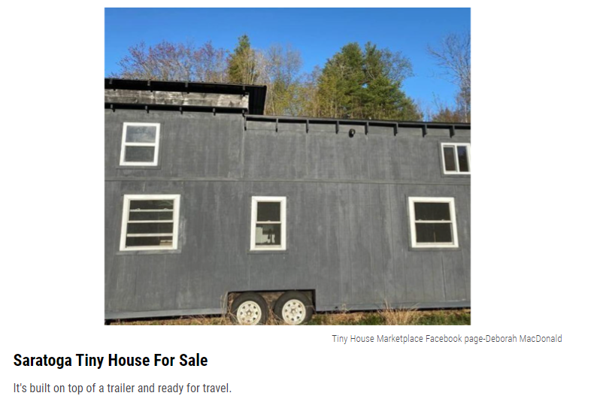
Tiny Homes – Affordable Housing
Tiny homes and affordable housing: Saratoga edition
This tiny home listed for $76,000 – on wheels and ready to go!

Slide 65
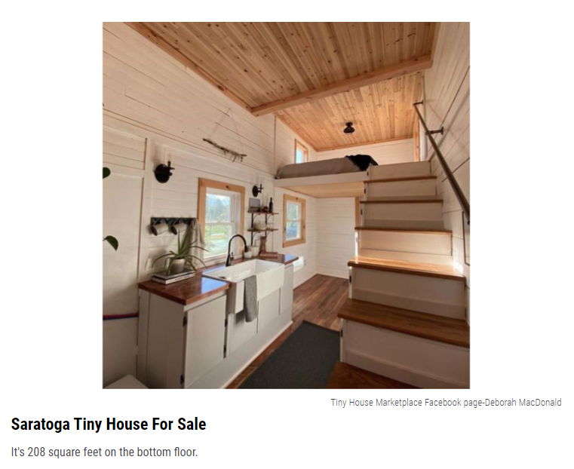
Tiny Homes – Affordable Housing
Tiny homes and affordable housing: Saratoga edition
This tiny home listed for $76,000 – on wheels and ready to go!

Slide 66
Tiny Homes and Affordable Housing
Executive Budget Proposals Addressing Affordable Housing – Directly and Tiny Homes (Indirectly – Affordable and ADUs)
2022- Provision that mandated ADUs in all localities ultimately stricken from final budget
2023-2024 Executive Budget proposal affordable housing initiative - “New York Housing Compact” creates a three-year new housing target for municipalities
Was ultimately stricken from final budget
Newest proposal – Executive Order 30 – “Pro-Housing Communities” receive priority in funding

Slide 67
Tiny Homes and Affordable Housing
How do these proposals impact tiny houses?
Tiny homes are generally more affordable than traditional single-family homes
Are tiny homes ADUs?
Depends on the local zoning code
Tiny homes can take many forms- structure could be principal building, even if the lot size is significant

Slide 68
How Do We Regulate?
How do we know if someone is even has a tiny home? How can we regulate them if we don’t know?
Neighbor complaints
Tiny home / STR websites- presumption of operation (include in code) if property is listed
Google search
County registry if county has VCA with short-term rental platform – should have a list of properties, which might incorporate some tiny homes

Slide 69
Addressing Tiny Homes at the Local Level: Final Thoughts
Definitions matter! How does the locality want to define tiny homes?
All forms authorized? Site-built, chassis, mobile, RV style?
A broad definition could encompass all forms of tiny homes
Keep in mind that different types may be subject to different requirements (e.g., site-built versus mobile home versus recreational vehicle)
Consider the comprehensive plan and ensure housing options for the community are taken into account
Look to land use toolkit and creative methods outside of zoning and land use to regulate

Slide 70
Questions?
khodgdon@nytowns.org
Association of Towns
150 State St
Albany, NY
(518)465-7933

