Slide 1
REGULATING SHORT-TERM RENTAL PROPERTIES
CDRPC FALL PLANNING & ZONING WORKSHOP – October 28, 2022

Slide 2
INTRODUCTIONS
KEVIN SCHWENZFEIER
SENIOR PLANNER
DAVID GILMOUR, AICP
SENIOR PLANNER
REGULATING SHORT-TERM RENTAL PROPERTIES
October, 2022

Slide 3
AGENDA
Defining the Short-Term Rental Unit
A Brief History of Short-Term Rentals
Current Trends & Challenges
Variation by Situation
Regulatory Pitfalls & Triumphs
Case Study: North Elba & Lake Placid
Recommended Minimum Requirements
Discussion
REGULATING SHORT-TERM RENTAL PROPERTIES
October, 2022

Slide 4
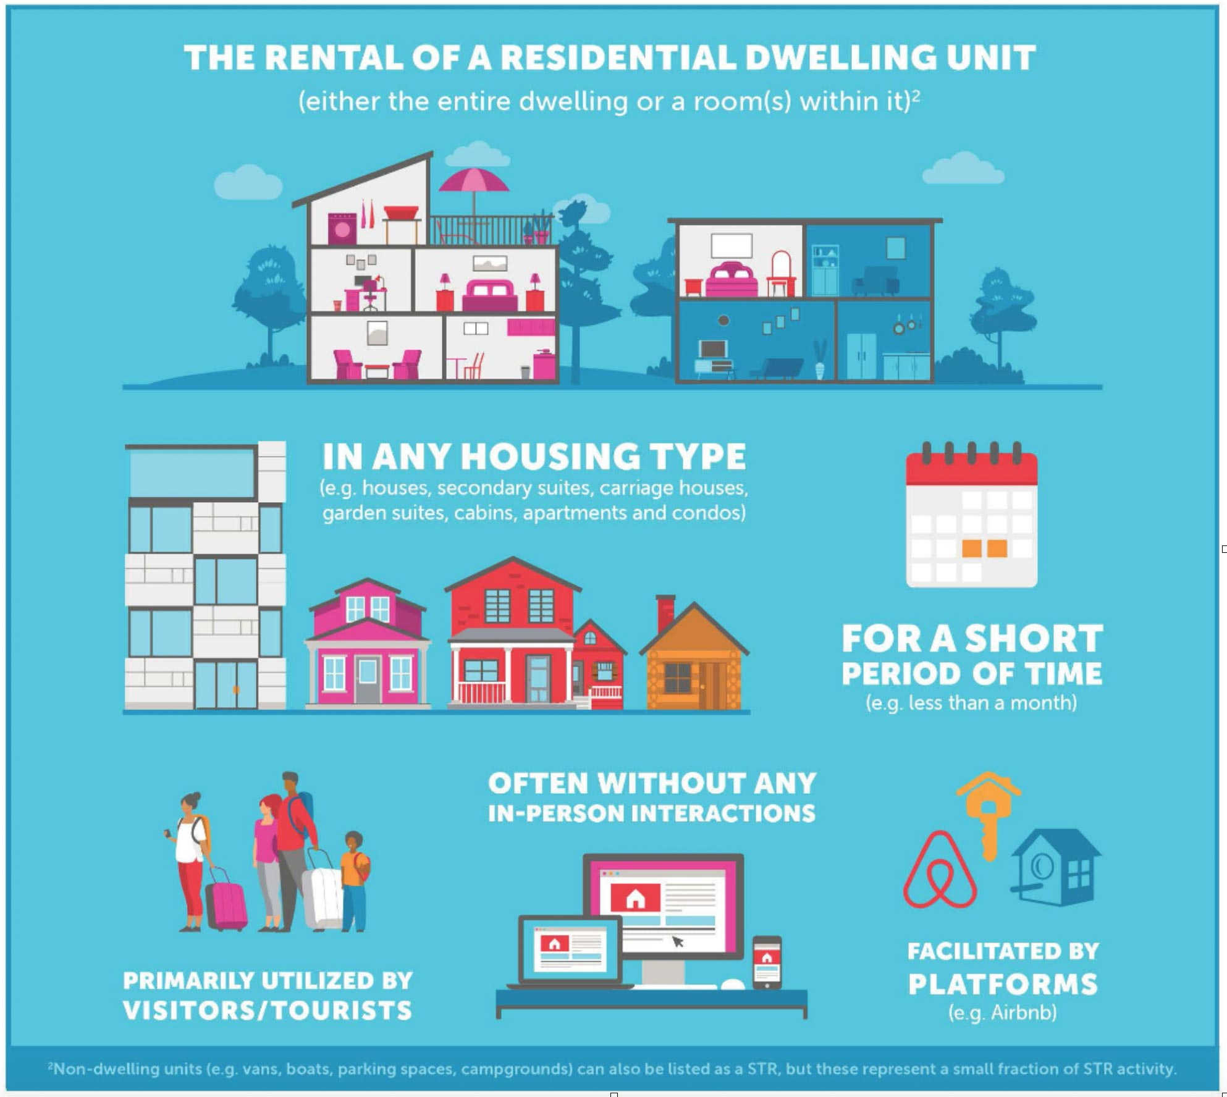
DEFINING THE SHORT-TERM RENTAL UNIT
Any rental of an entire or partial dwelling unit.
Including Houses, Apartments, Villas, Condos, Townhouses, Cabins, Guest Houses, Yurts, Mobile Homes, or Boats.
Typically for less than 30 days.
Online facilitation with little to no interaction with the owner or host.
Regulating short term rentals: a toolkit for Canadian local governments. Generation Squeeze.
https://www/gensqueeze.ca/st_toolkit_2020

Slide 5
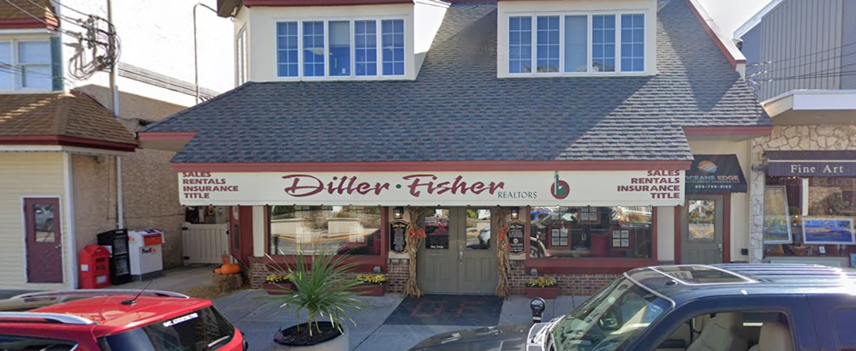
A BRIEF HISTORY OF SHORT-TERM RENTALS
Not a new phenomenon.
Traditional process.
Expansion and ease of booking is what’s new.
Google Maps Street View
REGULATING SHORT-TERM RENTAL PROPERTIES
October, 2022
Notes:
Short-term rentals are not a new phenomenon; vacation rentals have been popular in resort communities for decades.
They were traditionally obtained through a local real estate office which charged a fee to participating homeowners for the rental management of their property.
Rather, it is the expansion and ease of the mechanisms to find, book, and host short-term rentals that has changed due to the rise of the “sharing economy”.

Slide 6
A BRIEF HISTORY OF SHORT-TERM RENTALS
TOP PLATFORMS
REGULATING SHORT-TERM RENTAL PROPERTIES
October, 2022
Notes:
While dozens of online platforms exist for short-term rental services, the most popular players include: VRBO, Booking.com, and airbnb.
VRBO or Vacation Rentals by Owner was founded in 1995 as the first online booking services.
In 2008, Airbnb changed the game allowing individuals to not only book just a room within a rental unit, but also entirely automate the process of payment and access.
The services provided by these companies have rapidly become an integrated part of our accommodation culture.

Slide 7
A BRIEF HISTORY OF SHORT-TERM RENTALS
Municipalities have the authority to regulate short-term rentals under the police powers of Town Law.
A Town Board may permit and otherwise regulate hotels, inns, boarding houses, rooming houses, lodging houses, associations, clubs or any building or part of a building used in the business of renting rooms.
REGULATING SHORT-TERM RENTAL PROPERTIES
October, 2022
Notes:
Municipalities have the authority to regulate short-term rentals under the police powers of Town Law §130(20).
A Town Board may permit and otherwise regulate hotels, inns, boarding houses, rooming houses, lodging houses, associations, clubs or any building or part of a building used in the business of renting rooms.

Slide 8
CURRENT TRENDS
Scaled up.
Increased independence
Increased customization.
Decreased regulation.
Rapid Change > Challenges.
REGULATING SHORT-TERM RENTAL PROPERTIES
October, 2022
Notes:
Over the last 15 years, the online companies have been able to exponentially scale up the resort community rental model to include urban, suburban, and rural communities as well.
The process became more independent and less regulated, while increasingly customizable; basically anyone with a bedroom could capitalize off of this new opportunity.
Due to this rapid change, new challenges have arisen within communities between short-term rental properties and the residents, business owners, and governments who have been inundated with this loosely regulated commercial activity.

Slide 9
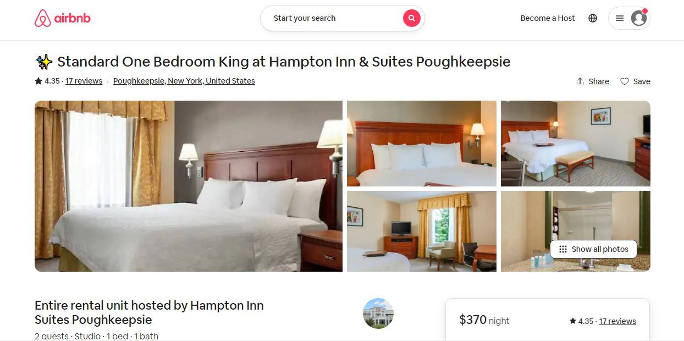
CURRENT TRENDS
Hotel companies and professional property managers capitalizing on the home rental space market.
REGULATING SHORT-TERM RENTAL PROPERTIES
October, 2022
Notes:
Hotel companies and professional property managers are now capitalizing on the home rental space market.
They are purchasing housing units and renting them not only through their own internet platforms, but also though the already established online retailers.

Slide 10
CURRENT CHALLENGES
NOISE
TRAFFIC
COMPETITION
TRASH
TRESPASSING
SAFETY
AFFORDABLE HOUSING
REGULATING SHORT-TERM RENTAL PROPERTIES
October, 2022

Slide 11
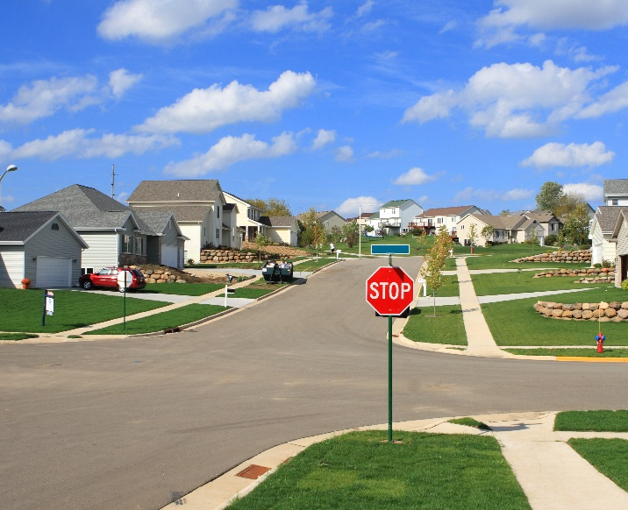
CURRENT CHALLENGES
SEASONAL
RURAL
SUBURBAN
URBAN
REGULATING SHORT-TERM RENTAL PROPERTIES
October, 2022

Slide 12
CURRENT CHALLENGES
SEASONAL COMMUNITIES
Higher percentage of short-term rentals than a suburban, bedroom community.
Contend with parking, noise, trash, events, and infrastructure issues on a much larger scale.
Inadequate supply of owner-occupied housing and rental properties is felt more acutely - workforce and residence are priced out of housing.
REGULATING SHORT-TERM RENTAL PROPERTIES
October, 2022

Slide 13
CURRENT CHALLENGES
RURAL COMMUNITIES
Tend to have the issue of population increases per unit with large-scale events allowed at single properties.
Properties may allow for well over the reasonable ratio of beds to guests.
These types of units also tend to overtax the private well and septic.
REGULATING SHORT-TERM RENTAL PROPERTIES
October, 2022

Slide 14
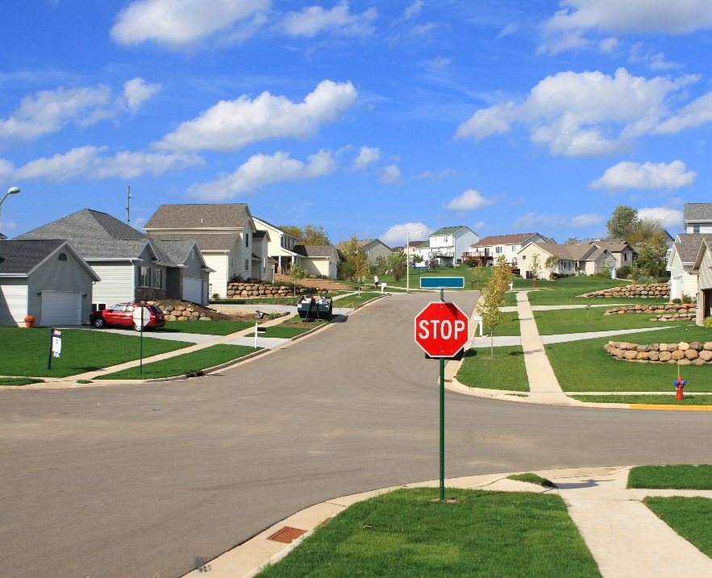
CURRENT CHALLENGES
SUBURBAN COMMUNITIES
More likely to have conflicts.
High rate of transient neighbors with concerns of safety, noise, trespassing, and trash.
REGULATING SHORT-TERM RENTAL PROPERTIES
October, 2022

Slide 15
CURRENT CHALLENGES
URBAN COMMUNITIES
Tend to have a greater number of mixed-use areas where short-term rentals tend to conflict less.
For business owners, competition from short-term rentals is of great concern; most are looking for a level playing field.
Traditional hotels, motels, inns, bed and breakfasts, and seasonal rental agencies are at disadvantage to online, peer-to-peer short-term rental companies since they are subject to business taxes and Department of Health regulations.
REGULATING SHORT-TERM RENTAL PROPERTIES
October, 2022

Slide 16
VARIATION BY SITUATION
Regulations regarding short-term rental units can vary widely depending on whether your community is seasonal, rural, urban, suburban, or a mix.
After community type, the reason why a regulation is needed is the most important factor for determining which type of law will be needed for a municipality.
The “why” is the catalyst which starts the process of enacting a new law; it represents the primary conflict(s) and demonstrates that regulation of this use is necessary.
REGULATING SHORT-TERM RENTAL PROPERTIES
October, 2022

Slide 17
REGULATORY ISSUES
No matter which type of community, short-term rentals are primarily taxing to local code enforcement.
WITHOUT REGULATION
WITH REGULATION
Code enforcement lacks any true power in dealing with these types of uses.
Can only rely on the property maintenance code or the limited powers of a noise ordinance.
With an enacted regulation, code enforcement is often the front line for compliance; in some communities this task can become burdensome to take on for a department that is typically just one person.
REGULATING SHORT-TERM RENTAL PROPERTIES
October, 2022

Slide 18
REGULATORY ISSUES
Definitions: Courts have sided with the owner of a rental property when the definition is unclear and clearly meant for outdated uses.
Atkinson v. Wilt, 94 A.d.3d 1218 (3d Dept. 2012)
Inspection: Can be time consuming and costly.
Violations: May be difficult to discern if reliant on complaints.
Noise: Ordinances are historically difficult to enforce and measure.
Compliance: Police power and monitoring is generally limited.
REGULATING SHORT-TERM RENTAL PROPERTIES
October, 2022

Slide 19
REGULATORY MEASURES
COMMUNITY-SPECIFIC SOLUTIONS
Regulatory measures vary widely between municipalities.
Avoid the temptation to adopt another municipality’s regulation and tailor the law to your own circumstances.
The regulations should directly correlate to the type and scale of the issue(s) the community is dealing with and/or trying to prevent.
PARKING
TRASH
If parking or overpopulation is an issue, then set a vehicle limit per bed or per bedroom.
If trash is a major issue, then include regulations on collection and screening.
REGULATING SHORT-TERM RENTAL PROPERTIES
October, 2022

Slide 20
REGULATORY MEASURES
Implementation of a permit process allows for a community to:
Collect fees which will provide enforcement funding.
Provide a mechanism of consequence.
A permit must be obtained for operation.
A permit gives residents and customers legal documentation to refer if an issue were to arise.
A permit can be revoked due to non-compliance.
REGULATING SHORT-TERM RENTAL PROPERTIES
October, 2022

Slide 21
REGULATORY MEASURES
PERMIT REGULATIONS COULD INCLUDE:
Parking Limit
Occupancy Limit
Building Code Compliance
Fire Code Compliance
Annual Rental Day Cap
Guest Registry
Local Contact Person
Clear Signage
Fencing
Nuisance Law Adherence
HOA Rules
REGULATING SHORT-TERM RENTAL PROPERTIES
October, 2022

Slide 22
REGULATORY MEASURES
BASIC PERMIT INFORMATION:
Number of beds
Number of bedrooms meeting minimum state code (70 square feet)
Number of parking spaces
Total square feet of rental unit
Provision for waste removal
Fire safety compliance
REGULATING SHORT-TERM RENTAL PROPERTIES
October, 2022

Slide 23
REGULATORY MEASURES
INSPECTIONS
BUILDING INSPECTIONS
STATE FIRE CODE INSPECTIONS
May be desired by some municipalities in order to verify the information provided on a permit application.
Fire Code compliance may be included as part of the permit approval process, but will require inspection.
REGULATING SHORT-TERM RENTAL PROPERTIES
October, 2022

Slide 24
REGULATORY MEASURES
LOCAL OCCUPANCY TAX
Legislation imposing a tax on all transient accommodations (typically 3-5%).
Any municipality in NYS may charge an additional tax on occupancy; including counties, towns, cities, and villages.
Many counties have passed this type of legislation which creates greater uniformity between its resident communities.
Property owners are required to register with the County Treasurer’s Office.
They must collect and remit the tax per guest stay to the County Treasurer.
Short-Term Rentals are subject to these laws and a municipal regulation should include registration as a requirement of a permit.
STR service providers may not collect the County Occupancy Tax on behalf of the property owner.
This registration system not only collects revenue for the local economy, but also provides for an additional layer of compliance.

Slide 25
RECOMMENDED MINIMUM REQUIREMENTS
The cost of a permit should directly correlate to housing unit dimensions (unit size, number of bedrooms, number of parking spaces, etc.).
Periodic renewal of a permit allows for an additional mechanism to track short-term rental properties.
The permit should be displayed within the unit and neighboring properties should be provided a copy.
The permit should include contact information for a local property manager who can respond to the property within a reasonable amount of time.
COST
RENEWAL
DIPSLAY
CONTACT
REGULATING SHORT-TERM RENTAL PROPERTIES
October, 2022

Slide 26
COMPLIANCE MONITORING SERVICES
For communities that have only part-time, shared enforcement staff, compliance monitoring services are a great alternative.
These services are able to track short-term rental properties within a community in real time.
They can provide weekly reports to the municipality so that the units locations are known and can be regulated through the local permitting process.
They can also provide customized noticing services to both the community and the property owner.
REGULATING SHORT-TERM RENTAL PROPERTIES
October, 2022

Slide 27
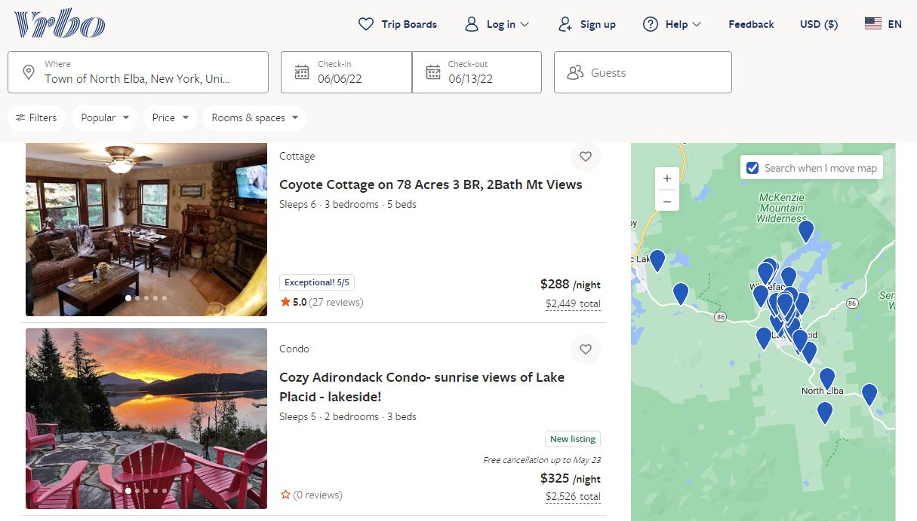
CASE STUDY: NORTH ELBA & LAKE PLACID
REGULATING SHORT-TERM RENTAL PROPERTIES
October, 2022

Slide 28
CASE STUDY: NORTH ELBA & LAKE PLACID
PURPOSE
Amend the Village of Lake Placid/Town of North Elba Land Use Code to regulate short-term rentals via comprehensive registration and licensing regulations.
Safeguard public health, safety and welfare by regulating and controlling the use, occupancy, oversight and maintenance of short-term rental properties.
Preserve the historical, natural, and cultural character of the community and the peace and enjoyment of neighboring homeowners.
Strive for a balanced approach that respects the property rights and interests of all homeowners – those who offer their homes as short-term rental properties and those who choose not to do so.
REGULATING SHORT-TERM RENTAL PROPERTIES
October, 2022

Slide 29
CASE STUDY: NORTH ELBA & LAKE PLACID
DEFINITION OF SHORT-TERM RENTAL
A dwelling unit that is rented, in whole or part, to any person or entity for a period of less than 30 consecutive nights, and includes any residential building or apartment, single- or two-family dwelling, condominium, townhouse, guest house, cottage, cabin, or accessory dwelling which is rented as a living quarters with kitchen for any period less than 30 consecutive nights.
This definition expressly includes Rooming/Boarding house as defined in Section 10.2 of the Village of Lake Placid/Town of North Elba Land Use Code.
This definition excludes timeshare, hotels, bed and breakfast establishments and school or non-profit dormitories.
"Rental" means an agreement granting use or possession of a residence, in whole or part, to a person or group in exchange for consideration valued in money, goods, labor, credits, or other valuable consideration.
Use of a short-term rental by a record owner of a property shall not be considered to be a rental under this section.
REGULATING SHORT-TERM RENTAL PROPERTIES
October, 2022

Slide 30
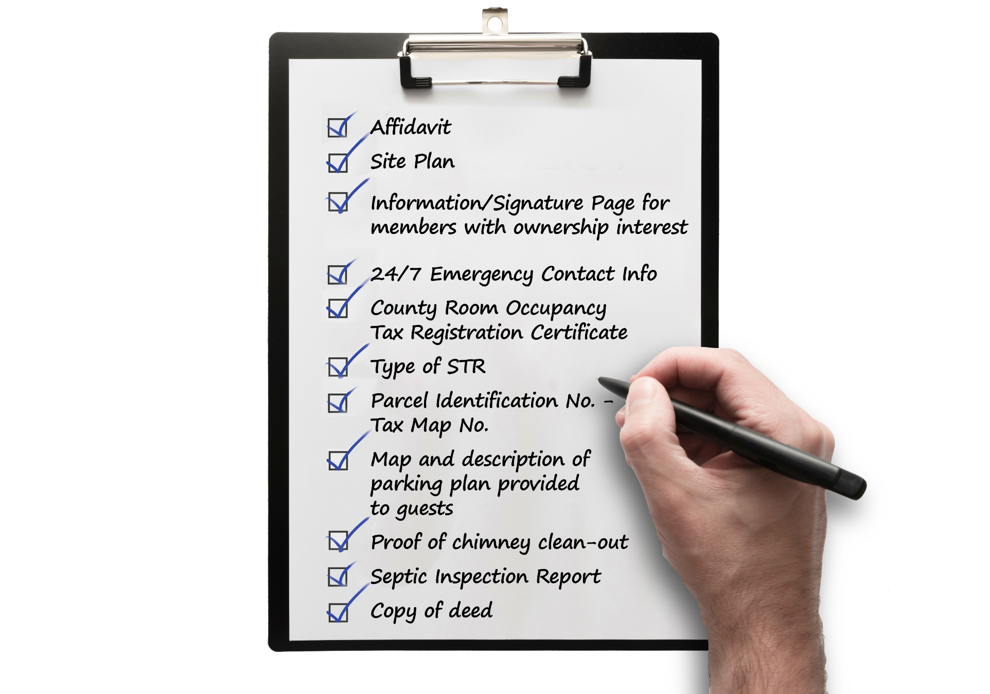
CASE STUDY: NORTH ELBA & LAKE PLACID
CHECKLIST FOR SHORT-TERM RENTAL PERMIT APPLICATION
Notes:
Affidavit (Registration and Application)
Site Plan (click here for details)
Information and Signature Page for all members with ownership interest (click here for form)
24/7 Emergency Contact Information (click here): The designated representative must be reachable 24/7 and live within a 60-minute drive to the short-term rental unit. This person may be the owner as long as those criteria are met. It is the owner's responsibility to contact the North Elba Building and Planning Department within 48 hours if there is a change of representative.
Essex County Room Occupancy Tax Registration Certificate (click here for a link to the Essex County Treasurer's Office).
Type of STR (click here for a list of STR Types).
Parcel Identification Number--Tax Map Number (click here for link to Essex County Image Mate Online).
Map and description of parking plan provided to guests: Description and plan showing where the spots will be located on the property that you will provide to your guests. The site plan will be acceptable if you show where the parking will be located and add a description.
Proof of chimney clean-out: acceptable proof is a copy of the invoice provided to you by the chimney cleaning company (the invoice must show the service provider's name, address and phone number).
Septic Inspection Report, if applicable (click here for septic inspection report form).
Copy of your deed (click here to obtain a copy of your deed).

Slide 31
CASE STUDY: NORTH ELBA & LAKE PLACID
APPLICATION REQUIREMENTS
I certify I have notification from an insurance company acknowledging the property is used as a short-term rental.
I certify street side emergency address numbers are displayed in accordance with 911 regulations.
I certify all smoke alarms and carbon monoxide detectors are incorrect working order and that the correct number of devices are installed per the New York State Building Code. (Include date of device).
I certify a working fire extinguisher is located in each cooking area and in close proximity to each open flame source.
I certify all chimney flues have been cleaned during the last 12 months.
I certify the trash containers are of sufficient size to accommodate the maximum occupancy allowed and that a collection plan is in place.
I certify I will notify tenants of noise and parking regulations in accordance with the applicable Town or Village Laws.
I certify there are (#)___ bedrooms in the rental unit.
I certify there are (#) ____ bathrooms and (#)___ ½ baths in the rental unit.
I certify there are ______ on-site parking spaces available.
If the rental unit is supplied by a municipal water source, I certify a meter is being monitored by the Village Water Department.
Owner supplied advertisement for unit being considered for short-term rental.
I certify the property complies with the New York State Property Law.
I certify that the property is registered with County Treasurer’s Office Occupancy Tax Program.
I, ______________________________ (print name), certify that the Short-Term Rental Permit for which I am applying meets all of the criteria described above. I acknowledge that failure to comply with the short-term rental requirements may result in revocation of the Short-Term Rental Permit.

Slide 32
CASE STUDY: NORTH ELBA & LAKE PLACID
MAXIMUM OCCUPANCY
The maximum occupancy for each short-term rental unit shall be the most restrictive of the following:
Maximum occupancy shall be calculated as 2 times the number of bedrooms that are in compliance with the New York State Building Code plus 2 additional occupants.
2 Bedroom unit = 4 occupants for 2 bedrooms + 2 additional = 6 maximum
4 Bedroom unit = 8 occupants for 4 bedrooms + 2 additional = 10 maximum
6 Bedroom unit = 12 occupants for 6 bedrooms + 2 additional = 14 maximum
Maximum occupancy for studio apartment shall be 2 occupants for the first 220 sq. ft. with 1 additional occupant for each additional100 sq. ft. of living space.
Ex.: 550 sq. ft. studio = 2 for first 220 sq. ft. + 3 for 330 remaining sq ft. = 5 max.
Maximum capacity of the septic system for properties serviced by a septic system
REGULATING SHORT-TERM RENTAL PROPERTIES
October, 2022

Slide 33
CASE STUDY: NORTH ELBA & LAKE PLACID
VIOLATIONS / PUNITIVE MEASURES
Any person, association, firm, company or corporation which violates any provision of this section or assists in the violation of any provision of this section shall be guilty of a violation punishable:
By a fine or penalty of not less than $350.00 and not exceeding $1,000.00for a first offense or, if greater, the maximum amount allowed under the Municipal Home Rule Law, the Town Law or the Village Law.
By a fine or penalty of not less than $1,000.00 and not exceeding $3,000.00 for a second offense both of which were committed within a period of five (5) years or, if greater, the maximum amount allowed under the Municipal Home Rule Law, the Town Law or the Village Law.
Each week's continued violation constitutes a separate additional violation.
REGULATING SHORT-TERM RENTAL PROPERTIES
October, 2022

Slide 34
CASE STUDY: NORTH ELBA & LAKE PLACID
SHORT-TERM RENTAL PERMIT FEE SCHEDULE
Studio/Efficiency – 2 Bedrooms $200
3-5 Bedrooms $500
6-8 Bedrooms $900
9+ Bedrooms $1,200
*14 days or less rentals do not pay a fee.
REGULATING SHORT-TERM RENTAL PROPERTIES
October, 2022

Slide 35
CASE STUDY: NORTH ELBA & LAKE PLACID
SHORT-TERM OUTCOMES
Due to the strict nature of the municipal ordinance, a lawsuit was filed against the town and village.
The suit claimed that the law violated:
An owners right to equal protection.
An owners right to be free of unreasonable search and seizure by allowing the code enforcement officer to inspect the property without warrant or reason.
An owners right to due process by instating a 90-day cap on renting, requiring a permit to operate, and allowing code enforcement to impose conditions.
Their first amendments rights under the US Constitution.
REGULATING SHORT-TERM RENTAL PROPERTIES
October, 2022

Slide 36
CASE STUDY: NORTH ELBA & LAKE PLACID
SHORT-TERM OUTCOMES
Out of the 13 legal actions brought before the municipalities, three were not dismissed by the federal court.
Only one action required revision in the code; code enforcement will require permission from a property owner prior to inspection.
Currently, there is a moratorium in place on new applications for short-term rental permits within both municipalities.
REGULATING SHORT-TERM RENTAL PROPERTIES
October, 2022

Slide 37
CASE STUDY: NORTH ELBA & LAKE PLACID
CONCLUSIONS
The case shows that balancing the needs of all parties is necessary to solve the challenges of short-term rental properties.
An overly strict or complicated law will most likely be challenged, while an overtly simplistic law may not garner the intended outcome.
The target outcome is a law that allows a community to know the location and number of short-term rental units, have contact information for a local property representative, regulate and enforce the properties similar to commercial businesses, and create a mechanism to fund enforcement and permitting.
REGULATING SHORT-TERM RENTAL PROPERTIES
October, 2022

Slide 38
DISCUSSION
HOW ARE SHORT-TERM RENTAL PROPERTIES
AFFECTING YOUR COMMUNITY?
REGULATING SHORT-TERM RENTAL PROPERTIES
October, 2022

Slide 39
Thank you!
TO REQUEST A COPY OF THESE SLIDES
OR SET UP A MEETING TO DISCUSS YOUR COMMUNITY’S NEEDS SURROUNDING SHORT-TERM RENTAL PROPERTIES,
PLEASE VISIT
labergegroup.com/2022/05/17/shorttermrental

