Slide 1
New York State Environmental Quality Review Act (SEQRA)
Notes:
Goal: To provide a broad overview of the purpose of the review, the process itself, and hopefully to demystify the local officials role
SEQRA vs. SEQR-many times used interchangeably (doesn’t matter how pronounced)
SEQR=Review Process; SEQRA=Legislation/Regulations
Little NEPA-National Environmental Policy Act-Approx. 22 other states have their own State Environmental Review
The reviewing power for smaller decisions made at the local level are kept at the local level (power, as well as, responsibility)
Was implemented in the mid 70’s (1975) and was designed to insure that localities were taking the environment into consideration at a time when many municipalities had not yet adopted land use controls-Degradation of the environment was going unchecked
Statute is Article 8 of NYS Environmental Conservations Law (Chapter 43, Consolidated Laws of NYS)
Regulations are Part 617 of Title 6 of the NYCRR (Codes, Rules, & Regulations of New York)
Passed by Legislature & signed by governor - regulations written at the agency (DEC) level for implementation of law
Pursuant to…Title 6 NYCRR Part 617 of the implementing regulations pertaining to Article 8 (SEQRA) of the Environmental Conservation Law
The NYCRR primarily contains state agency rules and regulations adopted under the State Administrative Procedure Act (SAPA). The 22 Titles include one for each state department, one for miscellaneous agencies and one for the Judiciary. Title 6 (of 22) Environmental Conservation
Chapter VI (6) –General Regulations

Slide 2
Introduction
Notes:
What agency enforces SEQR? The Legislature has made SEQR self-enforcing; that is, each agency of government is responsible to see that it meets its own obligations to comply. While the Department of Environmental Conservation is charged with issuing regulations regarding the SEQR process, DEC has no authority to review the implementation of SEQR by other agencies. In other words, there are no "SEQR Police."
What happens if an agency does not comply with SEQR? If an agency makes an improper decision or allows a project that is subject to SEQR to start, and fails to undertake a proper review, citizens or groups who can demonstrate that they may be harmed by this failure may take legal action against the agency under Article 78 of the New York State Civil Practice Law and Rules. Project approvals may be rescinded by a court and a new review required under SEQR. New York State's court system has consistently ruled in favor of strong compliance with the provisions of SEQR. (See also case law to be posted later.)
How can DEC assist agencies in implementing the SEQR process? DEC provides informal interpretations and guidance about the conduct of SEQR. These informal interpretations are based on the experience of DEC staff. DEC, however, cannot provide formal legal opinions about the conduct of SEQR by other agencies. State and local agencies and other interested parties should consult with their own legal counsel for formal interpretations of SEQR law and regulations.

Slide 3
Statutory authority
Environmental Conservation Law, Article 8
Title 6 NYCRR, Part 617
Discretionary actions made by state and local agencies subject to review
Coordination between stakeholders is encouraged and required in some cases
Process ensures mitigation of adverse impacts
State court system is only enforcement mechanism
Notes:
The SEQRA regulations may be found in Environmental Conservation Law Article 8, Title 6 of the Codes, Rules, & Regulations of New York (NYCRR) Part 617. State and local agencies must follow the procedures contained within when charged with making a discretionary decision that has been identified by the regulations as an “action.”
SEQRA provides an opportunity for communication between local and state agencies, citizens, and project sponsors that may not have otherwise occurred. The SEQR process is not a permitting process or one that results in an “approval” per se. Rather it provides a comprehensive assessment of proposed actions in order to reduce significant adverse environmental impacts while meeting the social and economic needs of a community.
The SEQRA regulations are not overseen or enforced by the NYS Department of Environmental Conservation (NYS DEC); the exception being a role in resolving disputes over lead agency status in special cases. As there is no enforcement entity named in statute, SEQR challenges are settled by the state court system, beginning with the Supreme Court. Significant factors in SEQR legal challenges include, standing of litigants, statute of limitations, and the timing of challenges.

Slide 4
Basic purpose Part 617.1 (c)
Incorporate consideration of environmental factors into an agency’s decision making process at earliest possible time
Notes:
The summary of intent within the regulations is to incorporate consideration of environmental factors into an agency’s decision making process early enough that the results of the environmental reviews will have real influence on their decisions. Although somewhat subjective, the rule of thumb is that the action should be bigger than a concept. This would be early enough to affect all decisions which could impact the environment, but far enough into the planning process that the range of available choices can be defined.
In the case of land use decisions, application submission for local approval typically triggers a review pursuant to the SEQRA. Examples could include a subdivision application to a planning board, or a use variance application to a zoning board of appeals. Land use matters sponsored by a governing board may also be subject to SEQRA, such as comprehensive plan adoption by a town board.

Slide 5
What are “environmental factors?”
Notes:
Get you thinking…
What are Environmental Factors?
SEQR interprets the term “environment” very broadly
These pictures are provided to demonstrate components of our environment which is to include not just natural systems— but also human and community resources
Important to Remember:
SEQRA is Intended to Achieve BALANCE between the Physical Environment, Social and Economic Resources
Bog Turtle; New York Status: Endangered; Federal Status: Threatened
Status More than half of the 74 historic bog turtle locations in New York still contain apparently suitable habitat. Only one quarter of these sites, however, are known to support extant (existing) populations, primarily in southeastern New York.

Slide 6
Resources or characteristics affected by action
Resources of agricultural, archeological, historic or aesthetic significance
Existing patterns of population concentration distribution or growth
Existing community or neighborhood character
Human health
Land
Air
Water
Minerals
Flora
Fauna
Noise
Notes:
Again, SEQRA defines environment broadly as can be evidenced by the descriptors within the regulations. They take into account resources or characteristics that could be affected by an action, including:
Land, air, and water are traditional resources that come to mind for most people. Don’t forget plants and animals, as are they losing their habitats and becoming endangered or being forced to relocate in developed areas.
But don’t forget human/social resources or characteristics
Noise (during construction and post)
Features of historic or aesthetic significance (historic sites, view sheds)
Population patterns (increase or decrease either of which may be beneficial depending on the situation-more people to DT, less people to suburbs)
Community character (does new development mean less opportunity for parkland, traffic)

Slide 7
How SEQRA works
Agency proposes action or receives application
Action classified*
Lead agency established
Significance of action determined*
Environmental Impact Statement (EIS), if needed
Findings and agency decision*
*SEQRA process can conclude at any of these points
Notes:
Step 1. Classifying the Action - The first step in classifying the action is to decide whether it is subject to SEQR
Step 2. Complete the Correct Environmental Assessment Form - NYSDEC SEQR Process - Step 2 Environmental Assessment
Step 3: Coordinate Review - NYSDEC SEQR Process - Step 3 Coordinate Review
Step 4: Determine Significance - The lead agency has 20 calendar days to make its determination of significance
Optional Step: Scope the Draft EIS - Scoping is the process by which the issues to be addressed in the draft EIS are identified
Step 5 Preparation of the Draft EIS - The applicant always has the right to prepare the draft EIS. If the applicant refuses to prepare the draft EIS, the lead agency has the option of preparing the draft EIS, having it prepared by a consultant, or terminating its review of the action
Step 6 Determine the Adequacy of the Draft EIS for Public Review (Accept or Return for Revision) - Upon receipt of a submitted draft EIS, the lead agency has 45 days to determine whether the document is adequate for public review in terms of scope and content
Step 7: Publish Notice that an EIS is Accepted for Public Review - Publish Notice
Step 8 Public Comment - The filing of the Notice of Completion of a Draft EIS starts the public comment period
Step 9 Decide Whether to Hold a Public Hearing - After the lead agency accepts the draft EIS, it must decide whether to hold a public hearing [see 617.9(a)(4)]
Step 10 Preparation of the Final EIS - The lead agency is responsible for the adequacy and accuracy of the final EIS, regardless of who prepares it
Step 11 SEQR Findings - Part 617.11 requires that each involved agency must prepare its own written SEQR findings statement, after a final EIS has been filed and before the agency makes a final decision

Slide 8
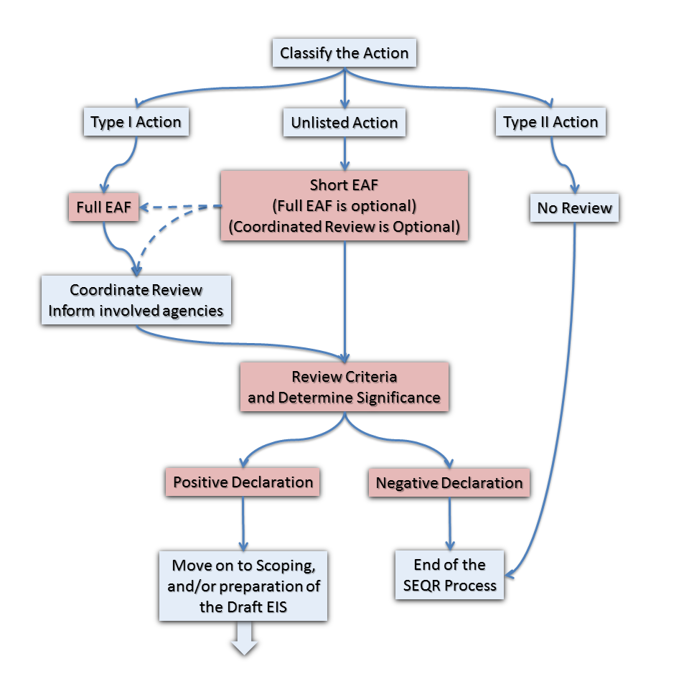
Notes:
The NYS Department of Conservation has constructed a road map explaining the steps from start to finish. An agency proposing an action or receiving an application triggers the SEQRA process.
Type II
Agency proposes action or receives application
Action classified
SEQRA process concluded
Unlisted & Type I
Agency proposes action or receives application
Action classified
Preparation of EAF
Lead agency established
Significance of action determined: Negative Declaration
SEQRA process concluded
Unlisted & Type I
Agency proposes action or receives application
Action classified
Preparation of EAF
Lead agency established
Significance of action determined: Positive Declaration
Environmental Impact Statement (EIS) prepared
Findings and agency decision
SEQRA process concluded

Slide 9
Notes:
The NYS Department of Conservation has constructed a road map explaining the steps from start to finish. An agency proposing an action or receiving an application triggers the SEQRA process.
Type II
Agency proposes action or receives application
Action classified
SEQRA process concluded
Unlisted & Type I
Agency proposes action or receives application
Action classified
Preparation of EAF
Lead agency established
Significance of action determined: Negative Declaration
SEQRA process concluded
Unlisted & Type I
Agency proposes action or receives application
Action classified
Preparation of EAF
Lead agency established
Significance of action determined: Positive Declaration
Environmental Impact Statement (EIS) prepared
Findings and agency decision
SEQRA process concluded

Slide 10
Notes:
The NYS Department of Conservation has constructed a road map explaining the steps from start to finish. An agency proposing an action or receiving an application triggers the SEQRA process.
Type II
Agency proposes action or receives application
Action classified
SEQRA process concluded
Unlisted & Type I
Agency proposes action or receives application
Action classified
Preparation of EAF
Lead agency established
Significance of action determined: Negative Declaration
SEQRA process concluded
Unlisted & Type I
Agency proposes action or receives application
Action classified
Preparation of EAF
Lead agency established
Significance of action determined: Positive Declaration
Environmental Impact Statement (EIS) prepared
Findings and agency decision
SEQRA process concluded

Slide 11
Notes:
The NYS Department of Conservation has constructed a road map explaining the steps from start to finish. An agency proposing an action or receiving an application triggers the SEQRA process.
Type II
Agency proposes action or receives application
Action classified
SEQRA process concluded
Unlisted & Type I
Agency proposes action or receives application
Action classified
Preparation of EAF
Lead agency established
Significance of action determined: Negative Declaration
SEQRA process concluded
Unlisted & Type I
Agency proposes action or receives application
Action classified
Preparation of EAF
Lead agency established
Significance of action determined: Positive Declaration
Environmental Impact Statement (EIS) prepared
Findings and agency decision
SEQRA process concluded

Slide 12
Actions
Notes:
All discretionary decisions to:
Fund, approve, or directly undertake projects or physical activities that may affect the environment. Also includes adoption of LLs, ordinances and possibly resolutions.

Slide 13
What are “actions?”
All are subject to SEQRA consideration
Undertaking, funding or approving projects or physical activities (discretionary actions)
Planning & policy making activities
Adopting rules, regulations & procedures
Any combination above
Notes:
Actions may include direct actions where a government agency is the sponsor, such as physical construction, planning, policy making, or adopting rules, regulations and procedures. Actions may also include granting approval or funding. Actions are discretionary decisions which may have one or more impact on the environment. Discretionary essentially implies the ability of an agency to say “yes”, “no”, or “only if.”
This is different from a ministerial act, which is the act of a governmental employee, which is performed according to statutes, legal authority, established procedures or instructions from a superior, without exercising any individual judgment. An example of a ministerial act would be issuing a building permit.

Slide 14
Classification of actions
One of three classifications
Type II* 6 NYCRR Part 617.5
Type I 6 NYCRR Part 617.4
Unlisted 6 NYCRR Part 617.2 (ak)
*DEC recommends making a note to file
Notes:
Actions must be given one of three classifications in order to determine the level of review required to consider the environmental impacts that could result from said action
Why Type II actions first??? Easiest to understand the difference between Type I and Type 2 actions by “backing” in, from smallest to largest.
Type 2 list is found in 617.5 .5(c). Some of the actions are excluded by act of law, such as certain activities by APA, PSC, or MTA. Others are just so “small” that no real gain from wider review under SEQR
DEC recommends making a note to file that documents determination/classification
Why Classification Matters: We need to know if we are coordinating with other agencies and which forms are used. ( I’ll touch more on coordination later) and we need to determine level of review an action will receive:
Sets Basic Review Requirements
Type II-No further review required
Type I-Must coordinate with other involved agencies; Must use Full EAF
Unlisted-Initiating agency chooses whether to coordinate; Agency may allow Short or Long EAF
The initial review depending on classification as Type1, Type 2, or Unlisted may result in:
No further review
Requiring completion of a long or Short Environmental Assessment Form
When an agency is classifying an action the agency must assess the Whole Action.
-Example of subdivision in several phases

Slide 15
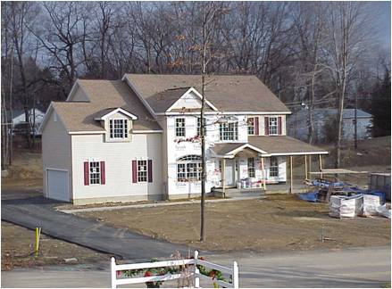
Type II actions
Pre-determined not to have significant adverse impact on environment
Area variances for one, two, or three family residences
Construction of commercial structure < 4,000 SF gross floor area and consistent with zoning
Official ministerial acts involving no discretion
Classification concludes SEQRA
Normal agency processes resume
Notes:
617.5 (a) reads “These actions have been determined not to have a significant impact on the environment or are otherwise precluded from environmental review”
No “SIG” impact…not NO impact
Examples you can relate to:
ZBA-Setback or lot line variances; Area variances for 1-2-3 family homes
PB-Construction of a non-residential structure having less than 4.000 SF in gross floor area & not require use variance
If an proposed action is classified as a type 2, no further review is required and SEQR is finished
Note helps to prove that you “did” SEQR. We able to demonstrate that we considered SEQR and decided it did not apply. Worst case is courts over rule classification, but not likely to get zinged for not “doing” SEQR
617.5 (c) is a list of 37 items that have been determined to not have a significant impact on the environment
(4) repaving of existing highways not involving the addition of new travel lanes;
(7) construction or expansion of a primary or accessory/appurtenant, non-residential structure or facility involving less than 4,000 square feet of gross floor area and not involving a change in zoning or a use variance and consistent with local land use (9) construction or expansion of a single-family, a two-family or a three-family residence on an approved lot including provision of necessary utility connections as provided in paragraph (11) and the installation, maintenance and/or upgrade of a drinking water well and a septic system;
(12) granting of individual setback and lot line variances;
(13) granting of an area variance(s) for a single-family, two-family or three-family residence

Slide 16
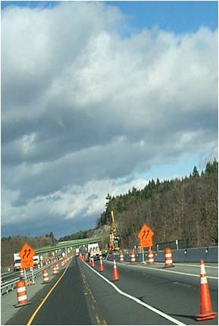
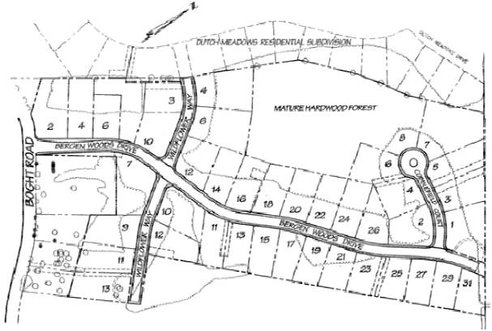
Type I actions
Carry presumption of significant adverse impact on environment
More likely to be issued positive declaration & require preparation of EIS
Requires that SEQRA continue until its conclusion
Notes:
One example:
the adoption of a municipality's land use plan, the adoption by any agency of a comprehensive resource management plan or the initial adoption of a municipality's comprehensive zoning regulations;
In term of construction projects, thresholds differ depending on the type of project and several factors, some examples being whether or not a community has adopted zoning or subdivision regulations, and whether or not the project will require connection to existing public water and sewer systems
Require that SEQRA continue to its conclusion
(11) any Unlisted action that exceeds a Type I threshold established by an involved agency pursuant to section 617.14 of this Part.

Slide 17
Unlisted actions
Not found on either Type I or Type II list
Physical disturbances of <10 acres (commercial)
Use variance needing no other approvals
Governing board may supplement Type I or Type II lists with otherwise Unlisted actions
No agency bound by action on another’s Type II list
Requires SEQRA continue to conclusion
Notes:
ak) …all actions not identified as a Type I or Type II action in this Part, or, in the case of a particular agency action, not identified as a Type I or Type II action in the agency's own SEQR procedures.
In other words they are actions that fall between the two “listed” categories
Regulations make provisions for generation of mun’s own list-Adopt separate to complement those contained in regs
Ex. In Cohoes considering sign unlisted to Type I because extensive site plan review for sign permits-adequate review
617.5 (b)-Expansion of Type II list-Mun can add unlisted actions
617.4 (a) (2)-Expansion of Type I list-Mun can add unlisted actions
Governing Body can officially adopt new list (resolution probably ok, local law recommended) if they would like an unlisted action to be classified as a Type I or II; No agency is bound by an action on another agency’s Type II but yes for Type I
Requires SEQRA continue to conclusion…Like Type I

Slide 18
Agencies
Notes:
OK now that we have talked about what needs to be reviewed, “Attorney” is going to discuss who has a role in the review…
Now that we have explained which activities need to be reviewed, we will now go on to discuss who has a role in the review. Those public bodies having a stake in a action would be considered “agencies.”

Slide 19
What are SEQRA “agencies?”
Agency: state or local public body
Involved agency: public body which has jurisdiction by law to fund, approve or directly undertake action
Interested agency: public body which does not have jurisdiction over project, but wishes to participate in process because of its expertise or specific concern
Lead agency: the involved agency responsible for determining whether EIS will be required, and for its preparation and filing, if required
Notes:
Lead Agency see SEQR review through from start to finish, to its completion
Other involved agencies basically abide by LA decisions and actions, but need to make sure they stay tuned in if they care at all about the project
Opportunity/obligation to look more broadly
Interested may participate as members of the public would
We’ve talked about classifying the action and agency decisions that get us involved in SEQR.
Now we want to talk for a moment about the different roles an agency might play in the SEQR process.
Under SEQR, an agency can be considered basically one of three roles: lead agency, involved and interested. Lead agency is more like a subset of the group of involved agencies, as you must be involved to take a lead agency role.

Slide 20
Possible SEQRA agencies
Involved
Interested
Planning board
Zoning board of appeals
Town board, city council, village board of trustees
School board
Industrial development agency & Local development corporation
State agency
State or local agencies acting in advisory roles
County planning board or regional agency GML §239-m review
Environmental management or conservation advisory councils
Not classified as SEQRA agencies:
Federal departments or agencies
Private entities
Notes:
§617.2 (c) Definitions
Agency means a state or local agency
The list can go on and on. These are some of the more usual examples.
Local government aspect of this term is significant
Since NYS is what’s called a “home rule state”, local governments make most of the fundamental land use decisions in NY
Interested:State or local agencies or entities acting in advisory roles
County planning offices providing General Municipal Law “239” reviews;
Environ. Mngmt. Councils & Conserv. Advisory Councils
Not classified as SEQR agencies
Federal agencies (like Corps of Engineers or FERC);
Purely private transactions involving no government review of funding

Slide 21
Establishing lead agency
Involved agencies only
If only one:
lead agency by design
If more than one:
lead agency is selected by consensus (coordinated)
no lead agency (uncoordinated)
Notes:
Once all of the involved agencies have been identified, a leader, or lead agency must be delegated if the intent is to coordinate the review. The lead agency is most easily established when only one exists. However, in most situations there will be at least two involved. Usually the agency has the greatest jurisdictional power over the underlying regulation that will volunteer to “take the lead,” and self-appoint If not, this must be resolved between the agencies.
In the case of uncoordinated review, delegation of a lead agency it is not necessary as each agency will act independently to review and a declare a determination of significance.
Lead agency must be agency with decision-making responsibility.
Coca-Cola Bottling v City of New York 1988

Slide 22
Establishing lead agency
Agency to propose action, or first receive application must contact all involved agencies
Distribute EAF Part 1 & application
Inform that lead agency must be established
Lead agency must be established within 30 days
Once established, lead agency must make determination of significance within 20 days
GML §239-m review need not be concluded prior
(full statement: EAF Part 1 & all materials submitted)
Notes:
Calendar days for timelines
Notification packet:
You can include a letter with a portion only requiring a signature for consent
Allows other agencies to refuse Lead Agency status before 30 days with minimal effort
Postage paid self-addressed envelope
20 days unless mutual consent between agency & applicant
Local govt officials seem to have a hard time with the concept of having 20 days to make a SEQRA determination of significance when the county can take 30 days for a 239-m review. The county, not being an involved agency, has nothing to do with the SEQRA review.
Full statement for county referral only requires Part I of EAF:
Matter of Batavia First v Town of Batavia 2006 NY Appellate Division: Overruled supreme court’s ruling that Part II, should have been provided also. The fact that the Town Planning Board did not submit Parts 2 and 3 of the EAF is of no consequence, because the County Planning Board had in its possession the same material that the Town Planning Board was considering in making its determination of significance.

Slide 23
Review

Slide 24
No decisions before SEQRA concluded
Notes:
Agencies must NOT act before complying with the provisions of SEQRA
Good time to recap
Now we know what is subject to SEQR review and who the players are
Important to note that all agencies that have jurisdiction over an action may NOT take action or render a decision on an application, undertake or fund a private or public action until the SEQR assessment is complete!
All local agencies, boards, authorities, districts, commissions and governing bodies must stop/yield…

Slide 25
“Complete application”
Local submission requirements have been satisfied for Type I or Unlisted action, and:
Negative declaration (or CND) has been issued; or
Positive declaration
Draft EIS has been accepted as satisfactory
6 NYCRR Part 617.3(c)
Once complete, hearing must be held within 62 days
Subdivision, special use permit, site plan
Notes:
All agencies may not take action or render a decision on an application, undertake or fund a private or public action until the application is complete. The application is not considered complete until the SEQR assessment is complete. An application is considered to be complete and ready to proceed with the underlying review, once the local application submission requirements have been satisfied, and one of the following scenarios exists:
A negative declaration has been issued and filed; or
A Draft EIS has been accepted for public review and the notice of completion has been filed for a positive declaration. The lead agency will not accept the Draft EIS until is it satisfactory with respect to scope, content and adequacy. Once accepted, the SEQR process will run concurrently with other procedures relating to the review and approval of the action, if reasonable time is provided for preparation, review and public hearings with respect to the draft EIS.
Once the application is complete, the agency is subject to a 62 calendar day maximum timeframe for holding statutorily and/or locally required public hearing for subdivision plats, special use permit applications, and site plans.

Slide 26
Literal compliance
Satisfaction of procedural requirements
Integration with other reviews where appropriate once application is complete
Draft EIS public hearing 617.3 (c)
Some elements of P&Z review may be similar, but are not to be substituted for or represented as being equivalent to SEQRA’s requirements
Separate & distinct processes
Notes:
In deliberating over cases in the past three or four decades, New York State courts have determined that both literal and substantive compliance are required. “Substantive” review requires evaluation of all potential impacts of a proposed action by reviewing agencies. We will discuss this concept further in the next slide. “Literal” review requires that reviewing agencies must follow SEQRA’s procedural requirements.
Once the application is complete, meaning a negative declaration issued or Draft EIS accepted, involved agencies are charged with integrating underlying reviews with that of SEQRA. For example, once the draft EIS is accepted, the SEQR process will run concurrently with other procedures relating to the review and approval of the action, if reasonable time is provided for preparation, review and public hearings with respect to the draft EIS.
Literal requirements include no substitution for or representation of underlying reviews as being equivalent to SEQRA’s requirements. Some elements of SEQR may be similar to review pursuant to local land use regulations (or state regulations in the case of variances); however, they are separate and distinct processes. Notice that SEQRA compliance is noted clearly in the statutes for subdivision, site plan, special use permit, and variance application review.

Slide 27
Subdivision – directly incorporated
Incorporate process directly into preliminary & final plat approvals
Town Law §276
Village Law §7-728
General City Law §32
Process differs if:
Planning board acts or does not act as lead agency
EIS required or not
Notes:
Subdivision review in particular is intertwined by statute with SEQRA with respect to time frames and shared public hearings, etc. . . . but they are still separate reviews.

Slide 28
Substantive compliance
Consider and evaluate all potential impacts
Take a “hard look”
H.O.M.E.S. v NYS UDC (1979)
Record written reasons why impact(s):
May be significant; or
Will not be significant
Notes:
Many local agencies put concerted effort into following the procedural, or “literal,” requirements of the SEQRA, that they neglect to honor the intent of the regulations, which is to consider impacts to the environment. By taking a “substantive” approach to the review criteria, its expected that agencies identify all relevant impacts and consider them relative to magnitude, duration, and context. Any impacts identified are to be weighed in making the determination of significance, and will determine whether or not an EIS will be required.
The state courts have also referred to substantive review as taking a “hard look” when analyzing impacts. One landmark case, H.O.M.E.S. v NYS Urban Development Corp (1979), pertained to a negative declaration issued on the proposed construction of a sports stadium in Syracuse, NY. The court upheld the petitioners claim that a negative declaration had to be supported by the record showing that the agency considered all relevant areas of environmental concerns. Failure to consider all concerns, such as traffic, resulted in the action being nullified. This decision resulted in the expression “hard look.”
The determination of significance, negative or positive, must be in writing and remain part of the record. Reasoned elaborations, which explain how the agency came to their conclusion, should be prepared. Decisions where no impacts are identified often means explanation with some additional narrative discussion. The reasoning does not need to be overly technical, and it is acceptable to re-use well-phrased discussions in findings document.

Slide 29
Avoid segmentation
“Whole action”: all components, phases, or aspects of proposal
Rezoning for specific project
Phased projects
Commercial or industrial parks
Some subdivisions
Sale of property
Road and highway projects
Notes:
Segmentation divides a project into pieces with each piece receiving individual determinations of significance. This practice may be intentional or unintentional, and may occur over time, as is commonly the case with phased development. Either way, segmentation may result in the cumulative environmental impacts of an entire action to be overlooked.
Segmentation is not permitted, except in rare situations. For example, if an applicant is proposing a project in phases, and truly does not know what the subsequent development plans will entail, an agency may chose to allow the segmentation. A safeguard practice could be to impose the condition that any subsequent development take into account the cumulative impacts of all phases. Standards for permissible segmentation may include: 1) no less protective of environment; 2) state reasons for segmentation; 3) identify other segments of action.

Slide 30
Environmental Assessment Form
Short EAF
Full “Long” EAF
Unlisted Actions at lead agency’s discretion
4 pages in length
Previously 2
Unlisted Actions at lead agency’s discretion
Mandatory for Type I Actions
25 pages in length
Previously 21
Notes:
Both the short and full environmental assessment forms, or EAFs, are provided to collect data and evaluate potential adverse environmental impacts during the review. They are not applications.
The information contained in an EAF may prove helpful in classifying an action. For this reason, requesting completion of an EAF for all, even Type II Actions, may reduce misclassification down the line. Most commonly the Short EAF, will be used for Unlisted Actions; however, the Full Form may be required at the discretion of the Lead Agency. All Type I actions require completion of the Full EAF.
The revised forms have been lengthened to accommodate new areas of environmental concern that may not have been recognized at the time of last revision. For example, questions pertaining to multi-modal forms of transportation, such as pedestrian and cyclist accessibility, have been added.
The Short EAF has been expanded from 2 to 4 pages, with a much improved Part 2 that better allows for the evaluation of potential impacts. It is expected that the revisions will result in the Short full being favored over the Full form for Unlisted Actions because of the additional questions having greater depth. The Full form continues to be substantially longer than the Short, and is now 25 pages.

Slide 31
Both full and short forms
Part 1: Project information
Project sponsor
Part 2: Impacts and their magnitude
Lead Agency
Part 3: Evaluation of moderate to large impacts identified in part 2
Lead Agency
Statement of Significance
Notes:
Both forms are laid out in three parts, with the first being the responsibility of the project sponsor or applicant, and the second and third lead that of lead agency.
Part 1: The applicant or project sponsor is responsible for the completion of Part 1. Responses become part of the application for approval or funding, are subject to public review, and may be subject to further verification. Thorough completion of Part 1 should be based on information currently available. The applicant may attach supplemental information which will be needed by or useful to the lead agency: project designs, studies, maps, applications or other documents available to date.
Part 2: The Lead Agency is responsible for completion of Part 2. Part 2 is based upon the information from Part 1 to identify potential adverse impacts that need further consideration by the reviewing agency. Part 2 is also used to decide whether those impacts will have a small, or a moderate to large impact. Interpretation on the size or significance of an impact is at the discretion of the reviewing agency.
Part 3: The Lead Agency is responsible for completion of Part 3. In this part the reviewing agency is meant to evaluate the moderate to large impacts identified in Part 2. Part 3 is where the reviewing agency evaluate whether or not each of the potential impacts for significance. The context, probability of occurrence, duration of impact, irreversibility of impact, geographic scope, magnitude, and cumulative impacts should all be considered.

Slide 32
EAF revision update
Revised forms effective 10/7/2013
Considers additional areas of environmental concern
1978 (full) & 1987 (short)
No longer a visual assessment form
Statement of significance in Part 3
Online “workbooks” with detailed guidance and instruction
Geographic Information Systems (GIS) Mapper
www.dec.ny.gov/permits/70293.html
Notes:
The DEC recently revised its environmental assessment forms (EAFs), which became effective on October 7, 2013. The revised forms are a general update to the existing forms, and incorporate consideration of areas of environmental concern that have become more prominent since the previous forms were last amended in 1978 and 1987. The new forms have replaced the previous forms, in addition to eliminating the supplemental visual assessment form, previously published at 6 NYCRR 617.20, appendices B. The statement of significance is now located within Part 3, rather than existing as a separate document.
New online workbooks contain information to guide project sponsors and agencies in the preparation and review of an EAF. The new Geographic Information Systems (GIS) “mapper” uses spatial data to populate some answers in Part I; conversely the tool may be used to verify answers given to those same questions if not used by the project sponsor initially. The online resources will make it easier for the reviewing agencies to determine the size and potential significance of an impact.

Slide 33
Uncoordinated review
Unlisted actions only
No lead agency
Each agency acts independently and issues individual determinations of significance
If any one agency issues a positive declaration:
All involved agencies must coordinate
Any negative declarations issued by other agencies are superseded
Exception: other agency already made final decision
6 NYCRR Part 617.6 (b) (4)
Notes:
Uncoordinated reviews are only an option for Unlisted actions. When uncoordinated, each agency reviews the project independently and the establishment of lead agency is not needed. Uncoordinated review continues unless any one agency identifies a significant adverse impact. In other words, if one or more agencies make a positive declaration, the agencies must coordinate. The reason being, that an Unlisted Action is less likely to be severe and only after a significant adverse impact is identified is coordination necessary. While reviewing without coordination, if one agency issues a positive declaration, any and all negative declarations are superseded. However, if one agency has already granted local final approval, while at the same time or prior to another agency’s issuance of a positive declaration, that approval is not void. In that case, the agency’s decision stands and it is not necessary to re-open SEQR.

Slide 34
Coordinated review
One integrated environmental review
Lead agency administratively responsible for conducting review process until its completion
Other involved agencies may assist lead by providing information and comments
Lead Agency responsibility cannot be delegated
6 NYCRR Part 617.6 (b) (3)
Notes:
This “Provides for a Single integrated Environmental Review of Proposed Actions”
Once selected as Lead Agency the responsibility lasts until the SEQR process is complete, it cannot be delegated to other agencies or committees not having jurisdiction
One agency serves as the lead agency to conduct the review even though there may be multiple involved agencies.
Agency which proposes a project or first receives an application must:
Identify all “potentially involved” agencies;
Advise each agency by mail that SEQR Lead Agency must be established;
Involved agencies have 30 days to respond with their intent
This is the basic start – but what do we send? Practical tip for good coordination packages
Not only Part I of the EAF-include added description of EAF is terse
Identify potentially involved agencies not everyone just in case:
Unsure if interested/involved:
Check EAF
Send letter but ask for jurisdiction in return letter
Maps!!!-need to know precise location to determine jurisdiction (DEC wetlands or stream disturbance permits, zoning variances)
Plans or sketches of the proposal-legal size get copies from applicant
Return “form” with return postage

Slide 35
Determination of Significance

Slide 36
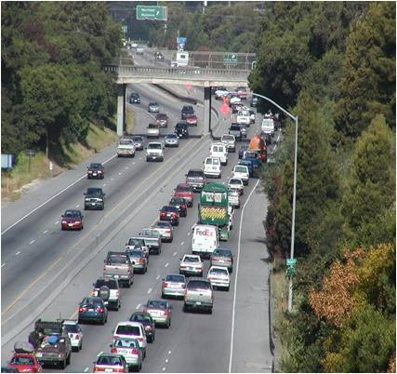
Determining significance Part 617.7
Notes:
A critical step
Karner butterfly endangered in NY
So, let’s take a minute and see where we are.
We’ve gotten a project in front of us. We’ve decided it is an action that requires SEQR review, we’ve classified the action (Type II, Type I or Unlisted) and as appropriate, we’ve coordinated the review with other involved agencies / parties to establish (for this exercise) the LEAD AGENCY.
Whew. And now it’s time to really get the SEQR review started.
Take the materials in front of us and work through whether or not we have possible environmental consequences – and decide what we are going to do about it or them.
Lead Agency determines significance which sets the path for the environmental review

Slide 37
Criteria
Adverse changes to the environment
Reduction of wildlife habitat
Hazard to human health;
Substantial change in the use of land
Creating a conflict with adopted community plans or goals
Impairment of “community character”
Notes:
617.7 (c) Criteria for determining significance.
To determine whether a proposed Type I or Unlisted action may have a significant adverse impact on the environment, the impacts that may be reasonably expected to result from the proposed action must be compared against the criteria in this subdivision. The following list is illustrative, not exhaustive. These criteria are considered indicators of significant adverse impacts on the environment:
List on slide: Condensed and not all inclusive

Slide 38
Evaluate impacts in context
Magnitude
Duration
Likelihood
Moderate (localized) Large (severe)
Short-term Medium-term Long-term Irreversible
Unlikely to occur Possibly will occur Probably will occur
Notes:
http://www.dec.ny.gov/permits/91450.html
Part 3 only addresses moderate to large impacts.
Understand What Makes an Impact Significant:
The significance of an impact is decided by evaluating the magnitude, duration, and likelihood of an impact occurring within the context (geographic scope, setting, and scale) of the project and project area.
Magnitude: Magnitude reflects both the area of land as well as the amount of a particular resource or the number of people being impacted.
Duration:
Likelihood: Given the nature of the project, some impacts may be very likely to occur while others may possibly occur, and others are unlikely to occur. The reviewing agency may decide that unlikely impacts may be of large magnitude or long duration but are ultimately not significant because they are so unlikely to actually occur. In other cases, an unlikely impact may carry such a high risk that the reviewing agency may decide it is very significant.

Slide 39
Context
Magnitude, duration & likelihood
Notes:
Reviewing projects in the CONTEXT in which they are proposed
All projects not just construction
Two “Big Box Stores”…see difference? Urban setting vs. Rural; parking requirements, amount of land needed to be cleared for project; compatibility with existing (or non-existent) development; new infrastructure vs. using existing
Target
Nicollet Mall, Minneapolis
www.faulkner.edu
Walmart
Madison Heights Virginia
en.wikipedia.org
Duration: Long term and likely irreversible

Slide 40
Will action have a potential significant adverse environmental impact?
Yes
No
Positive Declaration
EIS required
Negative Declaration
EIS not required
Process concludes
Notes:
There are generally two courses of action that the lead agency may take once rendering a determination of significance. Ask yourself, “will the action have a potential significant adverse environmental impact?”
Yes: Issuance of a Positive Declaration means that SEQR continues, and scoping will take place to make sure that issues of relevance will be discussed in the Environmental Impact Statement.
No: Issuance of a Negative Declaration concludes SEQR for the action. The determination of significance is to be recorded in Part 3 of the EAF. In the regulatory setting, the filing of a Negative Declaration completes the application pursuant to the SEQRA. Normal review processes may begin and the action can be acted upon.

Slide 41
Negative declaration
Analysis of adverse environmental impacts concludes:
No likely impacts identified; or
None identified are significant; or
Identified significant impacts are mitigated
Written determination must include reasons behind conclusions
Incorporate into any subsequent legal notices
6 NYCRR Part 617.7 (a) (2)
Notes:
A Negative Declaration means one of the three scenarios applies: there are no adverse environmental impacts identified; the impacts identified will not be significant; or, any potential impacts are mitigated by project plans. In other words, there is nothing to be gained by further analysis, and the preparation of an EIS will not be needed. Be explicit in “reasoned elaboration” and state whether you find each potential impact likely, significant, or neither. Describe any mitigation included in the project plans. Lastly, explain in your findings document how cited sources support your conclusions.
The regulations require that the classification and negative declaration must be incorporated into any subsequent notice required by law. In other words, if the lead agency has a obligation to publish a legal notice about the proposed action after it issues its negative declaration, the notice should include a brief reference to this effect. Only one subsequent notice needs to include this statement, not all subsequent notices.

Slide 42
Conditioned negative declaration
Criteria for CND determination
Only for Unlisted actions
Full EAF required
Coordinated review required
May be issued if imposed conditions will mitigate or avoid significant impacts
Publish notice in Environmental Notice Bulletin and provide at least 30 days for public comment
Must be rescinded and reissued as positive declaration if substantive comments identify that mitigation may not be accomplished
Notes:
A conditioned negative declaration (CND), otherwise known as a negative declaration with conditions, may be issued for those actions that meet certain criteria. First of all may apply to actions that are Unlisted actions—not Type I. Additionally, a coordinated review must have been the selected review method, with the submission of a Full EAF. This provision allows for an alternative to issuing a positive declaration where appropriate. For example, in the instance that easily articulated mitigation measures have been agreed upon during a meeting, it may appropriate to proceed with issuing a CND and wrapping up the SEQRA review.
Unlike the negative declaration, the CND requires a published a notice in the Environmental Notice Bulletin and that a minimum 30-day public comment period has been provided. The notice must state what conditions have been imposed. An agency may also use its own public notice and review procedures, provided the notice states that a CND has been issued, states what conditions have been imposed and allows for a minimum 30-day public comment period.
CNDs must be rescinded and reissued as positive declaration if substantive comments identify:
Impacts not previously identified or inadequately assessed
Deficiency in proposed mitigation measures
6 NYCRR Part 617.7 (d) (2)

Slide 43
After the negative declaration
Each agency returns to underlying procedures
Planning board or zoning board of appeals: site plans; subdivisions; variances; special use permits
Local legislative body: adoption/revision to zoning or comprehensive plan; funding or bonding
State or other local agencies: permits; grants, loans or bonds; construction; regulations
May be amended or rescinded prior to final decision if substantive changes proposed; new information discovered; changes in circumstances
Notes:
We will not need an EIS to conclude the review process under SEQR.
As noted, a written determination must include reasons behind conclusions.
There is no public comment period required.
Negative declarations may be amended or rescinded if at any time prior to final decision substantive:
Changes are proposed
New information is discovered
Changes in circumstances related to project arise and no significant adverse impacts will occur
6 NYCRR Part 617.7 (e) & (f)
Something to remember, in uncoordinated review, if any agency decides an EIS is required, the process goes back to coordination. All involved agencies who have not issued a final decision must then wait until Final EIS is done (Uniform Procedures Act and NYS General Municipal Law – some also in Town, City or Village Law)

Slide 44
Positive declaration
Intended for lead agency to apply low threshold
Action has potential to cause or result in at least one significant adverse environmental impact
Environmental Impact Statement required
If no coordination, one agency’s positive declaration supersedes another’s negative declaration
6 NYCRR Part 617.7 (a) (1)
Notes:
The SEQRA statute intends for the lead agency to apply a low threshold for issuing positive declaration, meaning a single potential significant adverse impact has been identified. Preparation of an environmental impact statement will be needed to further evaluate possible impacts,. The determination of significance is recorded on the front page of Part 1, where there is an attestation by the lead agency of a positive declaration. As previously mentioned, during an uncoordinated review, if any one of the agencies issues a positive declaration the process begins anew with coordination. All involved agencies who have not issued a final decision must then wait until the Final EIS is finished. Next we will further explore what the EIS should include.

Slide 45
Environmental Impact Statement

Slide 46
Environmental Impact Statement (EIS)
Disclosure document, the process by which:
Provides a means for agencies, project sponsors & public to systematically consider significant adverse environmental impacts, alternatives & mitigation
Facilitates the weighing of social, economic & environmental factors early in planning & decision-making process
6 NYCRR Part 617.2(n)
Notes:
An EIS is a disclosure document that aid the involved agencies in making their decisions.
An EIS provides a means for agencies, project sponsors and the public to systematically consider significant adverse environmental impacts, alternatives and mitigation
An EIS facilitates the weighing of social, economic and environmental factors early in the planning and decision-making process
A draft EIS is the initial statement prepared by either the project sponsor or the lead agency and circulated for review and comment. Part 617.2(n)
Also Generic & Supplemental
A draft EIS is the initial statement prepared by either the project sponsor or the lead agency and circulated for review and comment. An EIS may also be a "generic" in accordance with section 617.10, of this Part, a "supplemental" in accordance with paragraph 617.9(a)(7) of this Part or a "federal" document in accordance with section 617.15 of this Part.

Slide 47
Generic EIS
Broader & more general than site/project specific EIS
Should discuss logic & rationale for choices/options
May include assessment of specific impacts
May be conceptually based in some cases
May identify important natural resources, existing & projected cultural features, patterns & character
May discuss constraints & consequences of hypothetical scenarios that could occur
6 NYCRR Part 617.10
www.dec.ny.gov/permits/56701.html
Notes:
(a) Info contained in slide…
May be used to assess the environmental impacts of:
(1) a number of separate actions in a given geographic area which, if considered singly, may have minor impacts, but if considered together may have significant impacts; or
(2) a sequence of actions, contemplated by a single agency or individual; or
(3) separate actions having generic or common impacts; or
(4) an entire program or plan having wide application or restricting the range of future alternative policies or projects, including new or significant changes to existing land use plans, development plans, zoning regulations or agency comprehensive resource management plans.
(b) In particular agencies may prepare GEISs on the adoption of a comprehensive plan prepared in accordance with subdivision 4, section 28-a of the General City Law; subdivision 4, section 272-a of the Town Law; or subdivision 4, section 7- 722 of Village Law & the implementing regulations. Impacts of individual actions proposed to be carried out in conformance with these adopted plans and regulations and the thresholds or conditions identified in the GEIS may require no or limited SEQR review as described in subdivisions (c) and (d) of this section.
(c) GEISs and their findings should set forth specific conditions or criteria under which future actions will be undertaken or approved, including requirements for any subsequent SEQR compliance. This may include thresholds and criteria for supplemental EISs to reflect specific significant impacts, such as site specific impacts, that were not adequately addressed or analyzed in the GEIS
(d) When a final GEIS has been filed under this part:
(1) No further SEQR compliance is required if a subsequent proposed action will be carried out in conformance with the conditions and thresholds established for such actions in the GEIS or its findings statement;
(2) An amended findings statement must be prepared if the subsequent proposed action was adequately addressed in the GEIS but was not addressed or was not adequately addressed in the findings statement for the GEIS;
(3) A negative declaration must be prepared if a subsequent proposed action was not addressed or was not adequately addressed in the GEIS and the subsequent action will not result in any significant environmental impacts;
(4) A supplement to the final GEIS must be prepared if the subsequent proposed action was not addressed or was not adequately addressed in the GEIS and the subsequent action may have one or more significant adverse environmental impacts
(e) In connection with projects that are to be developed in phases or stages, agencies should address not only the site specific impacts of the individual project under consideration, but also, in more general or conceptual terms, the cumulative impacts on the environment and the existing natural resource base of subsequent phases of a larger project or series of projects that may be developed in the future. In these cases, this part of the GEIS must discuss the important elements and constraints present in the natural and cultural environment that may bear on the conditions of an agency decision on the immediate project.

Slide 48
Preparation of draft EIS (DEIS)
Initial statement circulated for review & comment
Prepared by project sponsor or delegated to lead agency
However, lead agency is responsible for determining adequacy of DEIS for public review within 45 days
30 day period for re-submission of a DEIS
Lead agency may charge fees to applicant in order to recover actual costs of either preparation or review of DEIS/FEIS, but not both
6 NYCRR Parts 617.9 & 617.13
Notes:
Prepared by, or caused to be prepared by, the lead agency. Ultimately, this document “belongs” to the Lead Agency.
If unacceptable, give guidance. Try to adhere to time frames (obligations more or less for lead agency; applicant or sponsor really has no clock for responding – it only effects them in the long run).
DEIS often prepared by sponsor and submitted to lead agency
Lead agency must review to determine if DEIS is “adequate”
Standard is sufficient to start public review
May be returned to sponsor for revision
Must provide specific written comments or suggested changes
Lead agency has 45 days for review
30 days if resubmission
When circulated to involved agencies, needs full cover page with contacts and dates
Minimum 30 day public comment period after filing Notice of Completion of DEIS
A draft EIS is the initial statement prepared by either the project sponsor or the lead agency and circulated for review and comment.
6 NYCRR Part 617.9 (prep)
6 NYCRR Part 617.13 (fee): No fee for prep of EAF & Det. of Sig.

Slide 49
Scoping the DEIS
Focus DEIS on significant issues
Identify what information is needed
Eliminate non-significant issues
Identify alternatives
Identify mitigation measures
Provide opportunity for other agency and public input
6 NYCRR Part 617.8
Notes:
Let’s talk a moment about scoping. OPTIONAL????
Alternatives & Mitigation—1 or more SIG issues have already been identified if POS DEC’d
Scoping must include an opportunity for participation by public and other agencies. It identifies relevant environmental effects of an action to be addressed in a draft EIS, in other words, it focuses on the relevant issues. It is also intended to create consensus among lead agency and other involved agencies.
Alternatives and mitigation discussions are core of the EIS; some differences in what NYS case law and feds consider alternatives available to a private sponsor.
Scoping may be initiated by the applicant / sponsor or required by the lead agency.
Scoping may be Formal or Informal:
FORMAL: Initiated by lead agency or requested by the project sponsor. Results in a written scope of issues that is controlled / the responsibility of the lead agency. The purpose is to narrow issues and ensure that the draft EIS will be adequate for public review and ensure public participation in the EIS development process.
INFORMAL: Draft EIS based on informal comments from the involved agencies and the “pos dec”. This is fine for small, readily defined actions with a relatively narrow range of clear cut impacts or issues. In general though, EIS’s without scopes often attempt to discuss every topic conceivable. A lead agency also risks not discovering issues or resources of local importance, or overlooking sources of information and local or site history.

Slide 50
Draft EIS (DEIS) content
Describe action
Define location & setting
Evaluate potential significant adverse impacts
Identify potential mitigation
Discuss reasonable alternatives
Analyze “no action” alternative
6 NYCRR Part 617.9 (b)
Notes:
The Draft EIS should be analytical—not technical, so that the lay person may understand the content. There is no regulatory requirement as to how lengthy the document must be. It is most important that the potential impacts of the action, mitigation measures, and alternatives are fully analyzed and explored. It’s acceptable that the result of scoping only reveal one impact, as long as all have been considered.
The range of mitigation measures or alternatives may include, as appropriate, alternative: sites; technology; scale or magnitude; design; timing; use; and types of action. For private project sponsors, any alternative for which no discretionary approvals are needed may be described. Site alternatives may be limited to parcels owned by, or under option to bed owned by, a private project sponsor.
Alternatives, such as the “no action,” scenario should be considered. Although adverse impacts may be avoided by the action not going forward as proposed, at the same time there may be positive impacts that go unrealized. For example, there could be a large influx of regional employment by an industrial park or facility being built. Remember that economic impacts are meant to be balanced with other resources and physical characteristics.

Slide 51
Public hearings
Optional under SEQRA
Should be held concurrently with any other required hearing on same project
Public notice at least 14 days prior to hearing
Hearing must start between 15 and 60 days after Notice of completion w/hearing published
Public comment period continues for at least 10 days after close of hearing
6 NYCRR Part 617.9 (4)
Notes:
A hearing is optional under SEQR, with that decision left to the lead agency. In making this decision on whether or not to hold a hearing, the lead agency must consider: (a) degree of interest shown by the public or involved parties, (b) whether substantive or significant adverse environmental effects have been identified, (c) adequacy of mitigation measures and alternatives, (d) extent to which a public hearing can aid the agency in the decision making process. However, hearings required by underlying legislation are not optional. If a municipality holds a hearing pursuant to the SEQRA, that hearing should be held concurrently with hearings required by statute, such as for subdivision, special use permit, or an appeal to the ZBA, or as might be required in local regulations for site plan review.
Some municipalities choose to hold an additional public hearing(s) earlier in the process. One reason being that public input may be beneficial to the lead agency’s decision making process when making a determination of significance. This is certainly an accepted approach; however, a public hearing held before the completion of the DEIS is not to be considered the official SEQRA public hearing.
Take note that the requirement for public notice is 14 days prior to hearing. This is a substantially longer timeframe than what is required of hearings for most land use decisions. Hearing must start between 15 and 60 days after DEIS notice of completion is published on the ENB. Lead agency needs to publish notice in the Environmental Notice Bulletin. The ENB is the official publication of the NYS DEC as required under Environmental Conservation Law Article 3-0306(4). It is published weekly, on Wednesdays.
A minimum 30 day public comment period runs after filing Notice of Completion of DEIS. The public comment period continues for at least 10 days after close of the hearing. SEQR public comment period must continue at least 10 days after hearing closes. After the lead agency accepts the DEIS, the lead agency must give public notice and provide for public comment. Lead agency must prepare and file a notice of completion to: DEC, any involved agencies and appropriate local municipal governments.

Slide 52
Preparation of FEIS
Lead agency responsible for completion within:
45 days after public hearing, or;
60 days after DEIS notice of completion if no public hearing
Notice of completion begins 10+ day period for involved agencies and public to consider FEIS
Lead agency may issue written findings afterwards
Notice of Completion of Draft/Final EIS
Notes:
For projects where the lead agency is reviewing an application and not funding a project itself, the FEIS should be completed within 45 days after a public hearing; or, within 60 days after the DEIS Notice of Completion (if no public hearing is held). As is the case with the DEIS, once the FEIS is completed, a Notice of Completion must be prepared. The Notice of Completion of the FEIS starts the “public consideration” period, between acceptance of FEIS and issuance of the findings statement. No involved agencies can issue findings or final decisions until a reasonable time period, not less than 10 calendar days, have passed.
The public consideration period is not the same public comment period for the DEIS. It is not a review period for additional comment, per se. Should a project modification occur or change of circumstance require a lead agency or involved agency to substantially modify its decision, this can usually be accomplished. But preparation of a supplemental DEIS is recommended if changes are significant.

Slide 53
Final EIS (FEIS) content
Revised Draft EIS
Supplements, if applicable
All comments received
Lead agency’s responses to substantive comments
6 NYCRR Part 617.9 (b) (8)
Notes:
The final EIS contains the original DEIS and any revisions. The Final EIS is the lead agency’s product and is responsible for accuracy and adequacy. Following the conclusion of the public comment period on the DEIS, the document must be revised if necessary, and completed. It must consist of the DEIS, with revisions or supplements; copies of, or summary of, the comments received; the lead agency’s response to substantive comments. General objections to the project need no response. The lead agency decides which comments on a Draft EIS must be responded to in the final EIS. Substantive comments relates to relevancy to impacts, mitigation and alternatives.

Slide 54
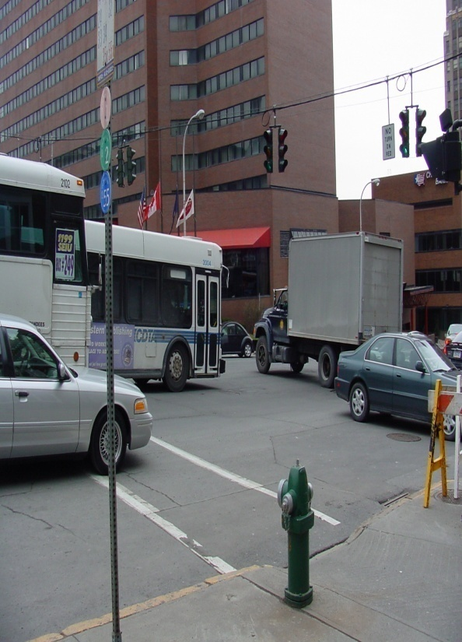
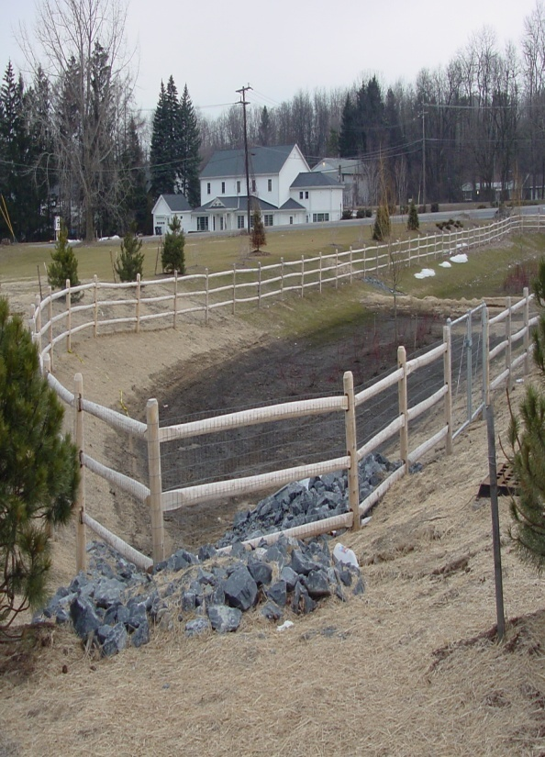
Conditions Part 617.3 (b)
Authority to impose substantive conditions that are practicable & reasonably related to impacts identified in EIS or in conjunction with CND
Notes:
Lead agency has the authority to impose substantive conditions that are practicable and reasonably related to impacts identified in EIS. Link information in FEIS to limitations or conditions to be included in agency decision. Imposing conditions as a result of findings in the EIS, is not the same as issuing a Conditioned Negative Declaration as a determination of significance; however, the authority for issuing a CND comes from the same area of statute. As mentioned earlier in the course, a CND is an option only for Unlisted actions—not Type I actions.
617.3(b) SEQR does not change the existing jurisdiction of agencies nor the jurisdiction between or among state and local agencies. SEQR provides all involved agencies with the authority, following the filing of a final EIS and written findings statement, or pursuant to subdivision 617.7(d) of this Part (CND) to impose substantive conditions upon an action to ensure that the requirements of this Part have been satisfied. The conditions imposed must be practicable and reasonably related to impacts identified in the EIS or the conditioned negative declaration.

Slide 55
Decision-making and findings
Findings must:
Consider information in FEIS
Balance environmental factors
Provide rationale for decisions
Certify rules have been followed
Certify chosen alternative mitigates adverse environmental impacts to extent possible
Findings & final decision may be made concurrently
SEQR Findings Form
Notes:
Each involved agency must make its own “findings” that relate information in the FEIS to that agency’s underlying action. They may borrow from the lead agency findings, but they must issue their own and should be consistent with those of the lead agency. Each Agency’s SEQR findings must consider information in the final EIS; balance environmental factors; provide rationale for decisions; certify that rules have been followed; and certify that chosen alternative avoid or minimize adverse environmental impacts to the maximum extent practicable. A decision of the underlying review process may be made concurrently with findings.

Slide 56
Filing and Publication
Notes:
This final section will address filing and publication requirements pursuant to 6 NYCRR Parts 617.12. This section of the regulations also requires that the lead agency retain all original SEQRA documents in an file which constitutes the record. The record must be readily accessible to the public and made available upon request. The municipality may require that requests are made in conformance with the Freedom of Information Law (FOIL). In the case that sufficient copies of the EIS are not available to meet public interest, the lead agency must provide an additional copy of the documents to the local public library.

Slide 57
Filing
What gets “filed”
Who gets a copy
Type I: negative and positive declaration
Unlisted: CND and positive declaration
Environmental Impact Statement
EIS Notice of completion
Notice of hearing
Findings
Involved agencies
Applicant
Individuals upon request
Chief Executive Officer
Additional filing may be applicable
NYS DEC: EIS only
NYS DOS: EIS only in coastal areas
Notes:
‘Filing’ simply means providing a copy of a specific document. The SEQR documents subject to filing requirements include the determination of significance, environmental impact statement, EIS notice of completion notice of hearing (if on was held), and findings. For Type I actions, Negative and Positive Declarations require filing. Only Positive and Conditioned Negative Declarations are subject to those requirements for Unlisted actions. Part 3 of the new EAFs, have incorporated a ‘statement of significance’ that may be used for the purpose of filing determinations of significance.
Copies of these documents must be provided to all involved agencies, the applicant (if applicable), any individuals upon request, and the municipal Chief Executive Officer (CEO), which may be a village or city mayor or town supervisor. Additional filing requirements come into play if an Environmental Impact Statement (EIS) has been prepared. A copy of the EIS must be sent to the NYS Department of Environmental Conversation. If a state action is located in a coastal area, another copy of the EIS must be sent to the NYS Department of State.

Slide 58
Environmental notice bulletin (ENB)
Official online publication www.dec.ny.gov/enb/87269.html
Type I: negative and positive declaration
Unlisted: CND and positive declaration
Notice of completion of EIS
Published weekly: 6 PM Wednesday submission deadline for publishing following Wednesday
Submit ENB Notice Publication Form by email or mail:
enb@gw.dec.state.ny.us
ENB, NYS DEC, 625 Broadway, 4th Floor, Albany, NY 12233
Notes:
The Environmental Notice Bulletin is the official notice bulletin of the New York State Department of Environmental Conservation (DEC). Published in the ENB you will find notices of complete applications for environmental permits, and notices produced by state and local agencies for activities that are being reviewed under the State Environmental Quality Review Act (Article 8, ECL). Notices of DEC hearings, proposed and adopted changes to DEC policy, and technical guidance and regulations are among the other contents of the ENB.
Determinations of Significance—Negative and Positive for Type I actions and Conditioned Negative and Positive for Unlisted actions—and notices of completion of an Environmental Impact Statement must be published here. A specialized form for ENB submissions may be accessed online. Submissions for publication in the ENB are due by close of business Wednesday for publication in the following week's issue. The preferred manner of submission is by e-mail, but notices may also be sent my mail. Faxes will not be accepted.

Slide 59
New York Department of State
(518) 473-3355 Division of Local Government
(518) 474-6740 Counsel’s Office
(800) 367-8488 Toll Free
Email: localgov@dos.ny.gov
Website: www.dos.ny.gov
www.dos.ny.gov/lg/index.html

Slide 60
Contacting the NYSDEC
(518) 402-9167 Division of Environmental Permits
Email: deppermitting@dec.ny.gov
Website: www.dec.ny.gov
www.dec.ny.gov/permits/357.html

