Slide 1
Jeff T. Behler Regional Director, New York Regional Office U.S. Census Bureau New York State Data Center Affiliate Meeting May 7, 2015
What’s New & Upcoming in 2015
Notes:
Good morning, ladies and gentlemen. I’m very pleased to address the meeting of the New York State Data Center affiliates. This is the first time I’ve had the honor of speaking here, and I’d like to thank Laura Close and the New York State Department of Labor for working with the Census Bureau to provide this venue for the exchange of information that will be crucial for all of us going forward.

Slide 2
Overview
2020 Census Updates
2015 Census Tests
2020 Geographic Partnership Programs
American Community Survey Updates
American Fact Finder
Economic Census Releases
Notes:
2015 is an important year in the Census cycle. The planning for the 2020 Decennial Census, which was begun in 2010, is now in a stage where critical design plans and testing are required to formulate strategies to realize the spending limitations imposed by Congress – that we will spend no more on the 2020 Census than we did on the 2010 Census.
The ACS has undergone some changes, and content planning and review is underway.
As many of you have heard by now, American Fact Finder is going away. What will replace it, and when?
And, the final releases of the 2012 Economic Census are due this year. We will discuss the schedule of the small area geography releases.

Slide 3
2020 Census: Where Are We Today?
In the next census, we will be trying to reach an increasingly diverse and growing population of around 330 million people in more than 140 million housing units.
The Census Bureau is conducting research in order to inform key design decisions by the end of FY 2015.
3
Notes:
In an effort to contain costs while continuing to ensure an accurate enumeration, the Census Bureau is researching and testing new methods and technologies. This September, the Bureau plans to announce its preliminary design for the 2020 Census, and in October 2018 the Bureau plans to have all systems and processes for the 2020 Census developed and ready for operational testing. As Census Day 2020 gets closer, the margin for schedule slippages is becoming increasingly narrow.
The successful execution of the 2020 Census also depends on the effective implementation of a large and complex information technology (IT) development effort. This effort – the Census Enterprise Data Collection and Processing (CEDCAP) program – is intended to result in an interconnected set of systems to serve all the Bureau’s data collection and processing functions, including the systems and infrastructure needed to support the 2020 Census cost-saving initiatives.

Slide 4
2020 Census Operational Research and Development Efforts
Reengineering Field Operations
Optimizing Self-Response
Utilizing Administrative Records
Reengineering Address Canvassing
Up to
$5 Billion
in Savings
Through:
4
Notes:
The 2020 Census cost-saving initiatives are fourfold:
Savings of $1 billion by Reengineering the processes for updating the Bureau’s address list and map databases to reduce the need for employing field staff to walk every street in the nation to verify addresses.
Savings of $500 million by maximizing the self-response of households (and thus minimizing expensive in-person data collection) by offering an internet response option, social media advertising, and allowing respondents to respond without a unique identification code. The goal here is to communicate the importance of the 2020 census to our population to help generate the largest possible self-response and to reduce the need to follow up with those non responding housing units in the field.
Savings of $1.2 billion by expanding the use of data previously obtained by other government agencies. The goal here is to use administrative records, that is information from federal and state governments in addition to third party data, as well as data from commercial sources to help reduce the nonresponse follow up; and to identify vacant units and to enumerate nonresponding housing units.
And savings of $2.3 billion by reengineering field operations to automate case management and data collection, and using a new field structure with different field staff roles, work schedules, office configurations and staffing ratios.

Slide 5
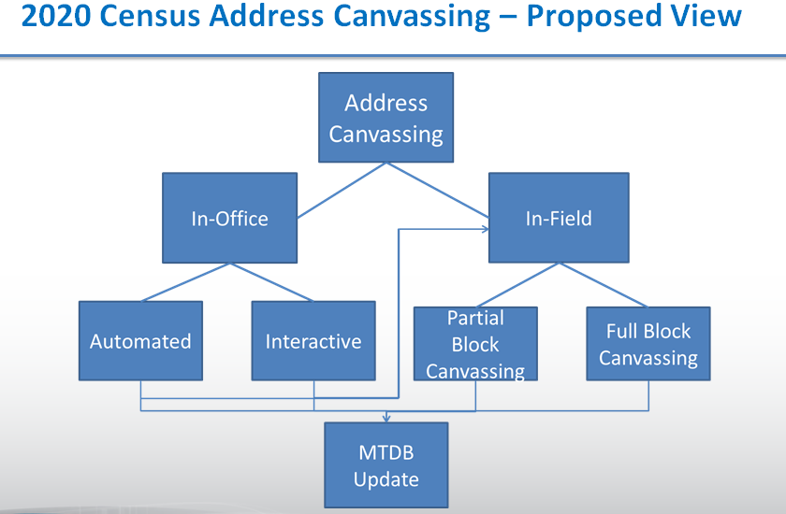
2015 Testing Activities
Address Validation Test
Informing the performance of the methods and models that will help us develop the address list
Testing the use of aerial imagery for change detection
Assisting in the delineation of the Reengineered Address Canvassing workloads
Full-Block Canvass: 10,100 blocks
Partial-Block Canvass: 600-1000 blocks
5
Notes:
The Address Validation Test contained two components. The first, a full-block canvass, will assess the ability of two sets of statistical models to predict blocks that have experienced address changes that have not already been captured in the Master Address File (MAF). The second component of the AVT is to assess a methodology that uses geographic specialists (a) to detect unrecorded changes in blocks, and (b) to identify portions of blocks where change is likely, thus enabling a partial-block canvass that could reduce workloads and cost.
We completed our 2020 census address canvassing business models to help model the flow of activities from start to finish in this terms of how we implement both in-office and in-field canvassing. We released information on change detection, we conducted market research to help us identify the available sources, processes, software and related technologies to help detect change on the landscape both in terms of structures, houses and street center lines. And in addition we've prepared a statement of work for a geospatial services Request For Proposal. This RFP will help determine the availability of commercial address and road data to help support a reengineered address canvassing.
Looking ahead, we're planning to complete our summary of responses to that change detection RFP. We will release the geospatial services RFP in May of this year, and we will release our validation test report identifying findings from those tests and finally develop a 2020 Census address canvassing capability and solution requirements.

Slide 6
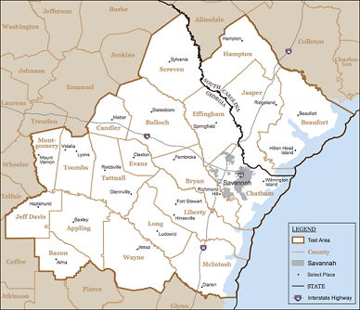
2015 Testing Activities
2015 Optimizing Self-Response Test
April 1, 2015 Census Day
A site test conducted in the Savannah, Georgia area, including neighboring counties in South Carolina that constitute the media market for Savannah
Continue testing pre-registration and “Non-ID” response to determine if we can optimize self and Internet response rates
Further refine the procedures for pre-registration in the Census
Study the feasibility of implementing real-time processing for the “Non-ID” response option
Research how advertising, outreach, and promotion can engage and motivate respondents for action
6
Notes:
Let's now turn to optimizing self-response.
The goal here is to communicate the importance of the 2020 Census to our population to help generate the largest possible self-response and to reduce the need to follow up with those non responding housing units in the field.
We're in the process of conducting the optimizing self-response test in the Savannah, Georgia media market. This location was selected in part because of the wide distribution of two Type of Enumeration Areas (TEA) here. The area is almost evenly divided between Mailout/Mail Back and Update/Leave.
On February 23rd we started our Notify Me test. The respondent could opt for messages for e-mail or text. We began our advertising campaign on February 23rd as well and it's quite extensive.
We began self-response data collection on March 23rd. We sent our first reminder March 27th and on March 30th we did see a bump in the response rates. We found that encouraging people to respond via the internet, our internet push strategy, does work.
Census day was April first and we will continue with our activities.
We will complete our data collection for the optimizing self-response test at the end of May.

Slide 7
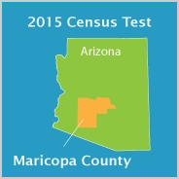
2015 Testing Activities
2015 Census Test
April 1, 2015 Census Day
Like the 2014 Census Test, this will be a site test and conducted in portions of Maricopa County, Arizona – 165,000 housing units in sample
Reengineer the roles, responsibilities, and infrastructure for the field
Evaluate the feasibility of fully utilizing the advantages of technology, automation, and real-time data to transform the efficiency and effectiveness of data collection operations
Automate training for enumerators and managers
Test and implement routing and/or navigation
Reengineer the approach to case management
Continue to research uses of administrative records to reduce and manage fieldwork
7
Notes:
The 2015 Census Test in Maricopa County will look at ways to improve the efficiency and effectiveness of “nonresponse follow-up.”
The goal here is to really use technology more efficiently and more effectively. To help manage tasks that traditionally have been conducted by humans, we're looking at reducing the field management structure, and we're working with a sophisticated operational control system to help us manage the workload during nonresponse follow up and we're looking at ways to automate training instead of using those stacks of verbatim paper manuals that we have in the past.
We opened the Local Census Office on January 26th and we have hired all field managers that will be working on that test.
We began our self-response data collection on the same day as the Optimizing Self Response test on March 23rd. We sent our self-response reminder on March 27th. And with this test, too, we saw a bump after that mailing.
Census day was April 1st. We will begin conducting our nonresponse follow up operation, on may 14th, and we're hiring enumerators for all three of our panels right now.
Using on a hand held device to enumerate housing units was also very successful. We have had very few glitches in the field and we learned we can reduce the number of nonresponse follow up pieces, through the use of administrative records. We'll complete our nonresponse data collection by June 23rd of this year.

Slide 8
2015 Testing Activities
2015 National Content Test
Will be a nationally representative sample, with oversampling of key sub-population groups – 1.2 million housing units in sample
September 1, 2015 Census Day
Conduct content testing
Race and Hispanic origin
Introduction of a Middle Eastern and North African category
Relationship
Introduction of same-sex relationship categories
Within-household coverage questions
8
Notes:
The 2015 National Content Test has two primary objectives:
Evaluate and compare different census content, including race and Hispanic origin, relationship, and within-household coverage.
Test different contact strategies for encouraging households to respond and, specifically, to respond using the less costly and more efficient Internet response option.
The key content to be tested in the 2015 NCT is related to within-household coverage, relationship, and race and Hispanic origin. The test will also include continued testing, building on our tests in 2014 and earlier in 2015, of contact strategies to optimize and maximize self response, particularly Internet self response. Mostly, those strategies are related to timing and format of mailings and reminders.
The specific sample designs for the 2015 NCT are currently under development, but the test will use a nationally-representative sample, including Puerto Rico, with oversampling of key population groups. The 2015 NCT is scheduled take place from August to November 2015, with September 1 as the Census Day.

Slide 9
2020 Census: What’s Next?
9
Notes:
Over the past couple months the 2020 Directorate has conducted a thorough review of the structuring of the schedule. It's important to stress that the content of the schedule has not changed.
All of the lines are still in the schedule, however the 2020 team has done a careful analysis of the way they organize their tiers.
Building IT systems and software is critical to the mission of reducing costs of the 2020 Census. One of the options that has been extensively tested is the Bring Your Own Device (BYOD) concept. It is hoped that substantial savings can be realized by having the enumerators use their own tablets, pads, or phones to collect decennial (and eventually all survey) responses.
Finally the 2020 planning group continues mitigating their project level risks. For FY 16 there has been added a new risk related to fiscal year funding as they do every year. This risk reads that in order to execute a 2020 Census to reduce cost while maintaining quality, the Census Bureau needs to receive the appropriate funding for the entire life cycle.
If FY16 funding is less than requested, then we will not benefit fully from the subsequent research.
As important as 2015 is in the Census cycle, in each subsequent year planning and testing become more and more critical.

Slide 10
2020 Geographic Partnership Programs
Redistricting Block Boundary Suggestion Project (BBSP)
Materials available to states in December 2015 – Verification in December 2016
Redistricting Voting District Project (VTD)
Materials available to states in December 2017 – Verification in December 2018
Local Update of Census Addresses (LUCA) Program
Invitation Fall of 2017 – Materials available Winter 2018 – Feedback shipped Summer 2019
Participant Statistical Areas Program (PSAP) & Tribal Statistical Areas Program (TSAP)
In planning – Materials available in December 2018
Boundary and Annexation Survey (BAS)
Annual response in December and January of each year – Submit material through May
Boundary Validation Program (BVP)
Highest Elected Official initial notification January 2020
Final review of BAS 2020 May or June 2020
10
Notes:
The planning for the 2020 Geographic Partnership programs is well underway; and as with all planning functions, some of the programs are further along than others. This shows the current schedule for the programs that many of you will be asked to participate in. I will briefly describe where we stand with each of the programs.
The Redistricting project will be the first to get underway – the primary difference between 2020 & 2010 will be that the regional offices will not be involved – this will be conducted exclusively from the Redistricting Data Office, Geography Division and the National Processing Center.
The 2020 LUCA Program will feature substantial changes from the 2010 program. Mike Horgan will address these in his presentation later today.
No substantial changes are anticipated for the 2020 PSAP/TSAP. The basic partnership structure is to be maintained, relying on county planners and regional planning authorities.
The Boundary & Annexation Survey, after a hiatus in 2014 due to sequestration cuts, has returned for 2015. We hope to continue the BAS annually through 2020, when it will be supplemented by the Boundary Validation Program.
We will also replace the MAF/TIGER Partnership Software with a new, more flexible interface called Geographic Update Partnership Software (GUPS). The GUPS will be required for all of the above programs, with the exception of BAS & BVP, where it will be optional. The GUPS will provide a web based as well as a stand alone application, and can be utilized by GIS users of all skill levels.

Slide 11
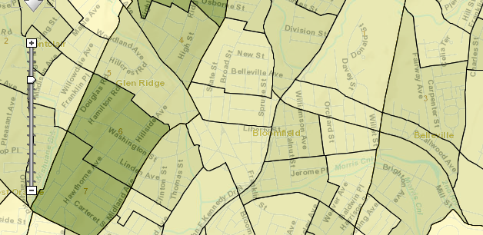
American Community Survey
Product Changes of Note
Discontinuation of the ACS 3-Year Estimates
2013 3-Year will be that last release – no 2014 3-Year release
Budgetary reasons
Rely on 5-Year Estimates for communities < 65,000
Block Group Data Added to American Fact Finder
Previously only available through the ACS Summary File.
Discontinuation of the ACS Summary File Retrieval Tool
Since Block Group Data now available in AFF, this was deemed unnecessary
11
Notes:
As I’m sure all of you probably know by now, in the fiscal year 2016 budget request, the Census Bureau proposed not reinstating the three-year product. There will be no release of the 2014 3-Year estimates this year. This will reduce the topicality of data for populations of geographies that are less than 65,000. They will, however, still be available in the 5-Year estimate. There has been strong resistance to this measure, especially from the State Data Center affiliates, but the 3-Year estimates were deemed the least used of the ACS datasets, and thus recommended for removal in a tight budgetary climate.
Perhaps the best ACS news in some time is that of being able to display and download ACS Block Group data via American Fact Finder. This allows for greater flexibility in downloading data for the smallest geographies in the ACS 5-Year universe. The user can now also download custom Block Group shapefiles for use in GIS directly from American Fact Finder. Since this functionality as been added to AFF, the ACS Summary File Retrieval Tool was deemed unnecessary, and will be discontinued.

Slide 12
American Community Survey
2014 -2015 Content Review
Candidates for Removal
Business or Medical Office on Property (H6)
Field of Degree (P12)
Marital History (P21, P22, P23)
12
Notes:
For the 2014-2015 Content Review, three subjects have been identified as candidates for removal from the ACS: Business or Medical Office on Property, Field of Degree, and Marital History. Field of Degree and Marital History were added to the ACS during the 2008-2009 Content Update. The goal of the Content Review is “To continually balance the level of effort to complete the survey with the ongoing and emerging needs of the federal government, the federal statistical system, and the nation for small area and small population information.
To meet this goal, the Census Bureau follows these four steps. First, the federal agencies articulate needs, then the Census Bureau and OMB assess needs. Following that, the ISCP (Interagency Council on Statistical Policy) subcommittee advises Census and OMB. Finally, the Census Bureau and OMB make content decisions. Under the Paperwork Reduction Act, the OMB approval process ensures the practical utility of the data, and minimizes respondent burden. The ICSP Subcommittee for ACS was chartered in 2012 to provide a broader perspective and advise Census and OMB when making content decisions.
Based on the review and feedback the from the call for comments Census Bureau released a Federal Register notice on April 28th proposing:
- Eliminating the business on property question
- Keeping the field of degree and marital history questions
There will be a 30 day public comment period on these recommendations, and the US Office of Management and Budget will review the comments and issue a decision.
As the timeline shows, after reviewing Federal Register Notice comments, OMB will give the Census Bureau its decision on 2016 content in June.

Slide 13
American Community Survey
Next ACS Content Review Update
Webinar Tuesday, June 23 2015
http://www.census.gov/acs/www/events/
View the ACS Content Review Web Page
Ongoing dialog and technical documentation
http://www.census.gov/acs/www/about_the_survey/acs_content_review/
ACS User Stories
We want to hear from our users how you use our data
Email william.w.adams@census.gov
13
Notes:
In the next ACS Content Review webinar, June 23, the ACS Office will discuss results of the first phase of the project, public comments received in response to a 60-day Federal Register notice published about the results, and next steps. The presentation will be followed by 10-15 minutes of questions and answers.
The Census Bureau also is providing access to the full set of comments received in response to the original 60-day Federal Register notice, and to the documentation package submitted to the Office of Management and Budget for its final determination on these planned actions. All of these materials will be available on the ACS Content Review Web page.
Pleased be advised that the Census Bureau is interested in your opinions, not just on the content of the ACS, but for how you use the ACS data. Having documentation from the data users is a potent weapon the we can use to maintain (and hopefully increase) appropriations for the American Community Survey. To that end, the Communications Directorate and the ACS office are actively collecting and documenting user stories on behalf of the New York state ACS users. If you’d like to participate, and increase the awareness of the broad use of the ACS, please contact Web Adams – he is here and has a lot of business cards to distribute.

Slide 14
American Fact Finder
AFF to be completely decommissioned by July, 2017*
Original plan was to have AFF sunset by July, 2016
From August, 2016 to July, 2017 AFF will run alongside replacement app*
AFF to be replaced by an As Yet Unnamed application
Starting Nov-Dec 2015, password protected version for SDC testing*
Testing version for Microdata Analysis & Advanced Queries
August 2016 – eventual replacement beta to run alongside AFF*
CEDSCI platform
Cost savings through elimination of duplicate systems & processes
Improved customer satisfaction through metadata standardization
Mapping, visualization & mash-ups integrated into search & data
*Please be advised – all dates are subject to change
14
Notes:
Perhaps the worst kept secret of the past year is that of the eventual demise of the American Fact Finder. The good news is that AFF will be available until July, 2017. And, if you have noticed the ‘Star’ table recommendation selection in AFF that came about in March, you recognize that AFF continues to be maintained and enhanced.
The previously announced schedule to have AFF decommissioned by July 2016 has been extended to allow Fact Finder to exist alongside its replacement app for approximately one year. The new, as yet unnamed application that will replace AFF is in development and well underway.
It is to be run off the CEDSCI (“sed-sy”- Center for Enterprise Dissemination Services and Consumer Innovation) platform; this is the platform for all current and future data dissemination applications. The primary goal is to eliminate duplicate data retrieval systems and more effectively manage the distribution of Census data. This system will deliver services for customers that include mapping, visualizations, and data mash-ups enabled across all our data sets, eliminating the current “siloed” approach.
CEDSCI plans to release a password-protected beta version of the new data dissemination app for testing to the SDCs around the end of this calendar year. This beta version will concentrate on metadata analysis and advanced queries.
Also note – these dates are approximate and subject to change.

Slide 15
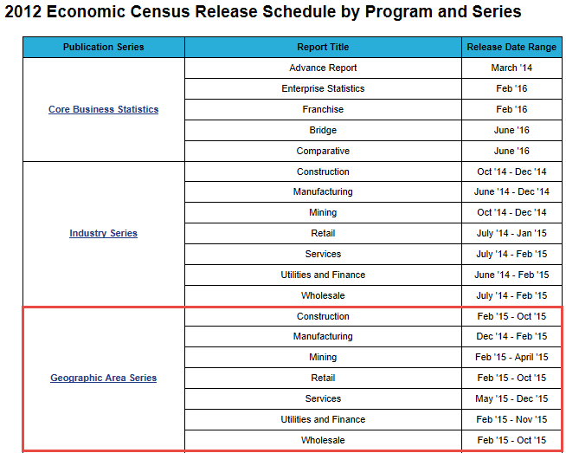
2012 Economic Census – Geographic Area Series
State Release Order
Group | State(s) | Group | State(s)
1 | CO | 10 | DE, DC, MD, NJ, OH, PA, VA, WV
2 | HI | 11 | KY, NC, TN
3 | MT | 12 | IL, IN
4 | AK | 13 | AL, AR, GA, LA, MS, SC
5 | ME | 14 | IA, MO, NE, SD
6 | AZ, NE | 15 | KS, MI, MN, ND, OK, WI
7 | CA | 16 | NM, TX
8 | ID, OR, UT, WA, WY | 17 | FL, US
9 | CT, MA, NH NY, RI, VT
15
Notes:
The Geographic Area Series is the final release of the 2012 Economic Census. This release is the most detailed and most comprehensive, and realizes the culmination of the 2012 cycle. The releases are conducted in a flow cycle, by groups, and New York is grouped with the New England states in order of release. The highlighted release schedule indicates that the entire program will be totally released by December.
In the lower right we show a table that indicates the releases so far for New York. The Manufacturing Geographic Area Series was released on January 27, and the Construction sector statistics were released on March 31. I have it on very good authority (Andy Hait, who with Earline Dowell will be demonstrating new economic data access tools tomorrow) that the Retail sector Geographic Area Series data for New York will be available by July. All Economic Census data is accessible through American Fact Finder.

Slide 16
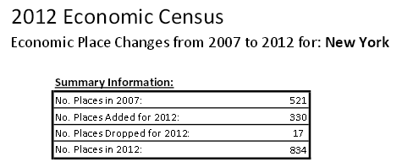
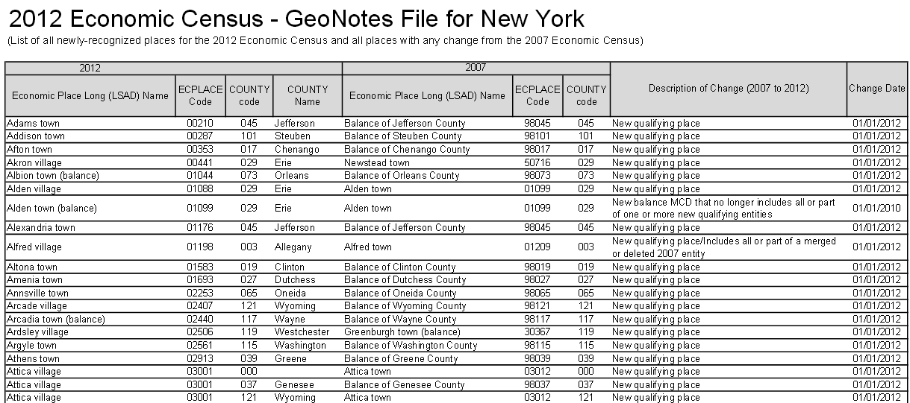
2012 Economic Census – Geographic Area Series
New Places
2007 EC cutoff: 5,000+ Pop or Jobs; Now 2,500+
Results in 330 New Places for NY
16
Notes:
The lower threshold for the Geographic Area Series means that all Census Bureau geographic places (towns, cities, villages and Census Designated Places) with population in excess of 2,500 will have 2012 economic data published and available via American Fact Finder. This means that 330 additional places will be reported in this cycle.
When the 17 places that received statistics from 2007 but fell beneath the reporting threshold for 2012 are subtracted from this total, it means that there is a net increase of 313 places with Economic Census data for 2012.

Slide 17
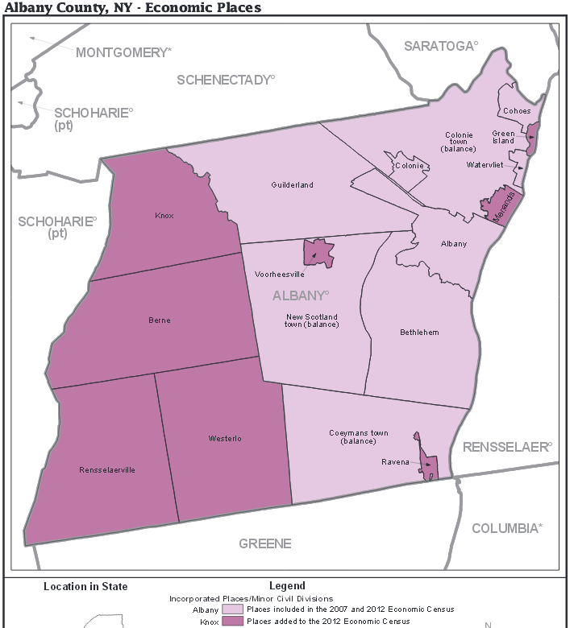
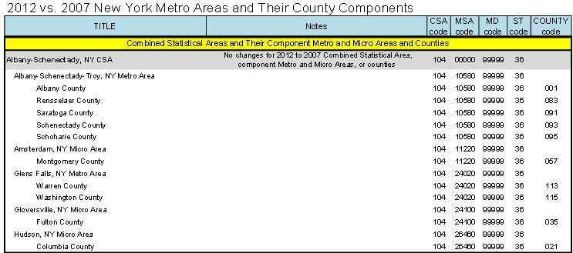
2012 Economic Census – Geographic Area Series
Graphic and Tabular Representations
Maps & tables of coverage
Metro area & place representation
17
Notes:
At the Economic Census website (business.census.gov) representations of the coverage areas of the 2012 Economic Census may be found. As you can see from these two examples, we publish economic data for Metro and Micro Statistical Areas – and illustrate coverage for every county. In this map example, the darker purple designates the geographic place new for the 2012 Economic Census. So, for the first time, Albany County will get wall to wall coverage of all its constitent parts in the Geographic Area Series. Also, you may notice that the towns with a village residing within them will be reported as, for instance, New Scotland town (balance). This ensures that there is no double reporting of data, and that the entire town’s statistics may be calculated by adding the balance number to Voorheesville’s number.

Slide 18
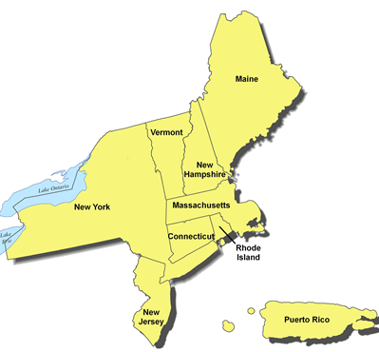
Contact Information
U.S. Census Bureau –
New York Regional Office
Data Dissemination Branch
(212) 584-3440 http://www.census.gov/regions/new_york/

