Slide 1
State Data Center Annual Affiliate Meeting New York State Department of Labor
Earlene Dowell
LEHD Program
Center for Economic Studies
U.S. Census Bureau

Slide 2
Local Employment Dynamics Partnership
Then:
Begun in late 1990s with a few states
Goal to generate new labor market statistics from existing records (UI and firm info)
Now:
53 partner states/territories
3 data products
4 web-based data tools

Slide 3
Building on State Inputs
We combine state records with other admin/census/survey data from the Census Bureau and other Federal agencies
We can then create public statistics on:
Firms & Establishments
Jobs & Workers
By Firm and Person Characteristics
Without new respondent burden

Slide 4
Protecting Personal Information
Some records enter the Census Bureau with SSNs, some with other personally identifiable information
First, the SSN is replaced with a “protected identification key” (PIK).
The PIK is used for all further matching.
Person Data

Slide 5
LEHD Processing: Merging Data
Unemployment Insurance Earnings Records
Employer-Worker
(most states)
OR
Establishment-Worker
(Minnesota only)
Earnings
Job history
Quarterly Census of Employment and Wages
(QCEW)
Employer and
Establishment
(Single/Multi-unit)
Geography
Industry
Ownership
UI Account Number (SEIN)
PIK (encoded SSN)
Federal EIN
Business Dynamics Statistics (BDS)
Firm age and size
Census, Surveys,
Other Administrative Records
Demographics
Place of Residence

Slide 6
LED Data Products
Quarterly Workforce Indicators (QWI)
Employment, Job Creation, Job Destruction, Hires, Separations, Turnover, Earnings
By industry, county, and worker characteristics
LEHD Origin Destination Employment Statistics (LODES)
Employment and Workplace-Residence Connections
Detailed geography + firm/worker characteristics
Broken in three categories
Job-to-Job Flows (Beta)
Job-to-Job Flows (J2J) is a new set of statistics on worker reallocation in the United States. It provides data on worker flows resulting from job change as well as hires and separation from and to persistent nonemployment spells. Also included in the new statistics are origin-destination data on workers changing jobs

Slide 7
Who Uses Our Data Tools?
Transportation Planners
Policy Makers
City Planners
State Planners
Economists
Emergency Management Professionals
Notes:
Transportation planners - who are interested in peoples’ commutes, parking issues, or migration.
Policy makers - use our data to evaluate the size of the workforce, the density, the age, and earnings of their area.
City and State planners - use the data to analyze the recession by studying metrics of the long history of industry details and job loss.
Economist - look at the demographic shifts, economic sustainability, or industrial impact on taxable sales.
And Emergency Management professionals may need to look at the impact of the potentially affected area or learn from the history of a disaster.
You can find many of these examples on our homepage, LEHD.ces.census.gov under the Learn More tab.

Slide 8
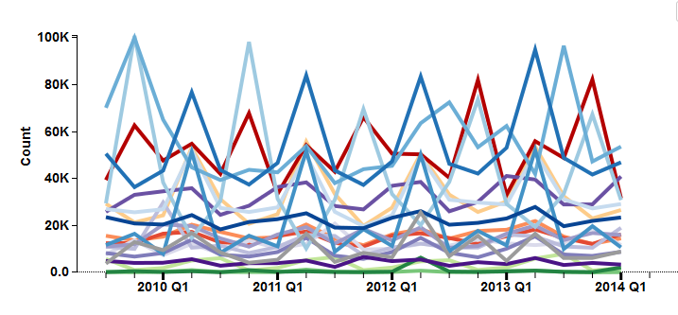
QWI Explorer
Detailed workforce dynamics, by worker characteristics and firm characteristics
Popular uses:
Local workforce demographics
Local industry workforce trends
Workforce turnover, job creation and destruction
Health Care and Social Assistance
Educational Services
State of New York – Job Creation
Notes:
Job Creation - Estimated number of jobs gained at firms throughout the quarter. This measure counts total employment increase at firms that grew over the course of the quarter.
Regions with most new jobs?
Industries most likely to create jobs?
Which industries are most likely to create jobs that younger workers gain?

Slide 9
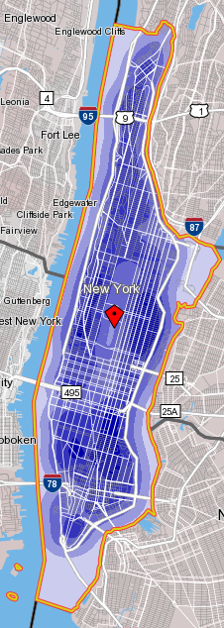
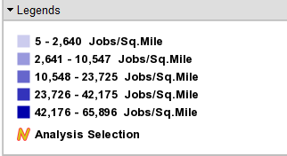
OnTheMap: Where workers live, and where they work
This map shows LODES data of where workers of New York county live
Popular uses:
local economic development
business site selection
emergency planning
Notes:
Home Area Profile Analysis

Slide 10
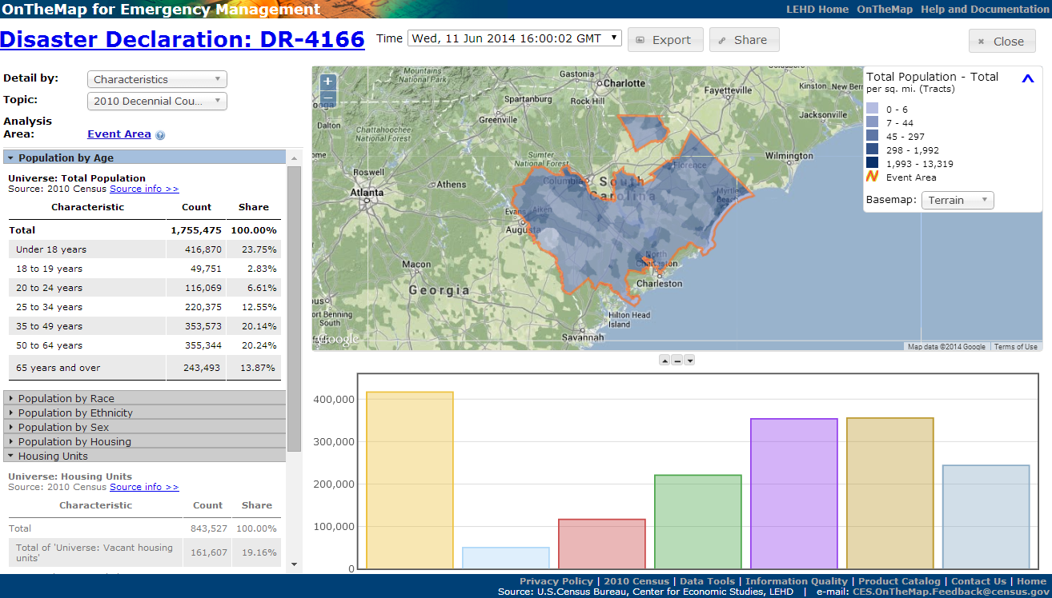
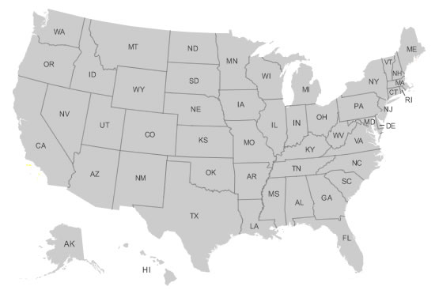
OnTheMap for Emergency Management
Hurricanes, Floods,
Winter Storms
Disaster Areas
Wildfires
Demographic & Economic Data
New Public Data Service for Emergency Preparedness & Response
Comprehensive Reports
Real-time Data Updates
Easy-to-use & Interoperable
Historical Event Archive
Flexible Analyses & Visualizations
Notes:
DR-4166 – South Carolina Severe Winter Storm
Assessing Workforce Impacts
Identify the number and location of affected workers
Examine workforce demographics
Identify affected Industries
Visualize where affected workers live
Assessing Population & Housing Impacts
Identify the number and location of affected residents
Examine population demographics of affected areas
Identify vulnerable population groups
Examine housing characteristics of affected areas
Emergency Preparedness & Response Planning
Where should response efforts concentrate?
Are there special or vulnerable population segments?
Uncover surrounding communities with secondary affects to workforce

Slide 11
Job-to-Job Flows
Notes:
New data set on worker reallocation in the United States. The national data distinguishes:
Rates of job change, by worker age, education, race and ethnicity
Worker separations to persistent nonemployment, by demographics
Hires from persistent nonemployment, by demographics
Origin-destination data for workers changing jobs
And, earning and earnings change associated with job change

Slide 12
Public Data Tools
All tools are free and available 24/7.
Live Demonstrations of
LED Extraction Tool (QWI)
QWI Explorer
OnTheMap
OnTheMap for Emergency Management
Notes:
Use New York Metro/Micropolitan Area for all examples

Slide 13
Hands-On Activities

Slide 14
QWI Explorer
We are Economic development consultants for the state of New York. The governor has asked the Department of Labor about strategies for bringing higher wage jobs to the Albany, NY metropolitan area.

Slide 15
QWI Explorer
Notes:
We will use the QWI data to look at Albany’s historical average monthly earnings (EarnS) broken out by the age of the firm. From these tables and charts we hope to glean some insight into whether business development policies should encourage new firms to start or entice existing firms to relocate to the Albany metro area.
Select New York
Select Earn S under Indicator
Under Sub-State Geography – under Geography Type arrow down to Metro/Micropolitan Areas, then click on Albany-Schectady-Troy, NY and OK
Under Firm Ownership click All Private (At this point you can see that majority of the high earners are 35 and above)
Under the X-Axis change to NAICS Sectors
Under the Group box change to Firm Age, then click on the blue Five Firm Ages Selected and click Check All then click OK
Go back to Quarters and click on the blue 2014 Q1, Click the check mark under Q1 then unclick the first Quarter 2014 and Unclick the last Quarter 2000 then click OK
If we click the All Firm twice it will have the earnings of Firms in ascending order ranking Finance and Insurance at the top after Utilities earning $4,890 in the start up companies and $6,095 in the companies 11+.
While Accommodation and Food Services start ups monthly salary is $1,106 and more than 11+ years $1,385.

Slide 16
OnTheMap
How many workers are located one mile from Albany International in a three mile radius that are start-ups?

Slide 17
OnTheMap

Slide 18
OnTheMap for Emergency Management
What is the population of 65 and older living alone during Hurricane Sandy in Albany County, NY?
Notes:
This determines what areas need assistance and what proportion of resources they require, in comparison with neighboring areas.

Slide 19
OnTheMap for Emergency Management

Slide 20
Thank You
Local Employment Dynamics
lehd.ces.census.gov
Contact
Earlene.KP.Dowell@census.gov
Tools
QWIExplorer.ces.census.gov
LEDExtract.ces.census.gov
OnTheMap.ces.census.gov
OnTheMap.ces.census.gov/em.html

