Slide 1
Using Census Bureau Data to Promote Economic Development
NY SDC Workshop
May 8, 2015
Presented by:
Andrew W. Hait
U.S. Census Bureau

Slide 2
Outline
Census Economic Programs Primer
Using Economic Data in AFF to Promote Economic Development
  What are we good at, and how can we continue to promote this and related businesses?
  What are we not so good at and how can we improve?
  How can we help businesses succeed?

Slide 3
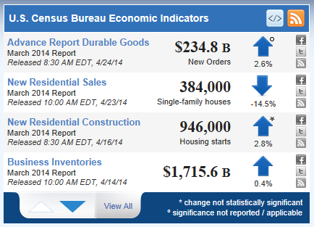
Census Economic Data
Monthly and Quarterly Data
  Leading Economic Indicators, like Monthly Retail Sales
Annual Data
  Annual Survey of Manufactures
The Economic Census and Related Programs

Slide 4

Key Economic Census Terms
NAICS (North American Industry Classification System)
  Our primary data dimension
Establishments (vs. Companies, Firms, etc.)
  Our collection/tabulation level
U.S. Code Title 13 and 26
  Protects business privacy

Slide 5
Our Scenario
Interested in creating a comprehensive profile of the New York State economy to help promote economic development.
  Latest data for employer businesses (CBP)
  Impact/importance of nonemployer businesses (NS)
  Latest detailed revenue data (EC)
  Impact/importance of minority- and women-owned businesses (SBO)

Slide 6
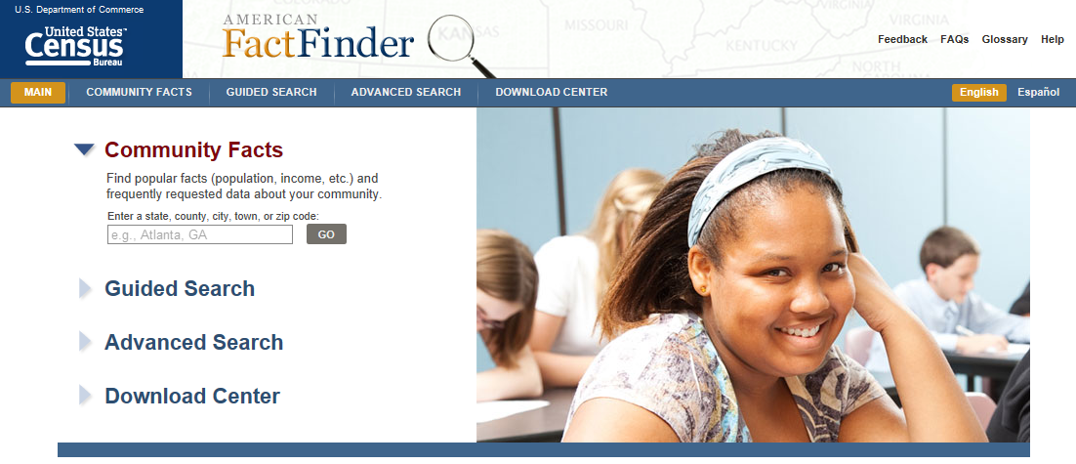
American FactFinder

Slide 7
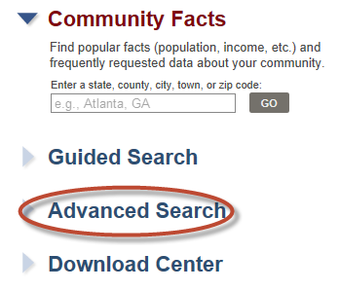
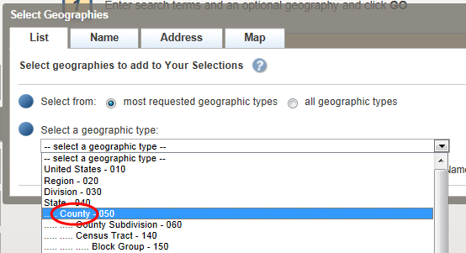
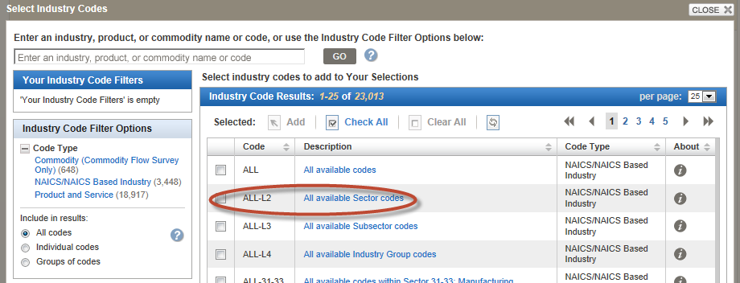
Finding the latest data available for New York businesses
2 steps using the Advanced Search
  Select the Geography
  Select the Industries

Slide 8

Employer Businesses
Covered by most Census Bureau economic programs (and most other sources)
Make up only 25% of all US businesses but over 96% of GDP
The primary engine that drives the US economy

Slide 9
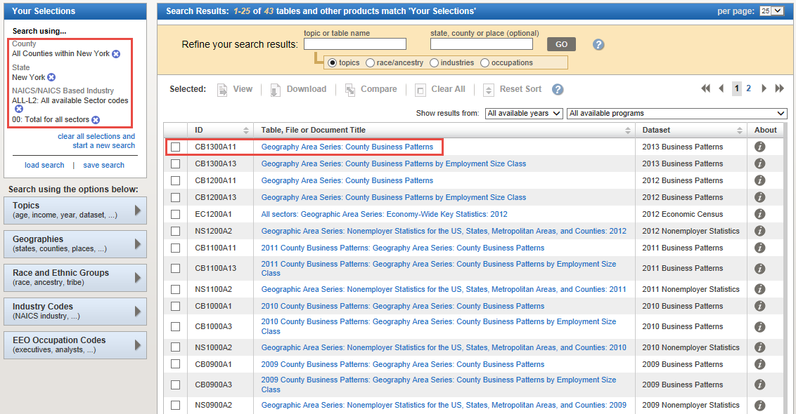
The Results

Slide 10
 | New York | 2013 |  |  |  | 2007 |  |  |  | Change: 2007 to 2013
2012 NAICS code | Meaning of 2012 NAICS code | Number of establishments | Paid employees (number) | Annual payroll ($1,000) | Annual payroll per employee ($) | Number of establishments | Paid employees (number) | Annual payroll ($1,000) | Annual payroll per employee ($) | Number of establishments | Paid employees (number) | Annual payroll ($1,000) | Annual payroll per employee ($)
0 | Total for all sectors | 532,669 | 7,688,492 | 466,815,127 | 60,716 | 519,489 | 7,529,882 | 429,074,494 | 56,983 | 13,180 | 158,610 | 37,740,633 | 3,733
11 | Agriculture, forestry, fishing and hunting | 598 | 2,626 | 94,328 | 35,921 | 618 | 5,342 | 161,186 | 30,173 | (20) | (2,716) | (66,858) | 5,747
21 | Mining, quarrying, and oil and gas extraction | 310 | 4,123 | 288,654 | 70,011 | 374 | 5,115 | 255,819 | 50,013 | (64) | (992) | 32,835 | 19,997
22 | Utilities | 625 | 39,502 | 3,959,976 | 100,247 | 575 | 39,699 | 3,625,599 | 91,327 | 50 | (197) | 334,377 | 8,920
23 | Construction | 46,019 | 311,669 | 19,647,185 | 63,039 | 48,012 | 328,933 | 18,758,753 | 57,029 | (1,993) | (17,264) | 888,432 | 6,010
31-33 | Manufacturing | 16,165 | 429,298 | 22,438,256 | 52,267 | 18,727 | 534,160 | 24,889,810 | 46,596 | (2,562) | (104,862) | (2,451,554) | 5,671
42 | Wholesale trade | 32,675 | 365,674 | 24,903,202 | 68,102 | 34,609 | 390,422 | 22,960,639 | 58,810 | (1,934) | (24,748) | 1,942,563 | 9,292
44-45 | Retail trade | 78,052 | 920,848 | 25,374,795 | 27,556 | 76,516 | 898,881 | 23,015,787 | 25,605 | 1,536 | 21,967 | 2,359,008 | 1,951
48-49 | Transportation and warehousing | 12,364 | 233,149 | 10,107,169 | 43,351 | 12,081 | 237,525 | 9,344,921 | 39,343 | 283 | (4,376) | 762,248 | 4,008
51 | Information | 11,286 | 272,164 | 27,423,737 | 100,762 | 11,605 | 294,238 | 23,105,470 | 78,526 | (319) | (22,074) | 4,318,267 | 22,235
52 | Finance and insurance | 28,160 | 533,082 | 100,666,618 | 188,839 | 29,046 | 577,873 | 107,617,524 | 186,230 | (886) | (44,791) | (6,950,906) | 2,608
53 | Real estate and rental and leasing | 32,145 | 165,008 | 9,269,020 | 56,173 | 32,264 | 170,882 | 8,351,454 | 48,873 | (119) | (5,874) | 917,566 | 7,301
54 | Professional, scientific, and technical services | 60,406 | 603,392 | 52,208,487 | 86,525 | 59,756 | 598,086 | 45,706,381 | 76,421 | 650 | 5,306 | 6,502,106 | 10,104
55 | Management of companies and enterprises | 2,937 | 181,086 | 23,978,133 | 132,413 | 2,691 | 187,658 | 25,380,430 | 135,248 | 246 | (6,572) | (1,402,297) | (2,835)
56 | Administrative and support and waste management and remediation services | 26,236 | 544,960 | 27,269,343 | 50,039 | 24,258 | 499,115 | 20,083,576 | 40,238 | 1,978 | 45,845 | 7,185,767 | 9,801
61 | Educational services | 7,933 | 397,212 | 16,164,922 | 40,696 | 6,642 | 349,684 | 12,276,543 | 35,108 | 1,291 | 47,528 | 3,888,379 | 5,588
62 | Health care and social assistance | 56,770 | 1,445,220 | 67,390,966 | 46,630 | 53,941 | 1,318,731 | 54,771,362 | 41,533 | 2,829 | 126,489 | 12,619,604 | 5,097
71 | Arts, entertainment, and recreation | 11,880 | 162,727 | 7,379,578 | 45,349 | 11,125 | 149,930 | 6,396,525 | 42,663 | 755 | 12,797 | 983,053 | 2,686
72 | Accommodation and food services | 50,978 | 708,551 | 15,618,078 | 22,042 | 43,418 | 580,333 | 11,330,990 | 19,525 | 7,560 | 128,218 | 4,287,088 | 2,517
81 | Other services (except public administration) | 56,279 | 367,519 | 12,611,226 | 34,314 | 52,565 | 362,334 | 10,969,996 | 30,276 | 3,714 | 5,185 | 1,641,230 | 4,039
99 | Industries not classified | 851 | 682 | 21,454 | 31,457 | 666 | f | D

Slide 11
New York Counties | 2013 |  |  |  | 2007 |  |  |  | Change: 2007 to 2013
Geography | Number of establishments | Paid employees (number) | Annual payroll ($1,000) | Annual payroll per employee ($) | Number of establishments | Paid employees (number) | Annual payroll ($1,000) | Annual payroll per employee ($) | Number of establishments | Paid employees (number) | Annual payroll ($1,000) | Annual payroll per employee ($)
New York County, New York | 105,439 | 2,116,201 | 217,575,925 | 102,814 | 104,063 | 2,051,315 | 209,613,581 | 102,185 | 1,376 | 64,886 | 7,962,344 | 629
Kings County, New York | 53,226 | 544,525 | 20,609,502 | 37,849 | 44,253 | 482,555 | 17,363,983 | 35,983 | 8,973 | 61,970 | 3,245,519 | 1,865
Suffolk County, New York | 48,689 | 557,995 | 27,802,358 | 49,825 | 48,674 | 573,823 | 25,715,071 | 44,814 | 15 | (15,828) | 2,087,287 | 5,012
Nassau County, New York | 47,683 | 532,008 | 26,644,029 | 50,082 | 48,098 | 536,218 | 24,318,678 | 45,352 | (415) | (4,210) | 2,325,351 | 4,730
Queens County, New York | 46,506 | 517,577 | 23,296,719 | 45,011 | 41,740 | 490,076 | 20,276,904 | 41,375 | 4,766 | 27,501 | 3,019,815 | 3,636
Westchester County, New York | 31,680 | 377,971 | 23,615,974 | 62,481 | 32,445 | 391,897 | 22,407,301 | 57,177 | (765) | (13,926) | 1,208,673 | 5,304
Erie County, New York | 22,535 | 413,072 | 16,936,366 | 41,001 | 22,590 | 406,973 | 14,515,635 | 35,667 | (55) | 6,099 | 2,420,731 | 5,334
Monroe County, New York | 17,458 | 344,253 | 14,656,626 | 42,575 | 17,184 | 348,613 | 13,691,960 | 39,276 | 274 | (4,360) | 964,666 | 3,300
Bronx County, New York | 17,090 | 240,666 | 10,353,551 | 43,020 | 15,616 | 215,834 | 8,756,573 | 40,571 | 1,474 | 24,832 | 1,596,978 | 2,450
Onondaga County, New York | 11,764 | 215,260 | 8,982,376 | 41,728 | 12,089 | 219,175 | 8,253,825 | 37,659 | (325) | (3,915) | 728,551 | 4,069
Tioga County, New York | 821 | 10,840 | 535,472 | 49,398 | 783 | 13,714 | 623,116 | 45,436 | 38 | (2,874) | (87,644) | 3,961
Allegany County, New York | 812 | 11,455 | 359,513 | 31,385 | 822 | 12,566 | 312,834 | 24,895 | (10) | (1,111) | 46,679 | 6,490
Wyoming County, New York | 787 | 9,408 | 305,546 | 32,477 | 804 | 9,220 | 274,902 | 29,816 | (17) | 188 | 30,644 | 2,661
Seneca County, New York | 718 | 9,130 | 315,025 | 34,504 | 707 | 9,839 | 295,867 | 30,071 | 11 | (709) | 19,158 | 4,434
Orleans County, New York | 646 | 8,024 | 260,937 | 32,520 | 698 | 8,443 | 212,830 | 25,208 | (52) | (419) | 48,107 | 7,312
Schoharie County, New York | 560 | 5,305 | 174,602 | 32,913 | 591 | 5,880 | 170,738 | 29,037 | (31) | (575) | 3,864 | 3,876
Yates County, New York | 551 | 5,087 | 146,044 | 28,709 | 550 | 5,119 | 127,893 | 24,984 | 1 | (32) | 18,151 | 3,725
Lewis County, New York | 529 | 4,737 | 162,063 | 34,212 | 530 | 4,675 | 133,723 | 28,604 | (1) | 62 | 28,340 | 5,608
Schuyler County, New York | 387 | 4,275 | 207,390 | 48,512 | 360 | 3,527 | 107,333 | 30,432 | 27 | 748 | 100,057 | 18,080
Hamilton County, New York | 197 | 855 | 23,662 | 27,675 | 202 | 866 | 23,880 | 27,575 | (5) | (11) | (218) | 100

Slide 12
 | New York County | 2013 |  |  |  | 2007 |  |  |  | Change: 2007 to 2013
2012 NAICS code | Meaning of 2012 NAICS code | Number of establishments | Paid employees (number) | Annual payroll ($1,000) | Annual payroll per employee ($) | Number of establishments | Paid employees (number) | Annual payroll ($1,000) | Annual payroll per employee ($) | Number of establishments | Paid employees (number) | Annual payroll ($1,000) | Annual payroll per employee ($)
0 | Total for all sectors | 105,439 | 2,116,201 | 217,575,925 | 102,814 | 104,063 | 2,051,315 | 209,613,581 | 102,185 | 1,376 | 64,886 | 7,962,344 | 629
11 | Agriculture, forestry, fishing and hunting | 6 | b | D |  | 12 | 200 | 11,414 | 57,070 | (6)
21 | Mining, quarrying, and oil and gas extraction | 16 | b | D |  | 6 | c | D |  | 10
22 | Utilities | 36 | i | D |  | 21 | i | D |  | 15
23 | Construction | 1,936 | 30,567 | 2,548,679 | 83,380 | 2,085 | 32,150 | 2,542,767 | 79,091 | (149) | (1,583) | 5,912 | 4,289
31-33 | Manufacturing | 1,982 | 18,931 | 889,844 | 47,005 | 2,796 | 32,969 | 1,613,689 | 48,946 | (814) | (14,038) | (723,845) | (1,941)
42 | Wholesale trade | 8,528 | 89,421 | 7,664,612 | 85,714 | 9,850 | 99,698 | 7,706,108 | 77,295 | (1,322) | (10,277) | (41,496) | 8,419
44-45 | Retail trade | 11,644 | 155,122 | 5,862,288 | 37,791 | 11,657 | 137,587 | 4,895,546 | 35,581 | (13) | 17,535 | 966,742 | 2,210
48-49 | Transportation and warehousing | 787 | 16,110 | 816,852 | 50,705 | 865 | 23,321 | 994,078 | 42,626 | (78) | (7,211) | (177,226) | 8,079
51 | Information | 4,577 | 153,939 | 19,821,904 | 128,765 | 4,478 | 152,293 | 14,940,580 | 98,104 | 99 | 1,646 | 4,881,324 | 30,660
52 | Finance and insurance | 7,753 | 284,733 | 80,200,761 | 281,670 | 8,119 | 313,505 | 89,641,408 | 285,933 | (366) | (28,772) | (9,440,647) | (4,263)
53 | Real estate and rental and leasing | 9,639 | 67,152 | 5,154,628 | 76,761 | 9,344 | 67,838 | 4,627,834 | 68,219 | 295 | (686) | 526,794 | 8,542
54 | Professional, scientific, and technical services | 17,745 | 289,232 | 32,882,373 | 113,689 | 17,886 | 284,123 | 28,814,234 | 101,415 | (141) | 5,109 | 4,068,139 | 12,274
55 | Management of companies and enterprises | 1,065 | 87,822 | 14,731,570 | 167,744 | 996 | 87,343 | 16,364,319 | 187,357 | 69 | 479 | (1,632,749) | (19,613)
56 | Administrative and support and waste management and remediation services | 4,469 | 149,341 | 8,289,217 | 55,505 | 4,301 | 149,740 | 7,583,690 | 50,646 | 168 | (399) | 705,527 | 4,860
61 | Educational services | 1,656 | 130,150 | 7,200,677 | 55,326 | 1,370 | 111,273 | 5,193,814 | 46,676 | 286 | 18,877 | 2,006,863 | 8,650
62 | Health care and social assistance | 8,213 | 243,950 | 14,147,710 | 57,994 | 7,632 | 219,421 | 10,888,114 | 49,622 | 581 | 24,529 | 3,259,596 | 8,372
71 | Arts, entertainment, and recreation | 4,348 | 62,353 | 3,853,602 | 61,803 | 4,060 | 61,744 | 3,554,769 | 57,573 | 288 | 609 | 298,833 | 4,230
72 | Accommodation and food services | 9,881 | 217,876 | 7,042,655 | 32,324 | 8,497 | 172,197 | 5,042,764 | 29,285 | 1,384 | 45,679 | 1,999,891 | 3,039
81 | Other services (except public administration) | 10,950 | 111,652 | 5,745,075 | 51,455 | 9,923 | 99,565 | 4,527,753 | 45,475 | 1,027 | 12,087 | 1,217,322 | 5,980
99 | Industries not classified | 208 | c | 6,482 |  | 165 | e | D |  | 43

Slide 13
 | Albany County | 2013 |  |  |  | 2007 |  |  |  | Change: 2007 to 2013
2012 NAICS code | Meaning of 2012 NAICS code | Number of establishments | Paid employees (number) | Annual payroll ($1,000) | Annual payroll per employee ($) | Number of establishments | Paid employees (number) | Annual payroll ($1,000) | Annual payroll per employee ($) | Number of establishments | Paid employees (number) | Annual payroll ($1,000) | Annual payroll per employee ($)
0 | Total for all sectors | 9,409 | 172,571 | 7,707,797 | 44,664 | 9,520 | 173,958 | 6,802,513 | 39,104 | (111) | (1,387) | 905,284 | 5,560
11 | Agriculture, forestry, fishing and hunting | 4 | a | 68 |  | 4 | 8 | 91 | 11,375 | 0 |  | (23) | (11,375)
21 | Mining, quarrying, and oil and gas extraction | 3 | b | D |  | 4 | 150 | 6,973 | 46,487 | (1)
22 | Utilities | 14 | f | 61,946 |  | 14 | 749 | 63,433 | 84,690 | 0 |  | (1,487)
23 | Construction | 750 | 7,424 | 495,765 | 66,779 | 778 | 6,587 | 406,187 | 61,665 | (28) | 837 | 89,578 | 5,114
31-33 | Manufacturing | 231 | 7,509 | 450,953 | 60,055 | 256 | 8,911 | 451,093 | 50,622 | (25) | (1,402) | (140) | 9,433
42 | Wholesale trade | 496 | 6,626 | 393,417 | 59,375 | 517 | 8,064 | 434,928 | 53,935 | (21) | (1,438) | (41,511) | 5,440
44-45 | Retail trade | 1,318 | 21,934 | 585,385 | 26,688 | 1,371 | 23,395 | 552,320 | 23,608 | (53) | (1,461) | 33,065 | 3,080
48-49 | Transportation and warehousing | 201 | 4,444 | 176,185 | 39,646 | 232 | 4,958 | 175,323 | 35,362 | (31) | (514) | 862 | 4,284
51 | Information | 225 | 5,822 | 377,879 | 64,905 | 247 | 6,437 | 374,281 | 58,145 | (22) | (615) | 3,598 | 6,760
52 | Finance and insurance | 649 | 12,753 | 943,322 | 73,969 | 668 | 13,300 | 812,259 | 61,072 | (19) | (547) | 131,063 | 12,897
53 | Real estate and rental and leasing | 423 | 2,707 | 105,039 | 38,803 | 422 | 3,076 | 105,243 | 34,214 | 1 | (369) | (204) | 4,588
54 | Professional, scientific, and technical services | 1,157 | 15,223 | 1,056,139 | 69,378 | 1,192 | 15,155 | 890,419 | 58,754 | (35) | 68 | 165,720 | 10,624
55 | Management of companies and enterprises | 67 | 2,805 | 145,827 | 51,988 | 69 | 3,202 | 177,272 | 55,363 | (2) | (397) | (31,445) | (3,375)
56 | Administrative and support and waste management and remediation services | 486 | 11,965 | 374,433 | 31,294 | 464 | 13,753 | 334,431 | 24,317 | 22 | (1,788) | 40,002 | 6,977
61 | Educational services | 156 | 11,305 | 440,966 | 39,006 | 132 | 9,168 | 292,242 | 31,876 | 24 | 2,137 | 148,724 | 7,130
62 | Health care and social assistance | 993 | 34,588 | 1,448,938 | 41,891 | 1,006 | 30,647 | 1,156,481 | 37,736 | (13) | 3,941 | 292,457 | 4,156
71 | Arts, entertainment, and recreation | 129 | 2,811 | 41,013 | 14,590 | 139 | 2,077 | 33,008 | 15,892 | (10) | 734 | 8,005 | (1,302)
72 | Accommodation and food services | 1,039 | 15,193 | 260,877 | 17,171 | 944 | 14,505 | 213,031 | 14,687 | 95 | 688 | 47,846 | 2,484
81 | Other services (except public administration) | 1,054 | 8,812 | 343,507 | 38,982 | 1,053 | 9,812 | 323,432 | 32,963 | 1 | (1,000) | 20,075 | 6,019
99 | Industries not classified | 14 | a | 177 |  | 8 | 4 | 66 | 16,500 | 6 |  | 111

Slide 14

Nonemployer Businesses
Only covered by a few Census Bureau economic programs (not covered by most other sources)
Make up 75% of all US businesses but less than 4% of GDP, but…
A key engine that drives the economic growth

Slide 15
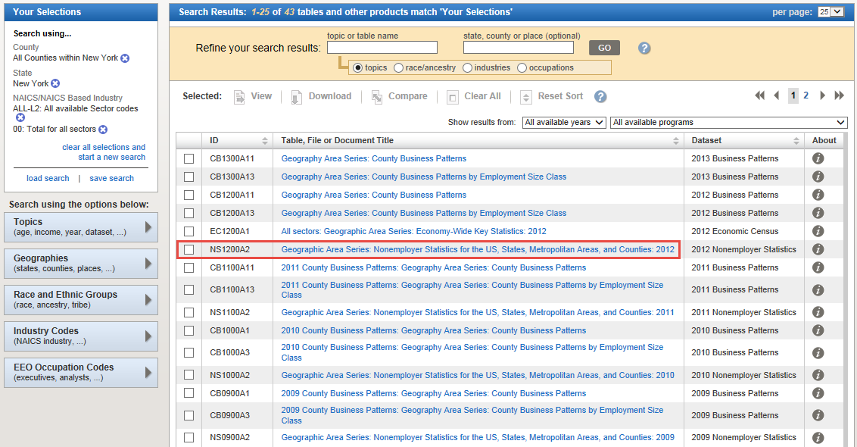
The Results

Slide 16
 | New York | 2012 |  |  | 2007 |  |  | Change: 2007 to 2013
2012 NAICS code | Meaning of 2012 NAICS code | Number of nonemployer establishments | Receipts ($1,000) | Receipts per establishment ($) | Number of nonemployer establishments | Receipts ($1,000) | Receipts per establishment ($) | Number of nonemployer establishments | Receipts ($1,000) | Receipts per establishment ($)
0 | Total for all sectors | 1,612,106 | 77,360,935 | 47,987 | 1,546,788 | 72,529,123 | 46,890 | 65,318 | 4,831,812 | 1,097
11 | Agriculture, forestry, fishing and hunting | 6,615 | 270,576 | 40,903 | 6,776 | 301,182 | 44,448 | (161) | (30,606) | (3,545)
21 | Mining, quarrying, and oil and gas extraction | 903 | 54,567 | 60,429 | 943 | 49,409 | 52,396 | (40) | 5,158 | 8,033
22 | Utilities | 1,238 | 45,253 | 36,553 | 865 | 42,745 | 49,416 | 373 | 2,508 | (12,863)
23 | Construction | 130,111 | 5,325,053 | 40,927 | 136,950 | 6,215,937 | 45,388 | (6,839) | (890,884) | (4,461)
31-33 | Manufacturing | 18,373 | 875,695 | 47,662 | 18,163 | 933,031 | 51,370 | 210 | (57,336) | (3,708)
42 | Wholesale trade | 33,167 | 3,413,094 | 102,906 | 32,873 | 3,395,884 | 103,303 | 294 | 17,210 | (397)
44-45 | Retail trade | 117,816 | 5,209,577 | 44,218 | 122,525 | 5,671,829 | 46,291 | (4,709) | (462,252) | (2,073)
48-49 | Transportation and warehousing | 99,376 | 4,805,134 | 48,353 | 93,225 | 3,895,455 | 41,786 | 6,151 | 909,679 | 6,568
51 | Information | 29,566 | 1,211,266 | 40,968 | 27,846 | 1,154,073 | 41,445 | 1,720 | 57,193 | (477)
52 | Finance and insurance | 50,316 | 4,659,036 | 92,596 | 53,362 | 4,985,801 | 93,434 | (3,046) | (326,765) | (838)
53 | Real estate and rental and leasing | 175,963 | 20,830,776 | 118,382 | 170,913 | 17,499,375 | 102,388 | 5,050 | 3,331,401 | 15,994
54 | Professional, scientific, and technical services | 244,159 | 11,877,760 | 48,648 | 232,272 | 10,893,906 | 46,902 | 11,887 | 983,854 | 1,746
56 | Administrative and support and waste management and remediation services | 106,709 | 2,286,399 | 21,426 | 97,841 | 2,241,110 | 22,906 | 8,868 | 45,289 | (1,479)
61 | Educational services | 49,443 | 719,524 | 14,553 | 45,038 | 674,413 | 14,974 | 4,405 | 45,111 | (422)
62 | Health care and social assistance | 172,750 | 5,712,438 | 33,068 | 166,821 | 5,279,723 | 31,649 | 5,929 | 432,715 | 1,419
71 | Arts, entertainment, and recreation | 122,319 | 3,986,694 | 32,593 | 116,490 | 3,565,922 | 30,611 | 5,829 | 420,772 | 1,981
72 | Accommodation and food services | 28,528 | 919,121 | 32,218 | 27,427 | 1,060,928 | 38,682 | 1,101 | (141,807) | (6,464)
81 | Other services (except public administration) | 224,754 | 5,158,972 | 22,954 | 196,458 | 4,668,400 | 23,763 | 28,296 | 490,572 | (809)

Slide 17
New York Counties | 2012 |  |  | 2007 |  |  | Change: 2007 to 2013
Geography | Number of nonemployer establishments | Receipts ($1,000) | Receipts per establishment ($) | Number of nonemployer establishments | Receipts ($1,000) | Receipts per establishment ($) | Number of nonemployer establishments | Receipts ($1,000) | Receipts per establishment ($)
Kings County, New York | 245,568 | 9,374,618 | 38,175 | 212,668 | 7,441,560 | 34,991 | 32,900 | 1,933,058 | 3,184
Queens County, New York | 224,014 | 7,829,204 | 34,950 | 200,563 | 6,720,555 | 33,508 | 23,451 | 1,108,649 | 1,441
Bronx County, New York | 111,884 | 2,941,475 | 26,290 | 100,792 | 2,440,640 | 24,215 | 11,092 | 500,835 | 2,076
Nassau County, New York | 130,866 | 8,525,350 | 65,146 | 126,456 | 8,219,122 | 64,996 | 4,410 | 306,228 | 150
Westchester County, New York | 92,400 | 5,904,163 | 63,898 | 89,003 | 5,737,182 | 64,461 | 3,397 | 166,981 | (563)
Richmond County, New York | 32,860 | 1,403,402 | 42,709 | 31,232 | 1,368,233 | 43,809 | 1,628 | 35,169 | (1,100)
Rockland County, New York | 25,826 | 1,404,436 | 54,381 | 24,930 | 1,365,725 | 54,782 | 896 | 38,711 | (402)
Erie County, New York | 45,160 | 1,988,903 | 44,041 | 44,346 | 1,864,433 | 42,043 | 814 | 124,470 | 1,998
Monroe County, New York | 43,936 | 1,916,181 | 43,613 | 43,465 | 1,742,224 | 40,083 | 471 | 173,957 | 3,530
Lewis County, New York | 1,665 | 68,578 | 41,188 | 1,621 | 59,524 | 36,721 | 44 | 9,054 | 4,467
Tompkins County, New York | 7,129 | 253,998 | 35,629 | 7,102 | 257,632 | 36,276 | 27 | (3,634) | (647)
Onondaga County, New York | 27,166 | 1,198,206 | 44,107 | 27,147 | 1,245,461 | 45,878 | 19 | (47,255) | (1,772)
Hamilton County, New York | 512 | 18,130 | 35,410 | 509 | 20,436 | 40,149 | 3 | (2,306) | (4,739)
Yates County, New York | 1,858 | 80,936 | 43,561 | 1,884 | 70,756 | 37,556 | (26) | 10,180 | 6,005
Suffolk County, New York | 121,791 | 6,466,440 | 53,095 | 121,818 | 6,494,263 | 53,311 | (27) | (27,823) | (217)
Franklin County, New York | 2,818 | 96,134 | 34,114 | 2,854 | 101,034 | 35,401 | (36) | (4,900) | (1,287)
Columbia County, New York | 5,810 | 249,747 | 42,986 | 5,870 | 281,237 | 47,911 | (60) | (31,490) | (4,925)
Ontario County, New York | 6,826 | 287,758 | 42,156 | 6,895 | 271,210 | 39,334 | (69) | 16,548 | 2,822
Essex County, New York | 2,989 | 125,120 | 41,860 | 3,073 | 105,970 | 34,484 | (84) | 19,150 | 7,376
Dutchess County, New York | 20,470 | 917,705 | 44,832 | 20,558 | 923,636 | 44,928 | (88) | (5,931) | (97)
Steuben County, New York | 5,242 | 188,312 | 35,924 | 5,766 | 199,117 | 34,533 | (524) | (10,805) | 1,391
Sullivan County, New York | 5,696 | 217,145 | 38,122 | 6,238 | 244,078 | 39,128 | (542) | (26,933) | (1,005)
Orange County, New York | 23,387 | 1,036,303 | 44,311 | 23,932 | 1,050,681 | 43,903 | (545) | (14,378) | 408
Ulster County, New York | 15,646 | 632,067 | 40,398 | 16,243 | 667,257 | 41,080 | (597) | (35,190) | (682)
New York County, New York | 219,249 | 16,659,381 | 75,984 | 220,602 | 15,731,504 | 71,312 | (1,353) | 927,877 | 4,672

Slide 18
 | Kings County | 2012 |  |  | 2007 |  |  | Change: 2007 to 2013
2012 NAICS code | Meaning of 2012 NAICS code | Number of nonemployer establishments | Receipts ($1,000) | Receipts per establishment ($) | Number of nonemployer establishments | Receipts ($1,000) | Receipts per establishment ($) | Number of nonemployer establishments | Receipts ($1,000) | Receipts per establishment ($)
0 | Total for all sectors | 245,568 | 9,374,618 | 38,175 | 212,668 | 7,441,560 | 34,991 | 32,900 | 1,933,058 | 3,184
11 | Agriculture, forestry, fishing and hunting | 92 | 2,295 | 24,946 | 81 | 3,617 | 44,654 | 11 | (1,322) | (19,709)
21 | Mining, quarrying, and oil and gas extraction | 28 | 756 | 27,000 | 14 | 285 | 20,357 | 14 | 471 | 6,643
22 | Utilities | 157 | 3,965 | 25,255 | 109 | 2,580 | 23,670 | 48 | 1,385 | 1,585
23 | Construction | 18,609 | 440,663 | 23,680 | 17,893 | 431,333 | 24,106 | 716 | 9,330 | (426)
31-33 | Manufacturing | 2,239 | 99,746 | 44,549 | 2,120 | 90,759 | 42,811 | 119 | 8,987 | 1,739
42 | Wholesale trade | 4,866 | 465,210 | 95,604 | 4,147 | 385,690 | 93,005 | 719 | 79,520 | 2,600
44-45 | Retail trade | 15,355 | 672,430 | 43,792 | 14,580 | 627,145 | 43,014 | 775 | 45,285 | 778
48-49 | Transportation and warehousing | 20,796 | 881,526 | 42,389 | 18,700 | 638,679 | 34,154 | 2,096 | 242,847 | 8,235
51 | Information | 6,580 | 212,715 | 32,328 | 5,020 | 143,800 | 28,645 | 1,560 | 68,915 | 3,682
52 | Finance and insurance | 3,336 | 193,487 | 58,000 | 3,511 | 266,667 | 75,952 | (175) | (73,180) | (17,952)
53 | Real estate and rental and leasing | 21,229 | 2,583,428 | 121,693 | 18,241 | 1,869,616 | 102,495 | 2,988 | 713,812 | 19,198
54 | Professional, scientific, and technical services | 35,817 | 1,344,020 | 37,525 | 28,454 | 983,603 | 34,568 | 7,363 | 360,417 | 2,956
56 | Administrative and support and waste management and remediation services | 14,815 | 237,482 | 16,030 | 12,566 | 207,832 | 16,539 | 2,249 | 29,650 | (509)
61 | Educational services | 7,707 | 106,711 | 13,846 | 6,070 | 79,320 | 13,068 | 1,637 | 27,391 | 778
62 | Health care and social assistance | 28,659 | 702,561 | 24,514 | 26,822 | 589,935 | 21,994 | 1,837 | 112,626 | 2,520
71 | Arts, entertainment, and recreation | 24,245 | 656,051 | 27,059 | 20,162 | 471,146 | 23,368 | 4,083 | 184,905 | 3,691
72 | Accommodation and food services | 5,061 | 121,900 | 24,086 | 4,377 | 121,576 | 27,776 | 684 | 324 | (3,690)
81 | Other services (except public administration) | 35,977 | 649,672 | 18,058 | 29,801 | 527,977 | 17,717 | 6,176 | 121,695 | 341
811 | Repair and maintenance | 4,107 | 93,050
812 | Personal and laundry services | 30,593 | 536,067
813 | Religious, grantmaking, civic, professional, and similar organizations | 1,277 | 20,555

Slide 19
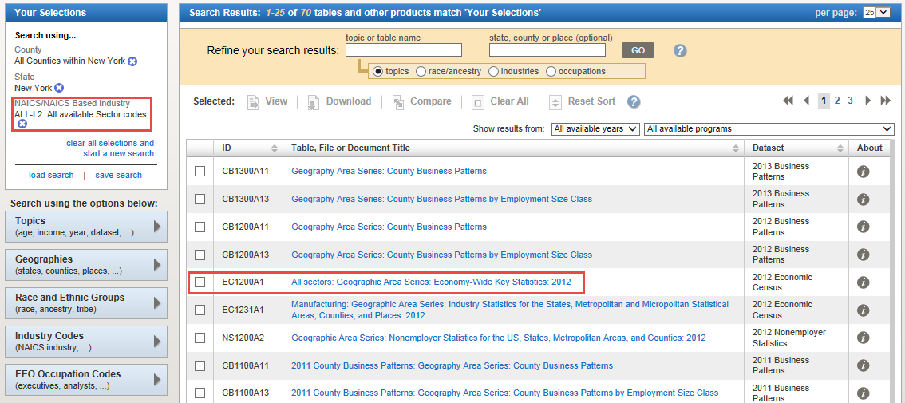
What about Revenue data?

Slide 20
New York: 2012
2012 NAICS code | Meaning of 2012 NAICS code | Number of establish-ments | Value of shipments or business done ($1,000) | Annual payroll ($1,000) | Number of employees | Number of nonemployer establish-ments | Nonemployer value of shipments or business done ($1,000) | Value of shipments or business done per establish-ment ($1,000) | Value of shipments or business done per employee ($1,000) | Value of shipments or business done per $ of payroll ($)
23 | Construction | 41,016 | 87,292,113 | 18,169,254 | 333,187 | 130,111 | 5,325,053 | 2,128 | 262 | 4.80
236 | Construction of buildings | 13,286 | 34,658,267 | 4,132,950 | 76,471 | 33,715 | 1,779,242 | 2,609 | 453 | 8.39
237 | Heavy and civil engineering construction | 1,204 | 11,084,718 | 2,424,484 | 36,458 | 1,598 | 94,377 | 9,207 | 304 | 4.57
238 | Specialty trade contractors | 26,527 | 41,549,128 | 11,611,820 | 220,258 | 94,798 | 3,451,434 | 1,566 | 189 | 3.58
31-33 | Manufacturing | 16,475 | 148,879,931 | 22,073,336 | 426,621 | 18,373 | 875,695 | 9,037 | 349 | 6.74
311 | Food manufacturing | 1,990 | 18,823,573 | 1,808,309 | 45,892 | 2,962 | 110,970 | 9,459 | 410 | 10.41
312 | Beverage and tobacco product manufacturing | 261 | 3,498,003 | 290,623 | 6,114 | 218 | 16,410 | 13,402 | 572 | 12.04
313 | Textile mills | 174 | 697,961 | 114,844 | 2,768 | 158 | 4,297 | 4,011 | 252 | 6.08
314 | Textile product mills | 322 | 652,985 | 151,188 | 4,422 | 193 | 7,297 | 2,028 | 148 | 4.32
315 | Apparel manufacturing | 1,106 | 1,531,147 | 333,900 | 11,648 | 2,112 | 89,674 | 1,384 | 131 | 4.59
316 | Leather and allied product manufacturing | 116 | 197,728 | 50,182 | 1,532 | 353 | 14,513 | 1,705 | 129 | 3.94
321 | Wood product manufacturing | 504 | 1,327,688 | 273,436 | 7,608 | 1,122 | 56,507 | 2,634 | 175 | 4.86
322 | Paper manufacturing | 255 | 6,115,366 | 801,547 | 14,602 | 92 | 5,578 | 23,982 | 419 | 7.63
323 | Printing and related support activities | 1,757 | 3,959,964 | 1,023,404 | 23,383 | 1,719 | 100,625 | 2,254 | 169 | 3.87
324 | Petroleum and coal products manufacturing | 133 | 1,058,553 | 81,023 | 1,471 | 49 | 3,527 | 7,959 | 720 | 13.06
325 | Chemical manufacturing | 569 | 28,714,454 | 2,502,008 | 38,387 | 654 | 22,059 | 50,465 | 748 | 11.48
326 | Plastics and rubber products manufacturing | 503 | 6,525,535 | 1,043,120 | 22,508 | 184 | 12,631 | 12,973 | 290 | 6.26
327 | Nonmetallic mineral product manufacturing | 631 | 3,749,131 | 725,951 | 14,698 | 540 | 23,105 | 5,942 | 255 | 5.16
331 | Primary metal manufacturing | 176 | 8,740,877 | 603,213 | 10,521 | 234 | 13,574 | 49,664 | 831 | 14.49
332 | Fabricated metal product manufacturing | 2,349 | 10,516,385 | 2,447,614 | 50,442 | 1,334 | 75,709 | 4,477 | 208 | 4.30
333 | Machinery manufacturing | 910 | 15,050,057 | 2,497,881 | 42,507 | 486 | 24,365 | 16,539 | 354 | 6.03
334 | Computer and electronic product manufacturing | 732 | 14,101,380 | 3,120,551 | 44,280 | 461 | 20,697 | 19,264 | 318 | 4.52
335 | Electrical equipment, appliance, and component manufacturing | 329 | 4,221,496 | 726,574 | 14,843 | 393 | 26,541 | 12,831 | 284 | 5.81
336 | Transportation equipment manufacturing | 341 | 8,479,134 | 1,322,665 | 20,922 | 364 | 17,006 | 24,865 | 405 | 6.41
337 | Furniture and related product manufacturing | 1,033 | 2,283,704 | 569,993 | 14,625 | 905 | 51,897 | 2,211 | 156 | 4.01
339 | Miscellaneous manufacturing | 2,284 | 8,634,810 | 1,585,310 | 33,451 | 3,840 | 178,713 | 3,781 | 258 | 5.45

Slide 22
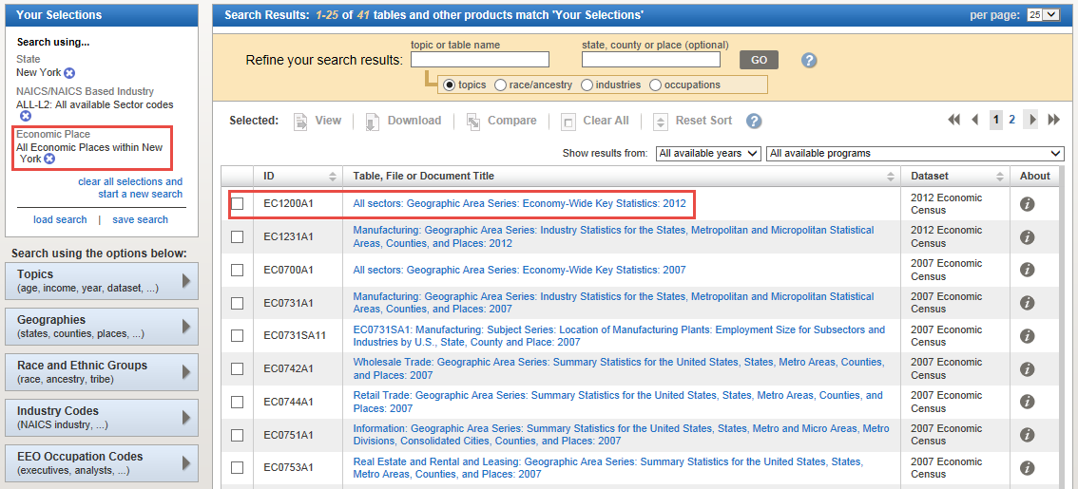
What about Places?

Slide 23
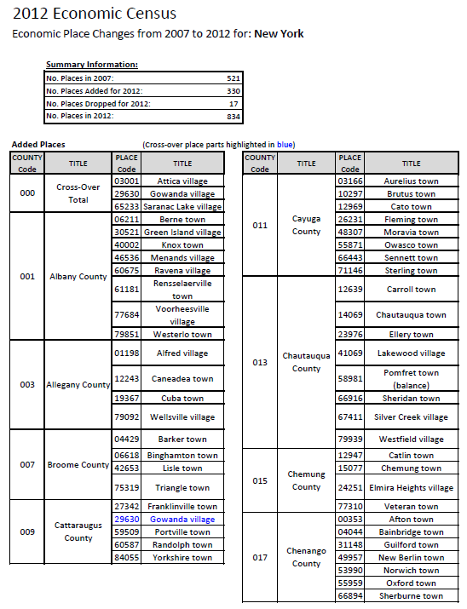
New Places
2007 EC cutoff: 5,000+ pop or jobs
2012 EC cutoff: 2,500+ pop or jobs
Results in over 5,000 new places published for 2012
330 added for NY (now 834)

Slide 24
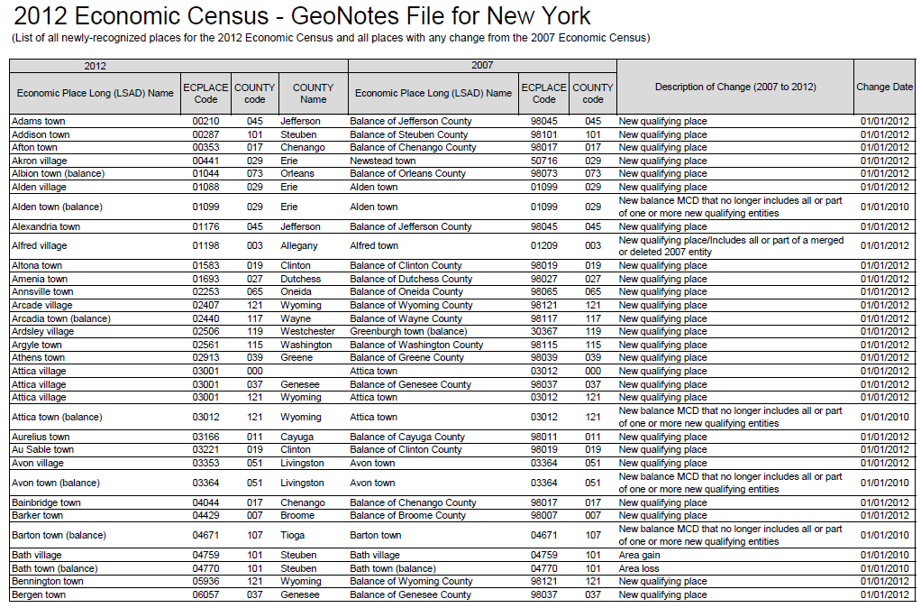
Place Changes
Adds / Drops
Boundary Changes
New Incorporations / Unincorporations

Slide 25

Minority-, Women-, and Veteran-Owned Businesses
Covered by one Census Bureau economic program (not covered by most other sources)
Share of businesses varies widely by industry and geography
A key engine that drives the economic growth

Slide 26
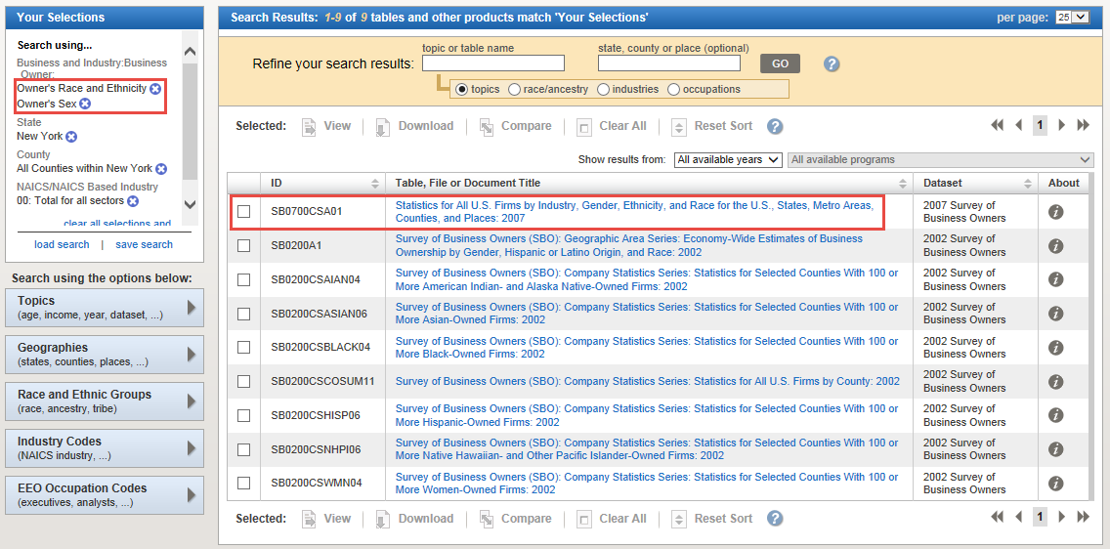
The Results

Slide 27
All New York Businesses by Race, Ethnicity, and Gender: 2007
Meaning of Race, Ethnicity, or Gender code | Number of firms with or without paid employees | Sales, receipts, or value of shipments of firms with or without paid employees ($1,000) | Number of firms with paid employees | Sales, receipts, or value of shipments of firms with paid employees ($1,000) | Number of paid employees for pay period including March 12 | Annual payroll ($1,000) | Number of firms without paid employees | Sales, receipts, or value of shipments of firms without paid employees ($1,000)
All firms | 1,956,733 | 2,257,362,689 | 428,567 | 2,186,865,138 | 7,462,672 | 412,902,035 | 1,528,166 | 70,497,551
All firms classifiable by gender, ethnicity, race, and veteran status | 1,890,719 | 769,691,830 | 382,992 | 702,270,339 | 3,411,024 | 143,510,137 | 1,507,727 | 67,421,491
White | 1,493,356 | 704,689,306 | 326,124 | 646,871,659 | 3,110,430 | 133,999,337 | 1,167,232 | 57,817,647
Black or African American | 204,004 | 12,589,106 | 11,530 | 8,571,857 | 66,581 | 1,707,733 | 192,474 | 4,017,249
American Indian and Alaska Native | 13,071 | 1,545,134 | 1,022 | 1,247,482 | 6,400 | 225,006 | 12,048 | 297,652
Asian | 196,825 | 50,482,681 | 44,214 | 44,966,089 | 224,576 | 7,141,767 | 152,612 | 5,516,592
Native Hawaiian and Other Pacific Islander | 1,852 | 179,533 | 306 | 143,016 | 876 | 25,371 | 1,545 | 36,517
Some other race | 10,583 | 1,701,322 | 1,314 | 1,382,983 | 6,792 | 210,437 | 9,268 | 318,340
Minority | 537,544 | 79,419,259 | 69,707 | 66,874,087 | 370,061 | 11,562,876 | 467,837 | 12,545,172
Equally minority/nonminority | 20,901 | 5,370,308 | 4,365 | 4,684,887 | 29,918 | 1,151,680 | 16,536 | 685,421
Nonminority | 1,332,274 | 684,902,263 | 308,920 | 630,711,365 | 3,011,046 | 130,795,581 | 1,023,354 | 54,190,898
Hispanic | 193,183 | 18,202,064 | 17,886 | 14,293,670 | 86,329 | 2,680,738 | 175,298 | 3,908,394
Equally Hispanic/non-Hispanic | 11,819 | 2,732,217 | 2,294 | 2,348,335 | 15,799 | 554,429 | 9,525 | 383,882
Non-Hispanic | 1,685,717 | 748,757,549 | 362,813 | 685,628,334 | 3,308,896 | 140,274,971 | 1,322,904 | 63,129,215
Female-owned | 594,517 | 83,851,312 | 66,079 | 68,431,777 | 461,725 | 15,923,865 | 528,438 | 15,419,534
Male-owned | 1,110,075 | 629,595,291 | 272,394 | 584,938,299 | 2,645,298 | 118,192,022 | 837,681 | 44,656,991
Equally male-/female-owned | 186,127 | 56,245,228 | 44,519 | 48,900,262 | 304,002 | 9,394,250 | 141,607 | 7,344,966
Publicly held and other firms not classifiable by gender, ethnicity, race, and veteran status | 66,014 | 1,487,670,859 | 45,575 | 1,484,594,799 | 4,051,647 | 269,391,898 | 20,439 | 3,076,059

Slide 28
All Albany County Businesses by Race, Ethnicity, and Gender: 2007
Meaning of Race, Ethnicity, or Gender code | Number of firms with or without paid employees | Sales, receipts, or value of shipments of firms with or without paid employees ($1,000) | Number of firms with paid employees | Sales, receipts, or value of shipments of firms with paid employees ($1,000) | Number of paid employees for pay period including March 12 | Annual payroll ($1,000) | Number of firms without paid employees | Sales, receipts, or value of shipments of firms without paid employees ($1,000)
All firms | 24,798 | 36,369,082 | 7,357 | 35,523,091 | 168,819 | 6,407,605 | 17,441 | 845,992
All firms classifiable by gender, ethnicity, race, and veteran status | 23,003 | 12,739,703 | 5,837 | 11,932,186 | 67,994 | 2,411,473 | 17,167 | 807,517
White | 20,504 | 11,790,084 | 5,253 | 11,057,352 | 62,708 | 2,254,850 | 15,251 | 732,732
Black or African American | S | S | S | S | S | S | S | S
American Indian and Alaska Native | S | S | S | S | S | S | S | S
Asian | S | S | S | S | S | S | S | S
Some other race | S | S | S | S | S | S | S | S
Minority | 2,840 | 1,056,849 | 682 | 978,324 | 5,887 | 182,017 | 2,158 | 78,525
Equally minority/nonminority | 206 | 5,766 | S | S | S | S | 185 | 2,526
Nonminority | 19,957 | 11,677,088 | 5,133 | 10,950,622 | 62,078 | 2,228,682 | 14,824 | 726,466
Hispanic | 554 | 107,927 | S | S | S | S | S | S
Equally Hispanic/non-Hispanic | S | S | S | S | S | S | S | S
Non-Hispanic | 22,376 | 12,630,622 | 5,736 | 11,831,072 | 67,428 | 2,386,194 | 16,640 | 799,551
Female-owned | 7,408 | 1,385,901 | 1,102 | 1,186,964 | 10,851 | 338,343 | 6,306 | 198,936
Male-owned | 13,308 | 10,279,107 | 4,016 | 9,754,997 | 49,672 | 1,884,805 | 9,291 | 524,110
Equally male-/female-owned | 2,288 | 1,074,695 | 719 | 990,225 | 7,471 | 188,325 | 1,570 | 84,470
Publicly held and other firms not classifiable by gender, ethnicity, race, and veteran status | 1,794 | 23,629,379 | 1,520 | 23,590,905 | 100,825 | 3,996,132 | S | S

Slide 29
So… What Else?
Drill down to more detailed industries
  Detailed industries within each sector
Drill down to more detailed geographies
  Places within each County
Compare to other geographies
  NY and NY counties to other states
View other related data
  ZIP Code and Product lines data
Merge in demographic data
  Per capita calculations
Merge in data from other sources
  Census and non-Census

Slide 30
Summary
A wealth of data available from Census Bureau Economic Programs
AFF is a powerful data extraction tool, but manipulating the data (in Excel and other tools) can help identify interesting stories in the data
Using these data can help spur economic development by helping us understand the local economy

Slide 31

Questions?

Slide 32
Andy Hait andrew.w.hait@census.gov
(301)763-6747

