Slide 1
Rain Barrels
What are they?
How do you get one?
And what to do with it.

Slide 2
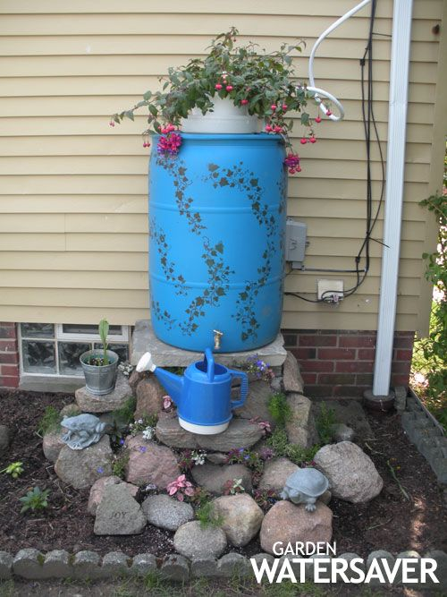
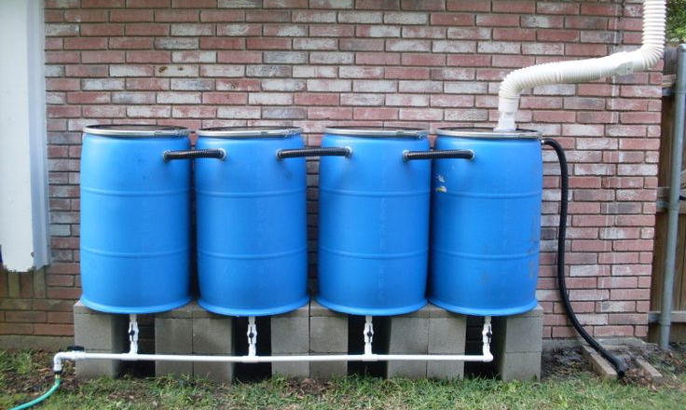
What is a rain barrel?
A rain barrel provides a reservoir for water from roof top run off
Once collected, the water can be used for a variety of uses, such as irrigation, livestock watering, and supply during dry spells
Another advantage of rain barrels is their ability to prevent storm water from overflowing combined sewer systems

Slide 3
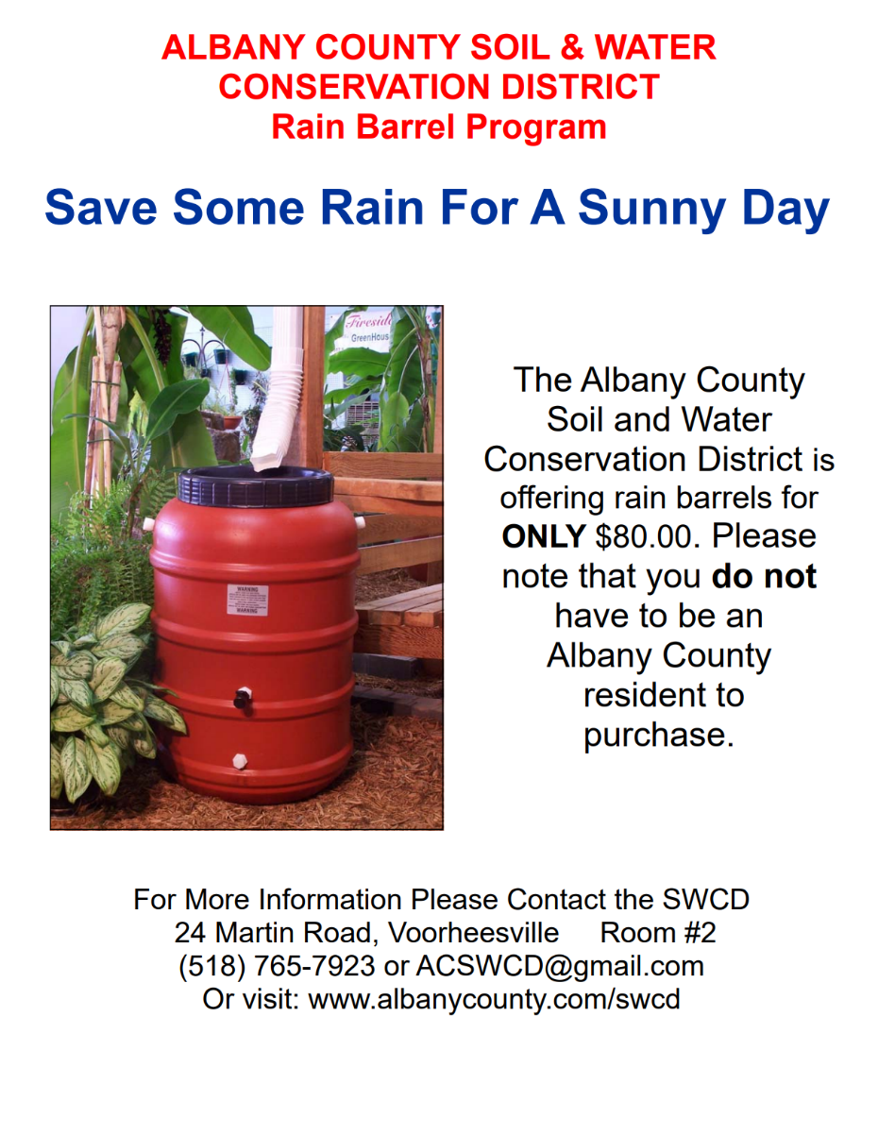
How do you get a rain barrel?
Rain barrels can typically be purchased from home improvement stores or be DIY if you’re crafty enough
The Albany County Soil & Water Conservation District also has a program offering rain barrels to any one who wants one

Slide 4
Setting up a rain barrel
Everything you need to know.

Slide 5
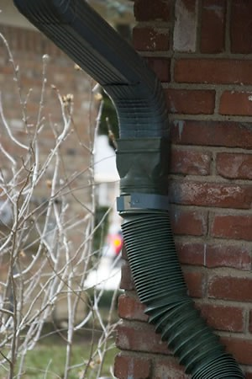
First steps
Once you’ve acquired your barrel, you’ll need to first detach part of your downspout
Then you will need to attach a downspout redirector to the open end of your downspout to make sure the water is sent directly into your rain barrel
If you do not have a downspout, you should be able to strategically place your rain barrel underneath where storm water typically runs off your roof

Slide 6
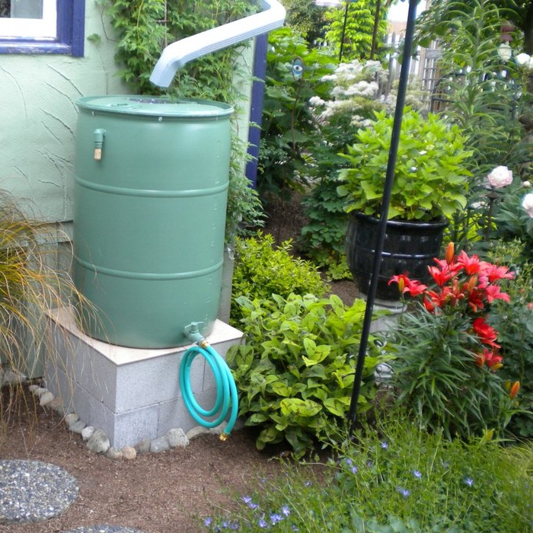
Next step
To ensure its success, your rain barrel should be placed on a stable and sturdy surface
(the barrel will become very heavy once it is filled with water!)
Congratulations, you’ve set up your very own rain barrel!

